Slide 1
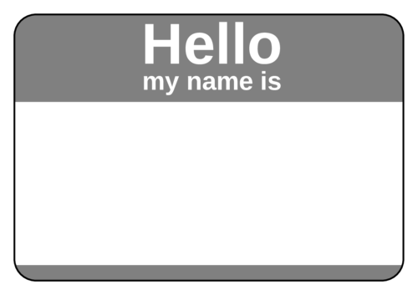
Welcome to the TRACS Webinar In CHAT, please introduce yourself
Name
Title
Location
Bonus: Share one of your favorite hobbies/activities

Slide 2
TRACS Webinar
Title, Location/Group, Date/Time

Slide 3
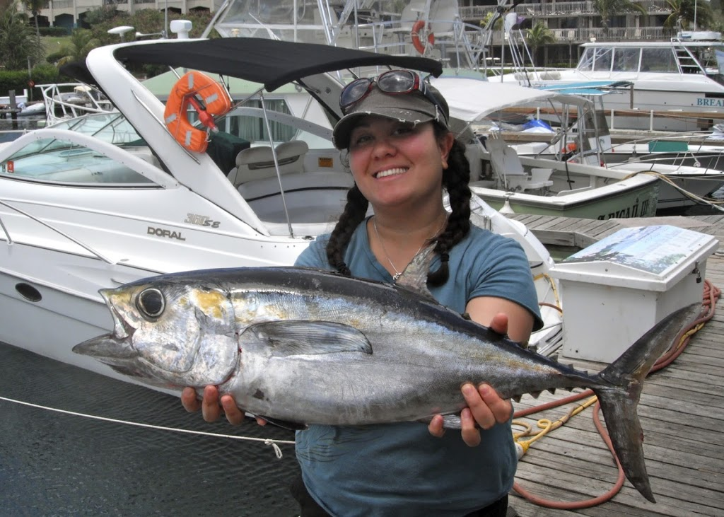
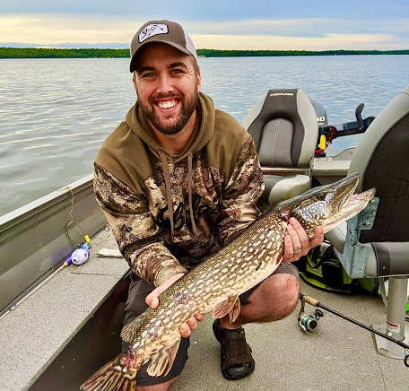
Meet the TRACS Training & Support Team
Yonah Cohen
TRACS Training Specialist
Debbie Wircenske
TRACS Help Desk Lead
Craig Kelling
TRACS Working Group Chair
For technical support and questions, contact the TRACS Help Desk (tracs-helpdesk@fws.gov).
Also consult with your Federal Aid Coordinators (FACs) and Regional Office Grant Specialists.

Slide 4
TRACS Overview - What, Who and Why)
TRACS Features Demo (Modules, Reports, Workflow, Mapping)
Wrap Up

Slide 5
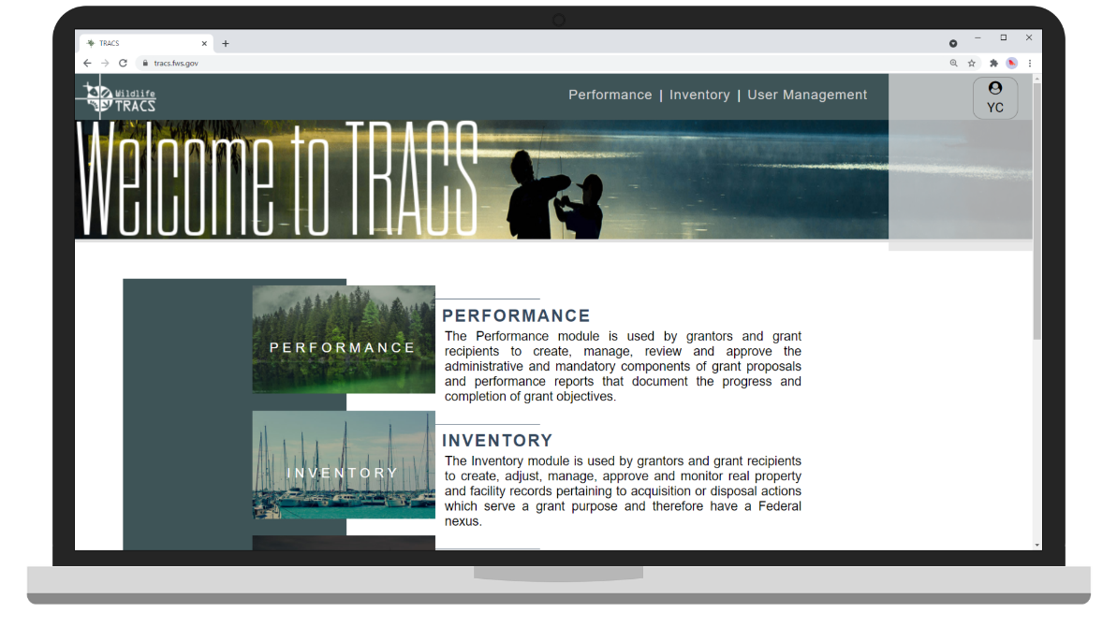
What is TRACS
Tracking and Reporting Actions for the Conservation of Species
TRACS serves as the performance reporting tool for Federal awards administered by the U.S. Fish and Wildlife Service’s Office of Conservation Investment.
Non-federal grant recipients and Federal grant specialists use TRACS to create, manage, review, and approve grant-funded projects and performance reports.

Slide 6
TRACS Working Group (WG)
29 State and Federal representatives
National review
Thousands of hours of development and testing
Unanimously accepted by State Directors and Joint Task Force (JTF)

Slide 7
Grant Programs in TRACS
Aquatic Education
Boating Access
Boating Infrastructure Grants (BIG)
Clean Vessel Act (CVA)
Hunter Education
National Coastal Wetlands Conservation
Sport Fish Restoration (SFR)
State Wildlife Grants (SWG)
Wildlife Restoration (WR)

Slide 8
Why TRACS
Enhances Accountability by:
Meeting Federal reporting requirements
Demonstrating sound grant management
Providing transparency on use of excise tax dollars
Improves Efficiency by:
Streamlining data entry and reducing redundancy
Using modern, user-friendly web technology
Simplifying performance reporting and response to data calls
Enables Effectiveness by:
Generating accurate, nationally consistent reports at various scales
Allowing projects to be viewed spatially (GIS)
Supporting efforts to tell the “Story”

Slide 9
TRACS Modules
PERFORMANCE - Standardized performance reporting tool that meets or exceeds regulation and utilizes objectives with quantitative metrics.
REPORTS - presents program accomplishments on a national scale and with spatial data using Geographic Information System (GIS) software.
INVENTORY - TRACS serves as the official repository for grant-funded Facilities and Real Property (Lands) and provides tools to maintain and monitor records for compliance.
ADMINISTRATIVE - State Fish and Wildlife agencies also use TRACS to enter annual hunting and fishing license holder data, which is used for License Certification and Apportionments.

Slide 10
TRACS Grant Elements
Grant Proposal & Project Statement(s)
Performance Reports
Facility Records Inventory
Real Property Records Inventory

Slide 11
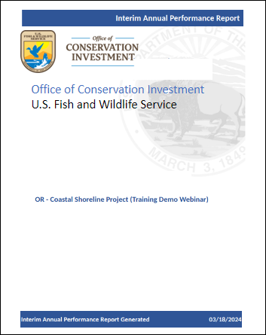
Performance Reporting
GrantSolutions is the Grant Management System for all Federal Awards. TRACS serves as the performance reporting tool for grants managed by the Office of Conservation Investment.
Reports are due in TRACS on an annual basis or more frequently per the award terms.
Interim Annual Reports are due 90 days from the end date of an interim reporting period.
Final Reports are due 120 days from the end date of the final period of performance.

Slide 12
Standardized Objectives
All standardized strategies, objectives and activities listed on the TRACS Performance Matrix
Eliminate vague and inconsistent objectives
Provide high quality consistent data across the U.S.

Slide 13
TRACS-Formatted Objectives
Activities
Specific
Measurable
Timebound
Clearly describes what we expect to achieve
Objective
Strategy
Approach

Slide 14
Standard Strategies
Coordination & Administration
Direct Habitat & Species Management
Environmental Review
Facilities/Areas Construction, Renovation, or Acquisition
Facilities/Areas Operation & Maintenance
Incentives
Outreach / Communication
Planning
Real Property Acquisition
Research, Survey, Data Collection and Analysis
Species Stocking
Stakeholder Involvement
Technical Assistance
Training / Education

Slide 15
Sample Objective: Research, Survey, Data Collection and Analysis
Objective Title: Conduct 2 investigations on the Monarch Butterfly by 6/30/2022.
Strategy: Research, Survey, Data Collection and Analysis
Standard Objective: Conduct Investigations
Target Date: 6/30/2022
Activity Tag: Fish and wildlife species data acquisition and analysis
Unit of Measure: # of investigations = 2
Additional Info Required: Identify target species = Monarch Butterfly (Danaus plexippus)
Approach: The approach answers the question “how” the objective will be accomplished by describing the actual work that will be done. This information should have adequate detail in order to demonstrate that the agency will use sound design, appropriate procedures, and accepted fish and wildlife conservation, management, or research principles.

Slide 16
TRACS Performance Matrix
TRACS standard strategies, objectives and activities are located on the TRACS Performance Matrix and supporting materials.
TRACS Training Resources including the Matrix are available on the WSFR Training Portal at: https://wsfrtraining.fws.gov/

Slide 17
Performance Report
Enter Objective Reports to document progress towards meeting project goals.
Performance Questionnaire 6-7 narrative “magic” questions to provide narrative context, provide recommendations, and highlight accomplishments.

Slide 18
Performance Reporting Questionnaire
For each statement by period of performance:
Q1 What progress has been made towards completing the objective(s) of the project?
Q2 Please describe and justify any changes in the implementation of your objective(s) or approach(es).
Q3 If applicable, please share if the project resulted in any unexpected benefits, promising practices, new understandings, cost efficiencies, management recommendations, or lessons learned.
Q4 For Survey projects only: If applicable, does this project continue work from a previous grant? If so, how do the current results compare to prior results? (Grantees may elect to add attachments such as tables, figures, or graphs to provide further detail when answering this question).
Q5 If applicable, Identify and attach selected publications, photographs, screenshots of websites, or other documentation (including articles in popular literature, scientific literature, or other public information products) that have resulted from this project that highlight the accomplishments of the project.
Q6 Is this a project you wish to highlight for communication purposes? Yes/No (add comments)
Q7 For CMS States only: If the grant is a CMS, has the state submitted an update report every 3 years detailing that the CMS components 1) inventory and scanning; 2) strategic plan; 3) operational plan; and 4) evaluation and control have been reviewed and summaries included which provide detailed review results and recommendations? (Select Yes or No, and fill out comments or check “Not Applicable” box)

Slide 19
‘Real Property’ refers to one, several, or all interests, benefits, and rights inherent in the ownership of a parcel of land or water.
TRACS is the official repository for grant-funded real property acquisitions and is used to create, approve, manage and monitor real property records with a Federal nexus.

Slide 20
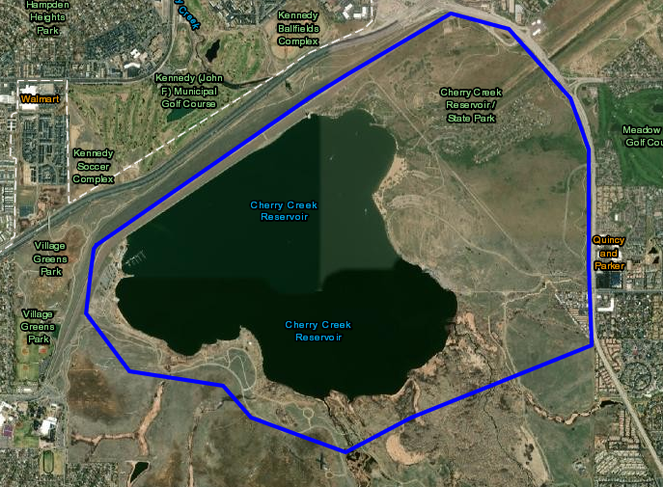
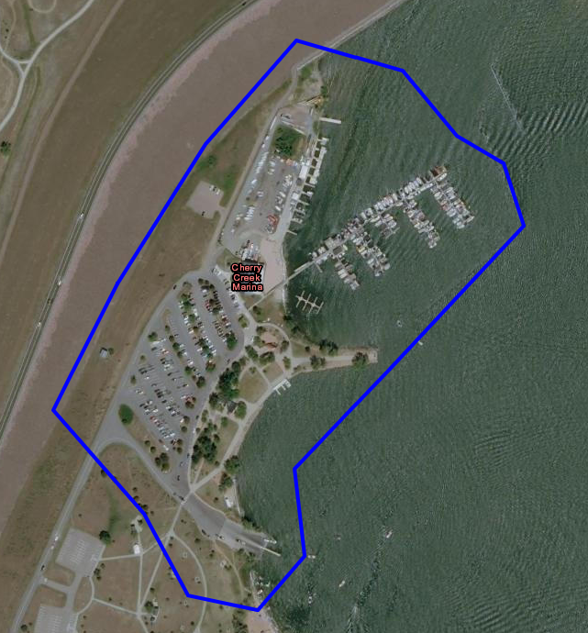
Facilities
Facility Records are required for reporting on grants that have the objective of facility construction, renovation or acquisition.
Components (amenities or features of a facility such as docks, launch ramps, parking lots, etc.) listed in the Facility Record

Slide 21
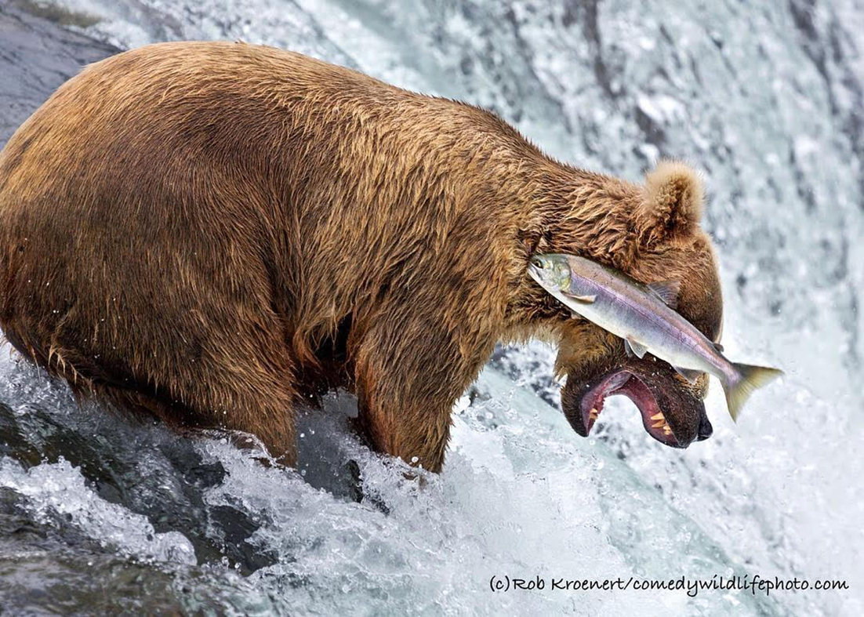
TRACS Resources
WSFR Training Portal: https://wsfrtraining.fws.gov
TRACS Help Desk Support:
tracs-helpdesk@fws.gov
or call 1-844-408-7227
Training questions or requests:
Yonah Cohen
TRACS Training Specialist
yonah_cohen@fws.gov

