Slide 1
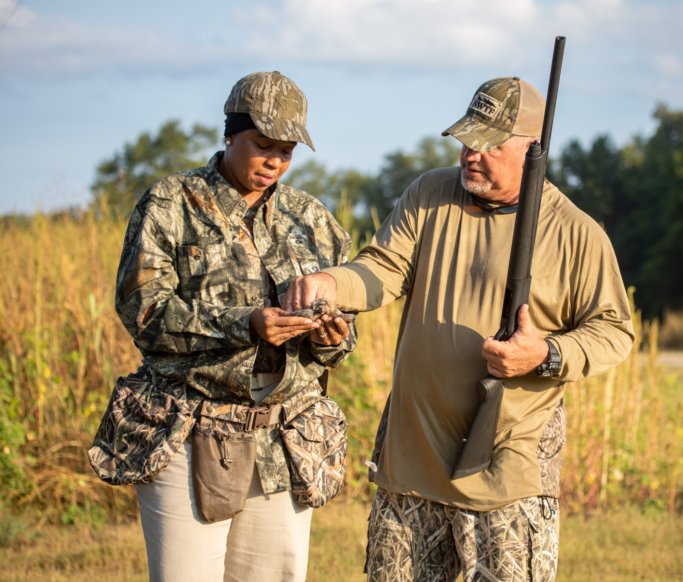
WSFR WILDLIFE RESTORATION/HUNTER EDUCATION ADVISORY TEAM
National WSFR Federal Assistance Coordinators Meeting, March 29 – 31, 2021 Lisa E. Van Alstyne, WSFR Policy Team Lead
Notes:
Thank you for allowing me a few minutes in your busy schedule this week to talk about the WSFR WR/HE Advisory Team.

Slide 2
WR/HE Advisory Team
Larry Mellinger, SOLICITOR
Christina Milloy
Modernizing PR Guidance Recommendation Team
Brad Gunn
Otto Jose
Phil King and Ryan Oster
Tom Decker
Christy Vigfusson
Cliff Schleusner
Lisa Van Alstyne
Notes:
The Team was established about a year ago with the purpose to coordinate reliable and consistent implementation and administration for projects/awards under the Wildlife Restoration Act, as amended by the Target Practice and Marksmanship Training Support Act and the Modernizing the Pittman-Robertson Fund for Tomorrow’s Needs Act.
Pictured here are the WSFR expert members of the Team – From the Regions we have Cliff Schleusner, Regional Manager from LR2 as our co-lead, Tom Decker from LR5 and Otto Jose from LR6 From WSFR HQ we have Christy Vigfusson, who has worn several hats since we started and is now the Programs Branch Manager and the other co-lead, Brad Gunn has assisted a lot during the year while supporting his Acting roles, Phil King from the Training Team, who recently retired and is replaced by Ryan Oster, Lisa Van Alstyne (that’s me), Policy Team Lead, Christina Milloy Programs Branch, and not pictured here is our Solicitor, Larry Mellinger.
Also, the Advisory Team on occasion worked with the JTF-sponsored Modernizing PR Team on overlapping topics. The Teams provided support to each other to maintain a cohesive effort to ensure our direction aligns.

Slide 3
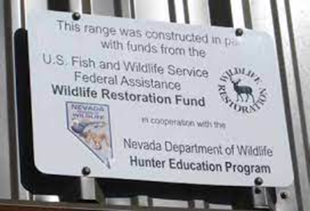
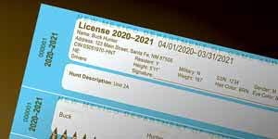
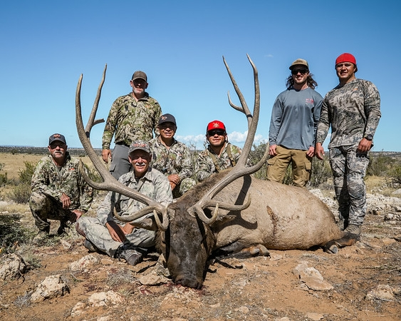
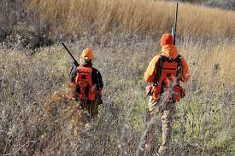
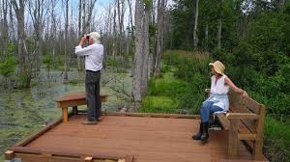
WR/HE Advisory Team: Topics Addressed
Marketing, Advertising, Promotions
Public Target Ranges: Mobile ranges, operations, maintenance, coordination, third-party ranges
State Electronic Data Systems
Guide services, guided hunts, species use for R3
Translating and clarifying regulations
Wildlife harvest donations
Events, Search Engines, Web sites
Incentives
Wildlife viewing
Notes:
The process the Team follows is for States to work with their WSFR Regional office or WSFR HQ contact to submit questions to the Team for consideration. We have also received a few topics from WSFR staff and have also proactively created some advisories that we feel will be supportive for State and Federal grant and project managers.
We received topics and questions consistently up through last November. Engagement since then has tapered off some, but the Team is still active! We can accept either specific questions, or examples of a grant proposal with associated questions. If anything during this conference triggers a thought or question, or you’ve been wondering about an activity, we encourage you to work with your WSFR contacts to forward your thoughts or concerns to the Team.
To date, the Team had published 25 advisories, with the 26th being finalized. Listed on this slide are some of the topics that we have addressed, and as you can see, we’ve tackled a wide range of topics. It has been wonderful working with many of you to consider the breadth of activities that are eligible for funding under the WR Act, as amended.
Of note, The State Electronic Data Systems advisory at (014) is also being addressed as a WSFR policy and is currently out for State comment, due April 9. Contact your Regional office or myself if you would like the opportunity to comment and did not receive the draft for review. WSFR realizes that States may have once used these data systems primarily for selling licenses, which is an income generating activity and not eligible for funding, but now these systems have expanded and manage so much more than simply license sales and we expect systems will continue to be expanded to support additional R3 activities and management. This guidance gives States an approach for requesting to assign some eligible costs of a SEDS to an award.

Slide 4
General Advisories
Legal Authorities for Determining Eligible and Allowable Costs/Activities Under the Wildlife Restoration Act: Advisory 2020-022
Reviewed and supported by WSFR and AFWA Solicitor
Explains the difference between eligible (under program authorities) and allowable (under FA regulations at 2 CFR 200)
Describes how laws, regulations, and policies work together as the “standards fixed by the Secretary of the Interior”
Writing a Grant to Support R3 Activities: Advisory 2020-025
Highlights best practices
Reinforces general principles
Emphasizes a path to approval
Notes:
The Team has also published two general advisories that we recommend ALL FACs and State grant writers read to assist in increased understanding. The first one listed here on Legal authorities was prompted by questions that arose from conversations about the various authorities, such as statute, U.S. Code, and regulations, and how they work together under a financial assistance program. Advisory 22 explains the difference between the term “eligible,”, which refers to activities supported by grant program authority, and the term “allowable,” which is guided by the financial assistance regulations at 2 CFR 200. At one point, the Advisory Team was asked if we could list all eligible activities under the Modernizing PR Act. We quickly agreed that this was a bad idea, because we do not want to limit creativity and innovation for activities that a State could support as having a clear connection to its R3 objectives. The Advisory 25 gives useful pointers on building a strong grant proposal, allowing States to maximize activities under the law.

Slide 5
Target Practice & Marksmanship Training Support Act and Modernizing the Pittman-Robertson Fund for Tomorrow’s Needs Act
Notes:
I want to quickly take you to the website for the Advisory Team that includes the advisories, but also several many resources to help support building successful projects. First, I would like to ask a few questions.
If you have visited the WR/HE Advisory Wiki space, please raise your hand.
If you have referred to any of the Advisories, please raise your hand.
Take to Wiki site and do walk through…..

