Slide 1
Wildlife & Sport Fish Restoration Program Federal Assistance Coordinators National Conference March 29, 2021
WSFR Accountability Initiative – Part I: Third-Party In-Kind Contributions and Proper Documentation
Scott Knight, Manager FASO Division
Ryan Oster, WSFR Systems & Training Branch

Slide 2
Top Audit Findings
WSFR grants routinely incorporate the use of third-party in-kind contributions to meet grant objectives and provide mandatory match requirements.
Issues around third-party in-kind contributions continues to be a common OIG finding in state audits.
Improper valuation methodology…
Improper or lacking documentation…
Volunteer hours seem unnecessary and unreasonable…

Slide 3
Third-Party In-Kind Contributions
“the value of non-cash contributions (i.e., property or services) that – (1) benefit a federally-assisted project or program; and (2) are contributed by non-Federal third parties, without charge, to a non-Federal entity under a Federal award.
Examples may include:
Volunteer time;
Unrecovered allocable indirect costs;
Real property (land & buildings)
Donated/discounted services;
Loaned goods
Donated goods (equipment / supplies)
2 CFR 200.1

Slide 4
Third-Party In-Kind Contributions…
Such costs are allowable when they meet all of the following criteria:
Are verifiable in the non-Federal entity’s records;
Are not included as contributions for any other Federal award;
Are necessary and reasonable for accomplishment of project or program objectives;
Are allowable under Subpart E “Cost Principles”;
Are not paid by the Federal Government under another Federal award, except when authorizing statute says that such funds can be applied as matching funds to other Federal programs.
2 CFR 200.306(b)

Slide 5
Third-Party In-Kind Contributions Cont.
Such costs are allowable when they meet all of the following criteria:
Are provided for in the approved budget when required by the Federal awarding agency; and
Conform to other provisions of 2 CFR 200, as applicable.
2 CFR 200.306(b)

Slide 6
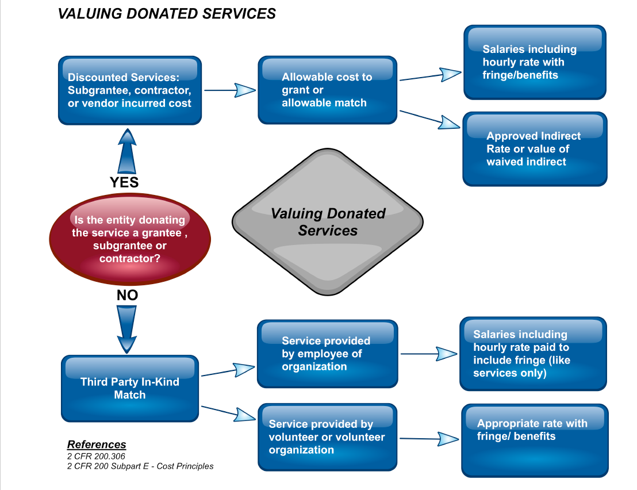
Valuing Donated Services

Slide 7
Documenting Volunteer Time
“For third-party in-kind contributions, the fair market value must be documented and supported by the same methods used internally by the non-Federal entity. (2 CFR 200.306(j)).
Minimum data elements:
Volunteer name
Name of activity
Date of activity
Hours worked
Miles driven
Volunteer signature
Supervisor signature (Agency acceptance)
Does your agency have policies speaking to use / documentation of volunteer time?

Slide 8
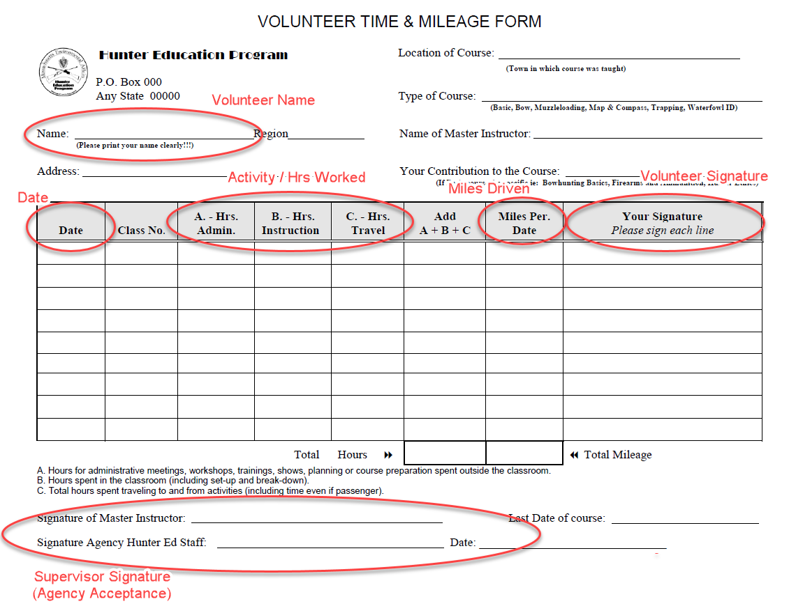
Volunteer Time and Mileage Form Fields

Slide 9
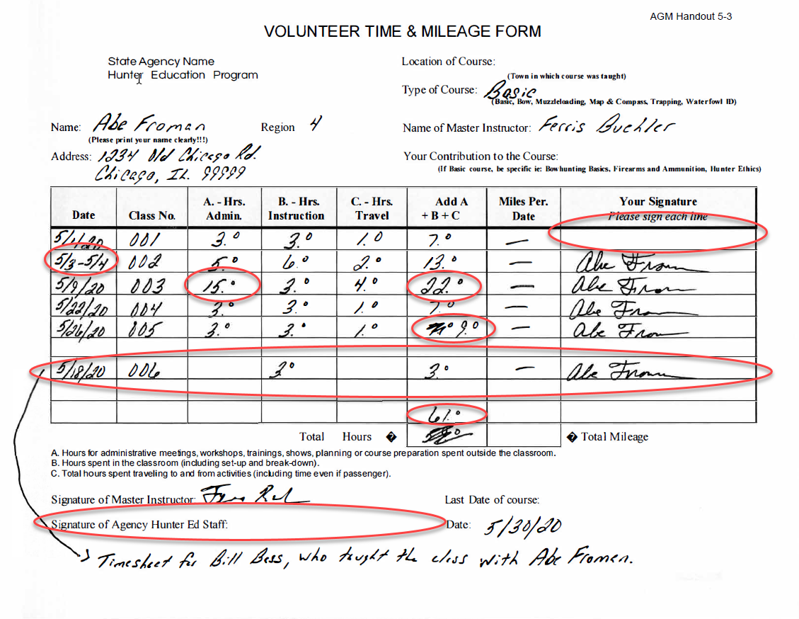
Volunteer Time and Mileage Form Image

Slide 10
Wrap up
Third-party in-kind contribution audit findings continue to be a common occurrence in WSFR grants.
WSFR may not allow States to “rebuild” third-party in-kind contributions documentation for questioned costs under state audits.
Come see us at a future Basic/Advanced Grants Management class.

Slide 11
Any Questions

