Slide 1
WSFR Coordinators Meeting
March 31, 2021
Dan Forster, Vice President & Chief Conservation Officer danforster@archerytrade.org

Slide 2
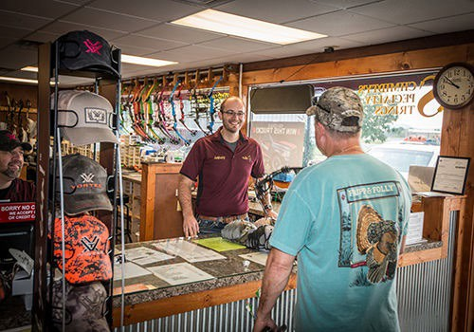
Archery Trade Association
Manufacturers, retailers, dealers, suppliers, wholesalers, etc.
Exist to GROW participation (Bowhunters - Target Archers)
Internal Focus – Business External Focus – Partners

Slide 3
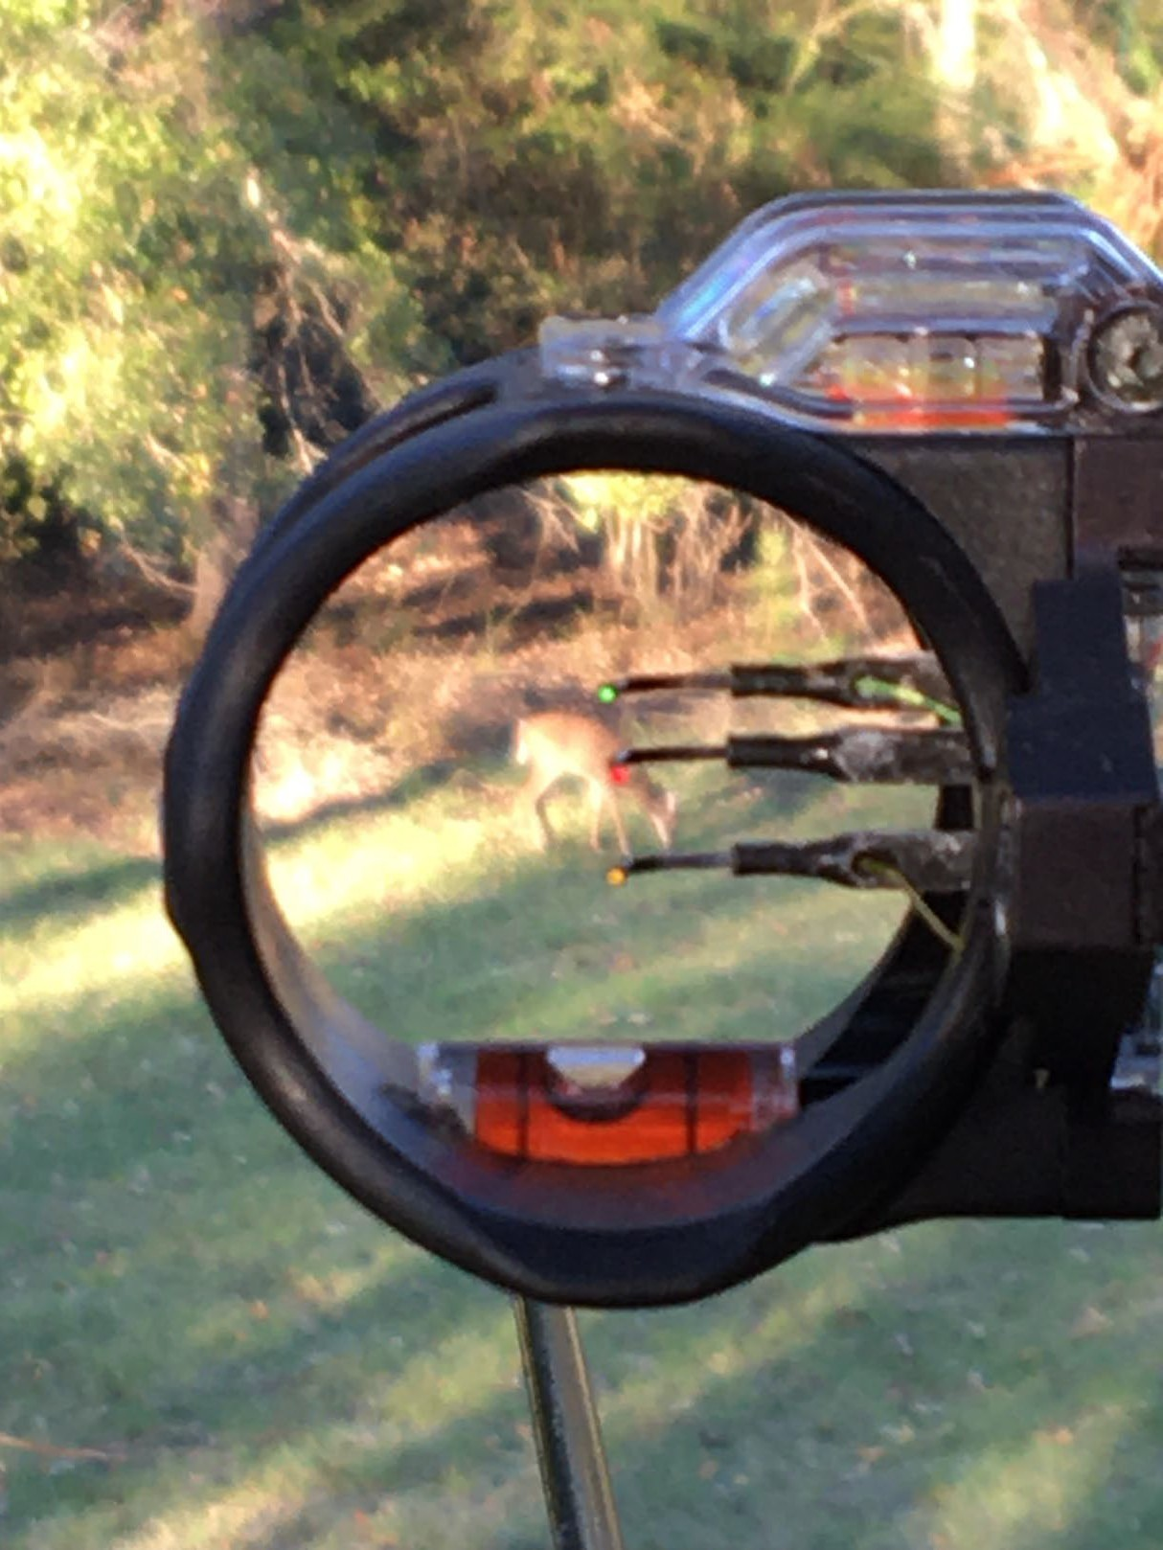
Partnership Value to Industry
Investment for the future
Return on Investment
Leverage Value
Accountability

Slide 4
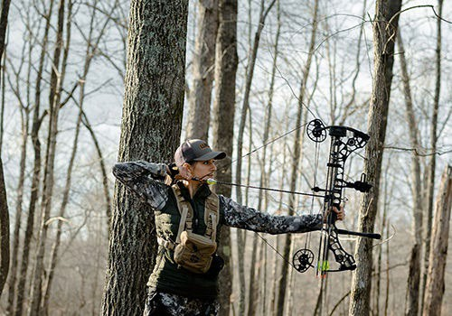
Partnership
1 Billion Contributed from Archery equip. since 1972
Fish & Wildlife Service
State Fish & Wildlife Agencies Sportsmen & Sportswomen
Also – IRS, Coast Guard, Treasury, Customs,

Slide 5
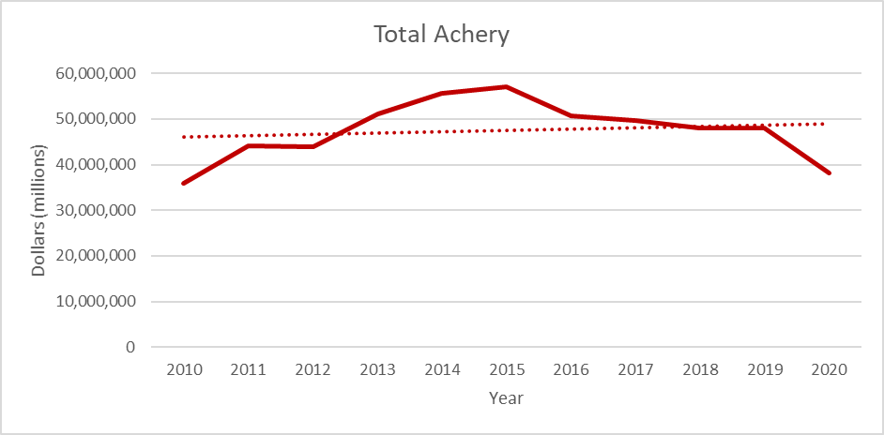
Federal Excise Taxes- Archery

Slide 6
Taxable Items
Bows Arrows Broadheads Quivers Peeps/Sights
Strings/loops Release/sling Stabilizer Silencer Arrow Rests
Firearms Ammunition
NOT
Scopes Mounts
Choke tubes Suppressors Slings
Air rifles

Slide 7
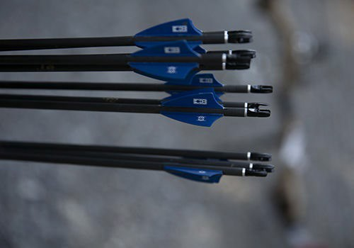
Federal Excise Taxes Complexity
Archery Items Taxed under Internal Revenue Code:
11% on the first sale of any taxable archery equipment sold by the manufacturer, producer, of importer into the United States.
Flat rate tax on each arrow shaft manufactured or imported – Adjusted annually: 2021
$.53 per shaft (has changed 9 times in last 14 years)
Quarterly Payments on IRS form 720
Constructive sales pricing
ATA has created a tax manual for our members
Access to legal and tax experts to assist
Provide education materials/show activities

Slide 8
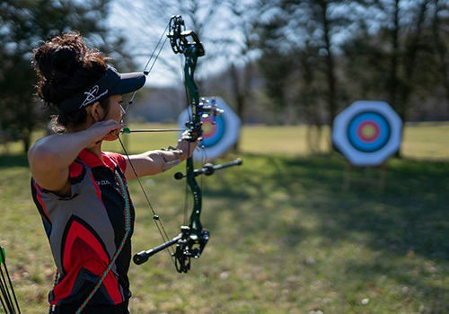
Challenges and Pressure Points
Recruitment, Retention and Reactivation of Bowhunters
Target Archery Contributions: Ranges/Programming
Data voids (Bowhunting participation and harvest)
FET Slippage

Slide 9
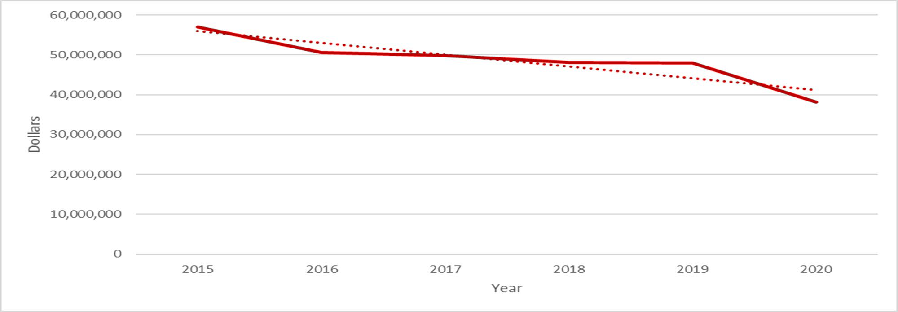
Avoidance of Archery FET?

Slide 10
Who pays the Federal Excise Tax?

Slide 11
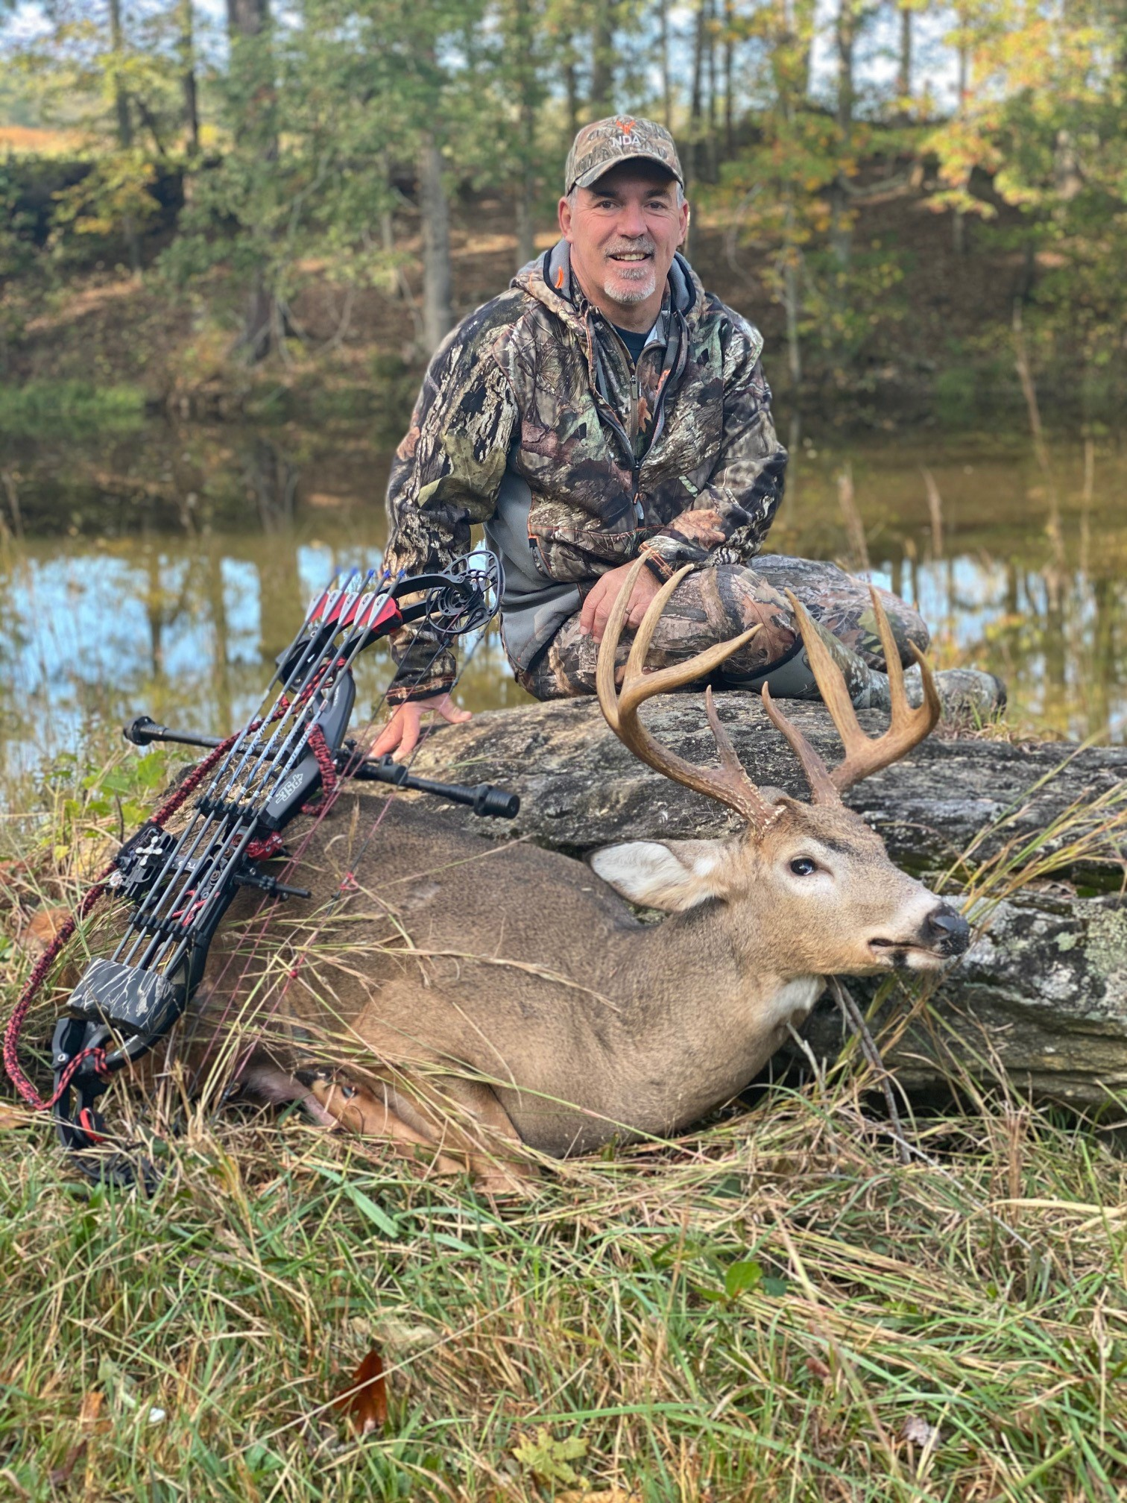
Questions?
Dan Forster danforster@archerytrade.org

Slide 12
Archery Trade Association Logo

Slide 13
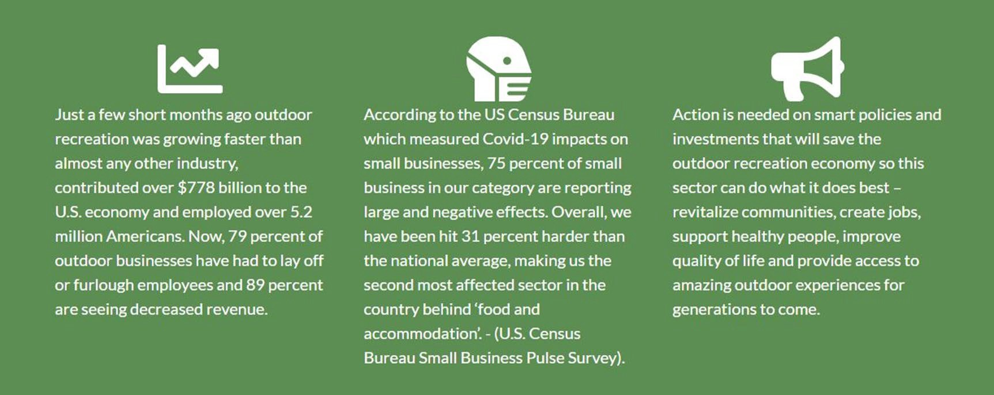
2020 Impacts to the Industry
recreationroundtable.org/covid-19-impacts-survey

Slide 14
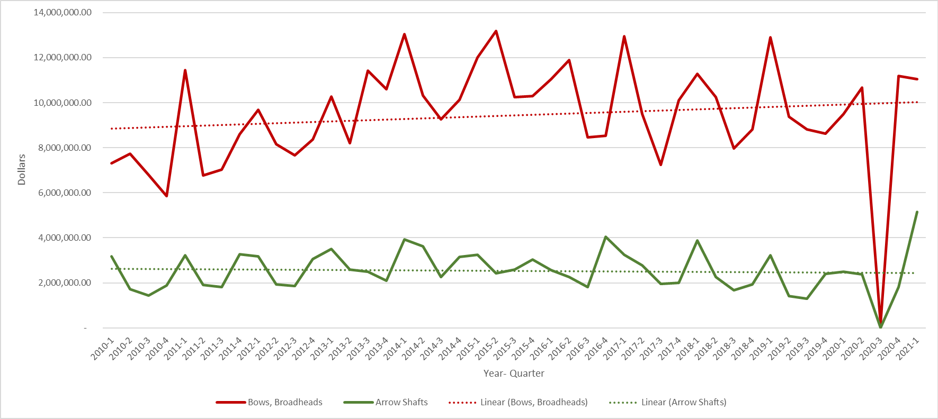
Federal Excise Taxes- Archery Cont.

