Slide 1
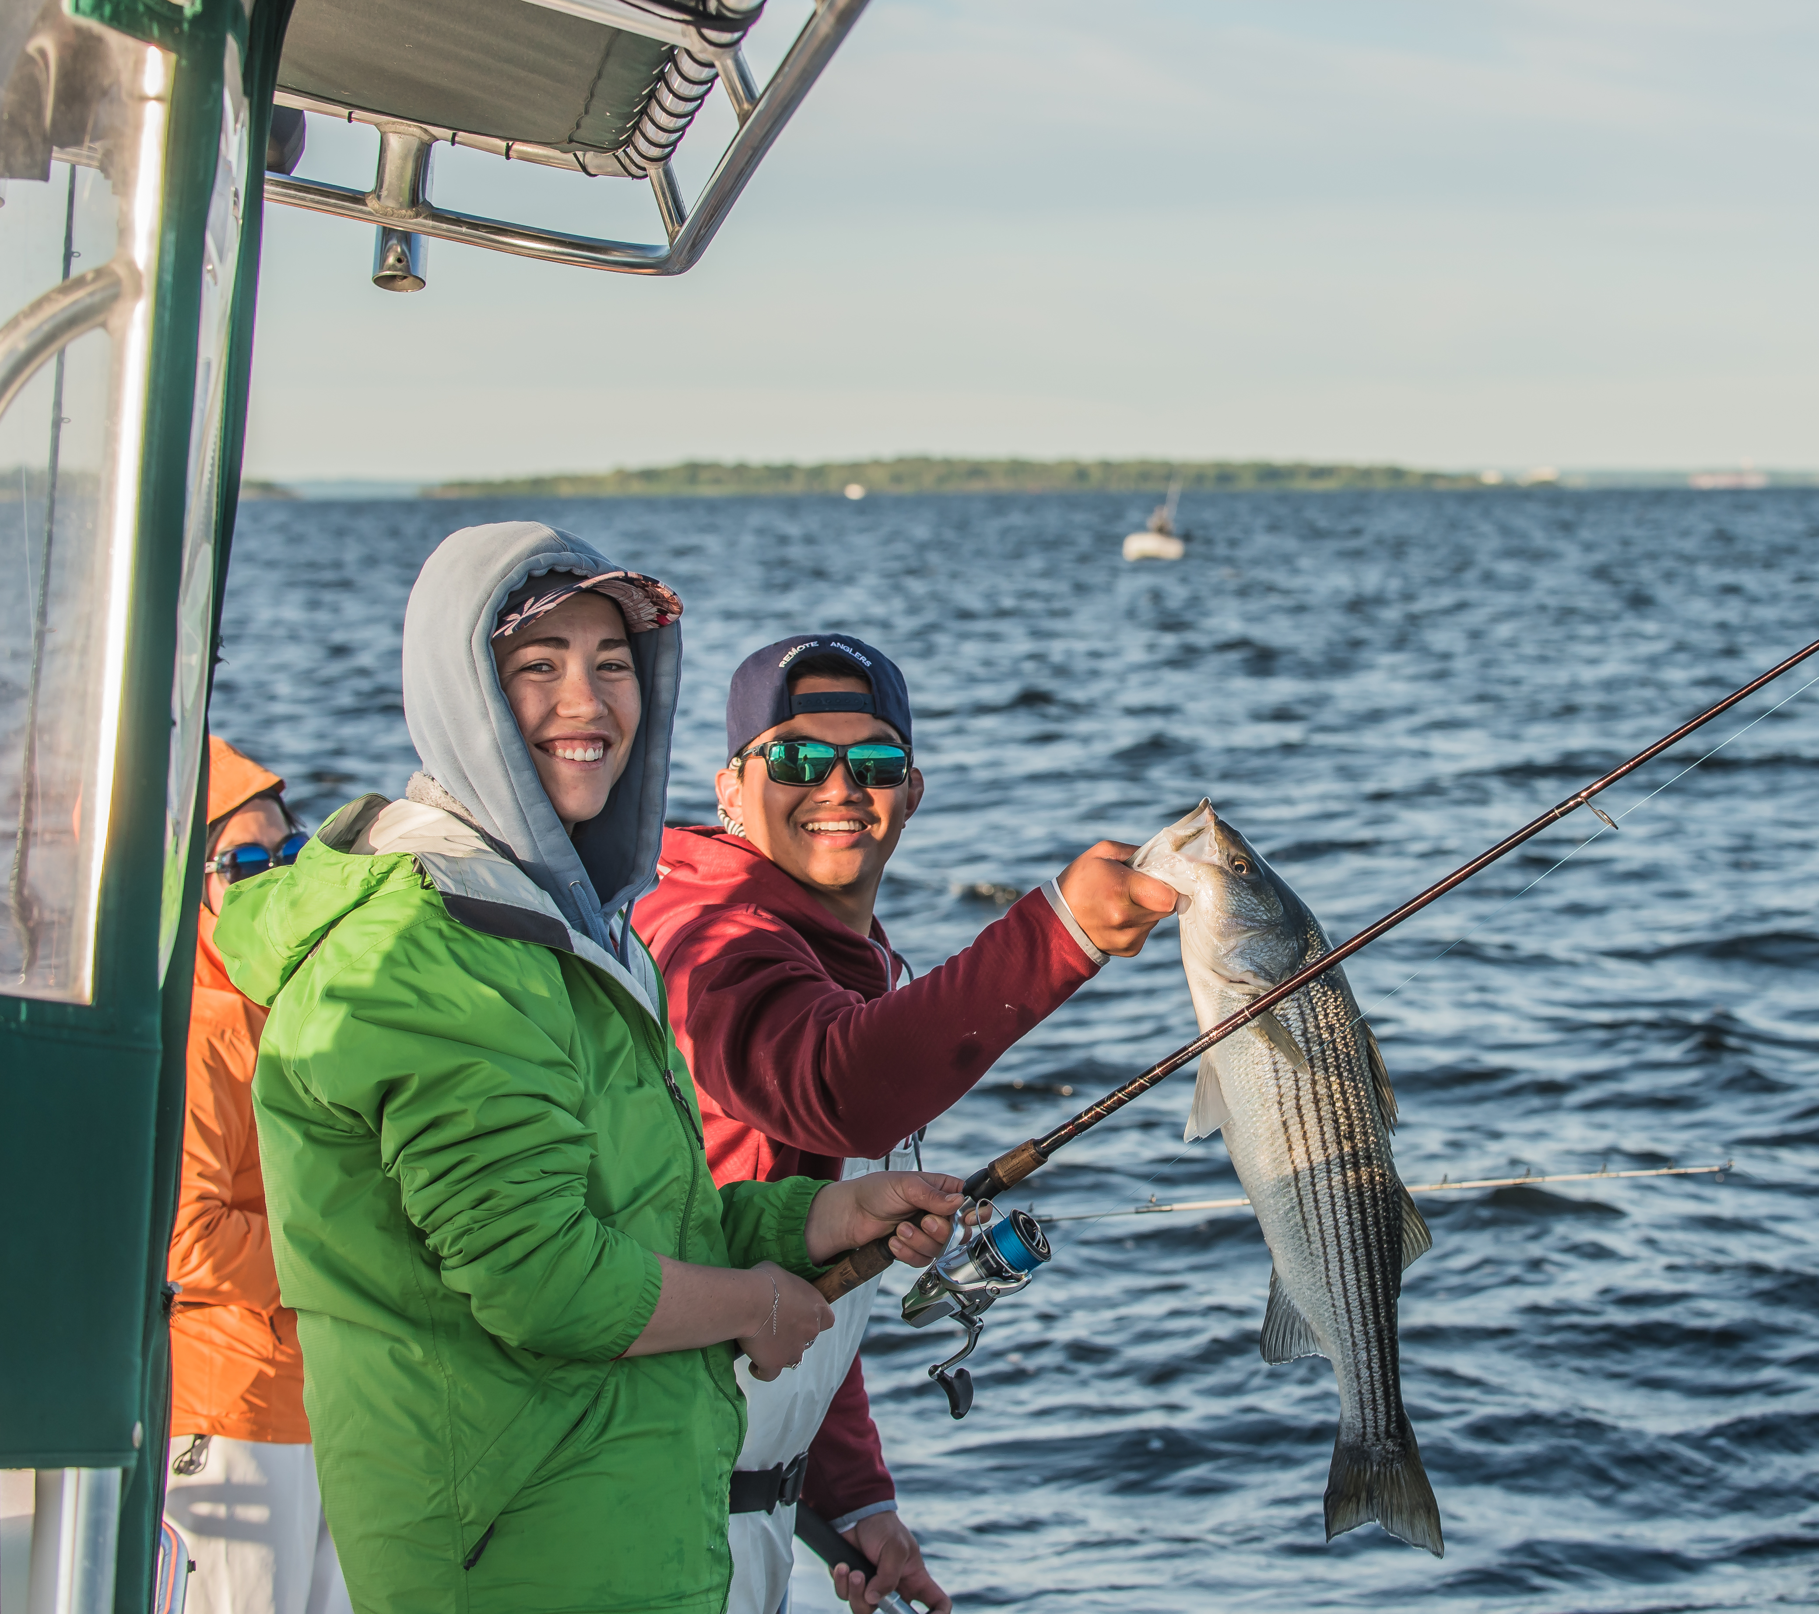
National Coordinator’s Meeting Partner with a Payer Initiative March 31, 2021- Tom Decker and Gabe Gries
.
Notes:
Fundamentally this Communication initiative is about the story of our collective work (the partnership of…….) and the conservation benefits and public opportunities of what we (collectively, you, me, Paul,) everyone on this call with our state agency and industry partners achieve.

Slide 2
“The Plan”
Notes:
Strategic Communications Plan completed in 2020 125 page document. Team of WSFR and EA staff and social scientist contractors
Identifies four principal audiences (including excise tax paying industries) (industry, state and federal agencies, congressional)
I will get to those in a minute
Both the process and the objectives and strategies for WSFR strategic communications plan were informed by social science. We systematically identifying key stakeholders to conducting interviews and focus groups to inform the plan....
We engaged social science experts to conduct interviews and focus groups with key stakeholders, including staff within the Service, to ensure the information we collected was done systematically and rigorously.
Evaluation? (not sure where you landed on this) We also included an evaluation step in the strategic plan as this step of adaptive management is critical to ensure that our strategies aimed at changing hearts and minds can be assessed to ensure they are hitting the mark and we are achieving our desired outcomes.

Slide 3
Excise Tax Paying Industry Audience
Notes:
One of these key audiences are the manufacturers and importers who pay federal excise taxes on firearms, ammunition, archery equipment, angling equipment and a tax on motorboat fuels. (Depending on the company, these programs date back to when the taxes came into place from 1937 or 1950).
Both the process and the objectives and strategies for WSFR strategic communications plan were informed by social science. We systematically identifying key stakeholders to conducting interviews and focus groups to inform the plan....
We engaged social science experts to conduct interviews and focus groups with key stakeholders, including staff within the Service, to ensure the information we collected was done systematically and rigorously.
Evaluation? (not sure where you landed on this) We also included an evaluation step in the strategic plan as this step of adaptive management is critical to ensure that our strategies aimed at changing hearts and minds can be assessed to ensure they are hitting the mark and we are achieving our desired outcomes.

Slide 4
Research Findings and Strategies
Findings:
Staff from excise tax paying industry have little or no relationship or awareness of state fish and wildlife agency roles.
Lack understanding of conservation partnership and benefits.
Hunger for content and program stories.
Strategies and Tactics-
Develop Awareness and Understanding of the benefits -
Strengthen Relationships
Notes:
There are over a dozen findings within the document for each audience.
Give you a sense here.

Slide 5
Messaging
General Industry Messages
Conservation partnership: conserves fish, wildlife, lands and waters; provides people with access to places to connect with nature and participate in outdoor recreation; and teaches people outdoor skills such as regulated fishing and hunting.
Conservation creates increased opportunities for outdoor recreation benefitting both recreationists and the retailers and manufacturers that support them.
Conservation and outdoor recreation support jobs and economies.
Notes:
Messaging
The state\federal\ industry conservation partnership conserves fish , wildlife, lands and waters, and provides people with access to connect with nature and participate in outdoor recreation
Teaches the public outdoor skills such as angling and regulated hunting.
Creates opportunities for outdoor recreation benefiting both retailers and manufacturers that support them, supporting jobs and the economy

Slide 6
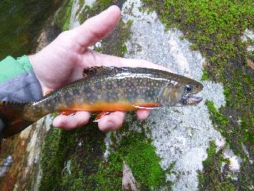
Objectives - Partner with a Payer Initiative
Increase awareness by manufacturers about successes that are achieved with excise tax funds
Increase understanding by State and WSFR staff of manufacturers and the origin of the funding for PR- DJ- projects.
Increase manufacturer access to success stories for sharing with their customers
Strengthen relationship - FWS, States and Manufacturers
Notes:
Roots of this endeavor started in 2016 with WSFR Northeast regions staff and NSSF working together to meet these objectives. (now encompasses all USFWS Regions, HQ and ATA, ASA, RBFF and others as well).
These are the objectives of the initiative and under which we operate.

Slide 7
WSFR - Tactical Team Members 2021
Matt Thomas
Kyle James
Gabe Gries
Heather Hollis
Fabian Romero
Justin Cutler
Otto Jose
Randy Spencer
Lori Bennett
Tom Decker, Chair
Craig Springer EA
Sam Moore – ACE Fellow
.
Notes:
Reminder Current Team Members:
All Regions and HQ are represented now.

Slide 8
Key Audiences – Trade Associations and Manufacturers
National Shooting Sports Foundation (1961) 12,000 companies.
Archery Trade Association (1953) 9000 companies.
American Sportfishing Association (1933) 900 companies.
.
Notes:
Reminder Current Team Members:
All Regions and HQ are represented now.

Slide 9
Key Audiences – Trade Associations and Manufacturers 2
National Marine Manufacturers Association
(1979) 1,300 companies.
American Fly Fishing Trade Association (1988) 1,200 companies.
.
Notes:
Reminder Current Team Members:
All Regions and HQ are represented now.

Slide 10
Individual Companies Colt Sig Sauer Federal Ammunition Mossberg Smith & Wesson Zebco Orvis Rapala
.
Notes:
Relationship is greater than just the Trade Associations, we also have relationships with individual manufactures
We currently have commitment from these and other industries. Often these companies may develop their own videos or blogs and share stories.
Their individual communications platforms have a huge reach beyond our traditional reach.
Smith and Wesson has over 1 million fans across five communications platforms.

Slide 11
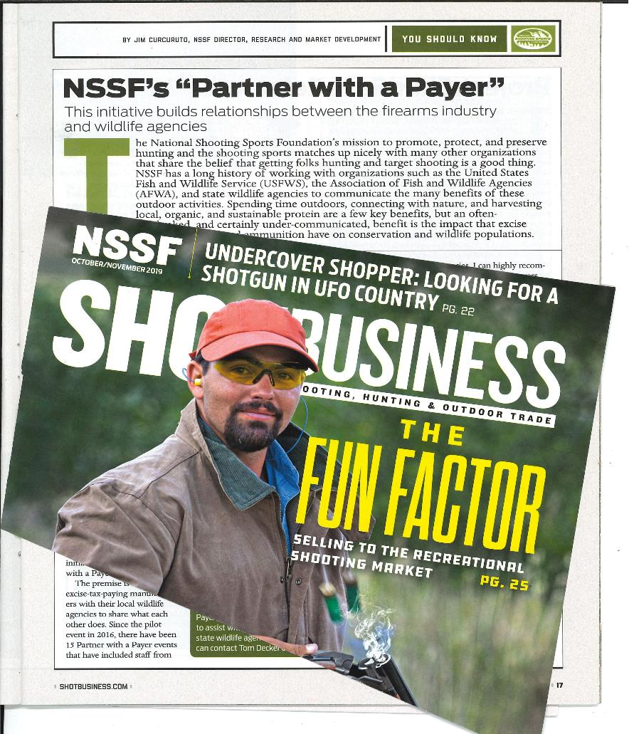
2020 Shot Show Initiative
Notes:
These communications were uniquely different than our general communication presence. We are specifically targeting venues where our KEY audiences get their information.
With the foundation of our social science work, in planning, research (interviews\focus groups), message development and venues for delivery….
We begin to move down the path of what are the program benefits and how do we develop these relationships.
Introduce Gabe Gries – Fisheries biologist and engaged in PwP for the past several years.

Slide 12
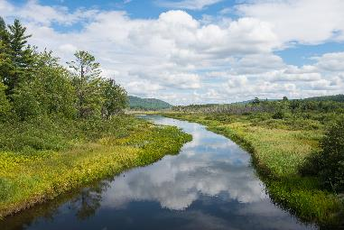
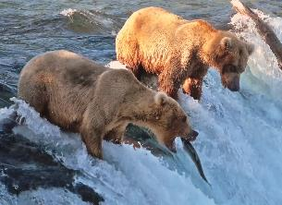
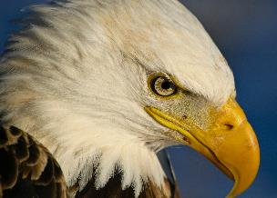
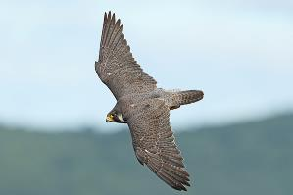
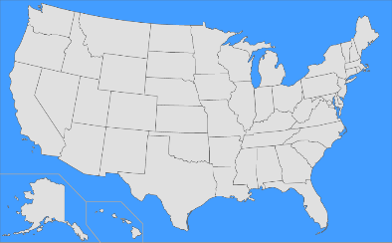
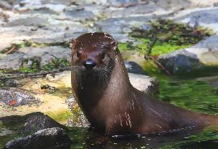
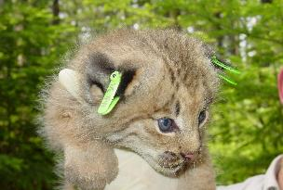
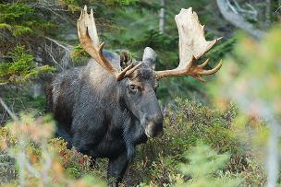
What’s achieved with the funds?
PR-Wildlife Restoration Program
450+ Bird & mammal species conserved and managed
46.9 Million
Acres of access 776
Shooting ranges (Firearm/Archery)
Notes:
Sharing the success and benefits of the WSFR partnership is paramount to PwP and luckily we have lots of great WSFR grant funded accomplishments to share with industry and others. I know you are aware of the accomplishments in your Region and maybe in others, but these next few slides that I’ll move through quickly show the impressive reach of what the PR and DJ programs accomplish nationally.

Slide 13
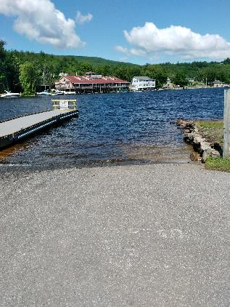
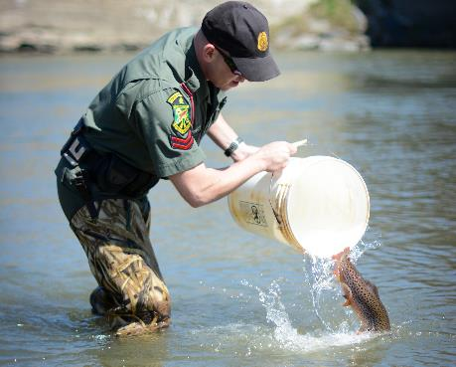
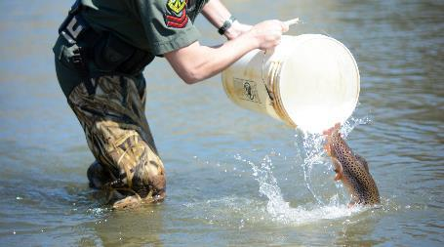
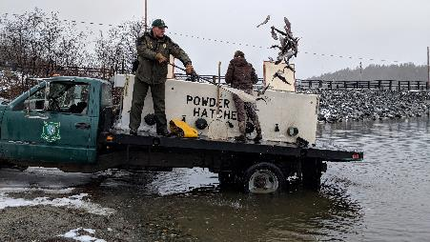
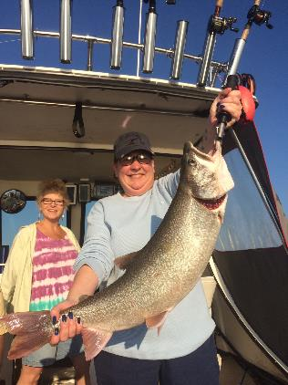
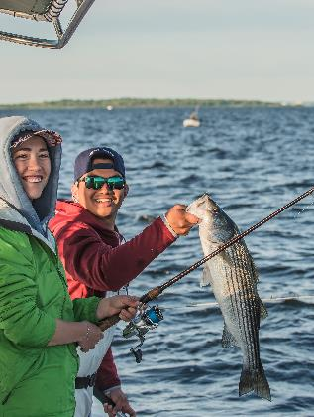
DJ-Sport Fish Restoration Program
What’s achieved with the funds?
200+ Fish species conserved and managed 6,439
Boating/fishing access sites O+M 1.3 billion
Fish stocked annually (70+ species)
316
State Fish Hatcheries O+M
Notes:
6,439 access sites where Operations and Maintenance is conducted. 1,143 new boat ramps constructed in past 5 years

Slide 14
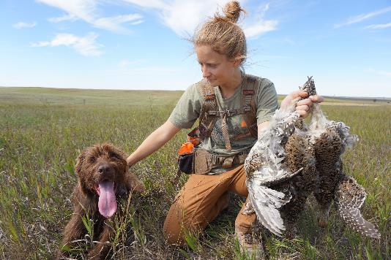
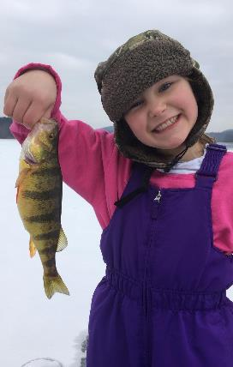
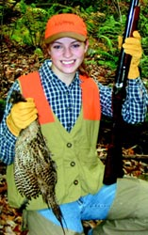
Educating and Connecting People to Nature
2.8 Million
Students educated in hunting,
fishing and aquatic resources annually
What’s achieved with the funds?
Over 198 grants supporting R3

Slide 15
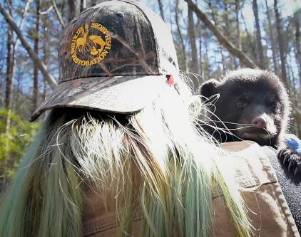
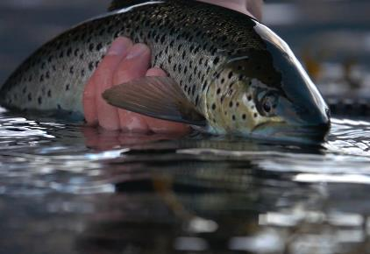
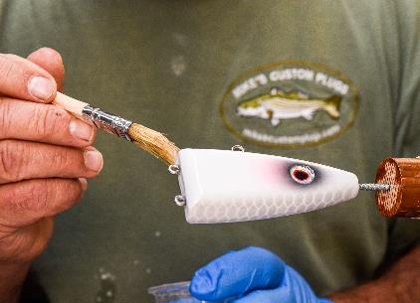
Communicating Grant Successes + Benefits to Industry
PwP manufacturer and field events
New PwP website (partnerwithapayer.org)
Brochures
Success Stories (written + video)
PwP Events
Grant funded accomplishments
Notes:
So we have all these great accomplishments and benefits of WSFR funded work. Now how to we get that information to Industry in a way that allows them to make the clear connection that these conservation and access successes are not only good for all Americans and wildlife, but to their business as well. In other words, the excise taxes are an investment in their company's future. Remember that as Tom indicated, industry lacks an understanding of what is done with the excise taxes they pay.
Go through bullets

Slide 16
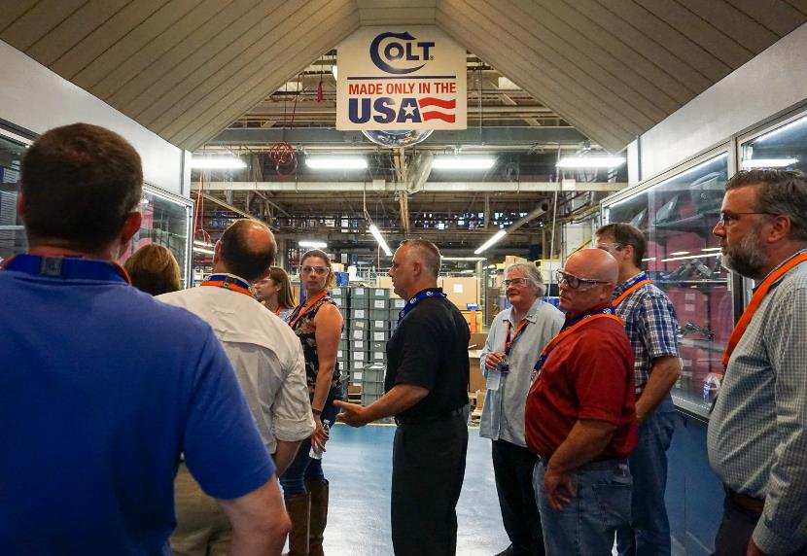
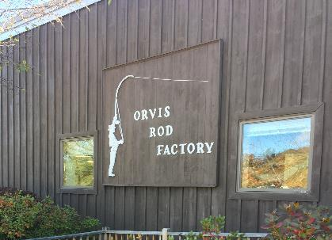
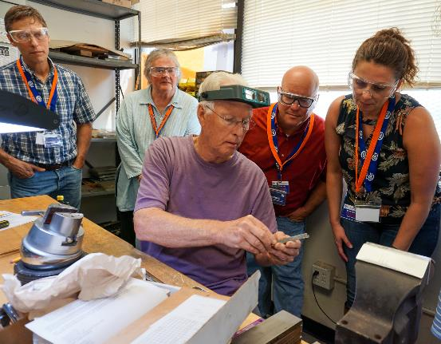
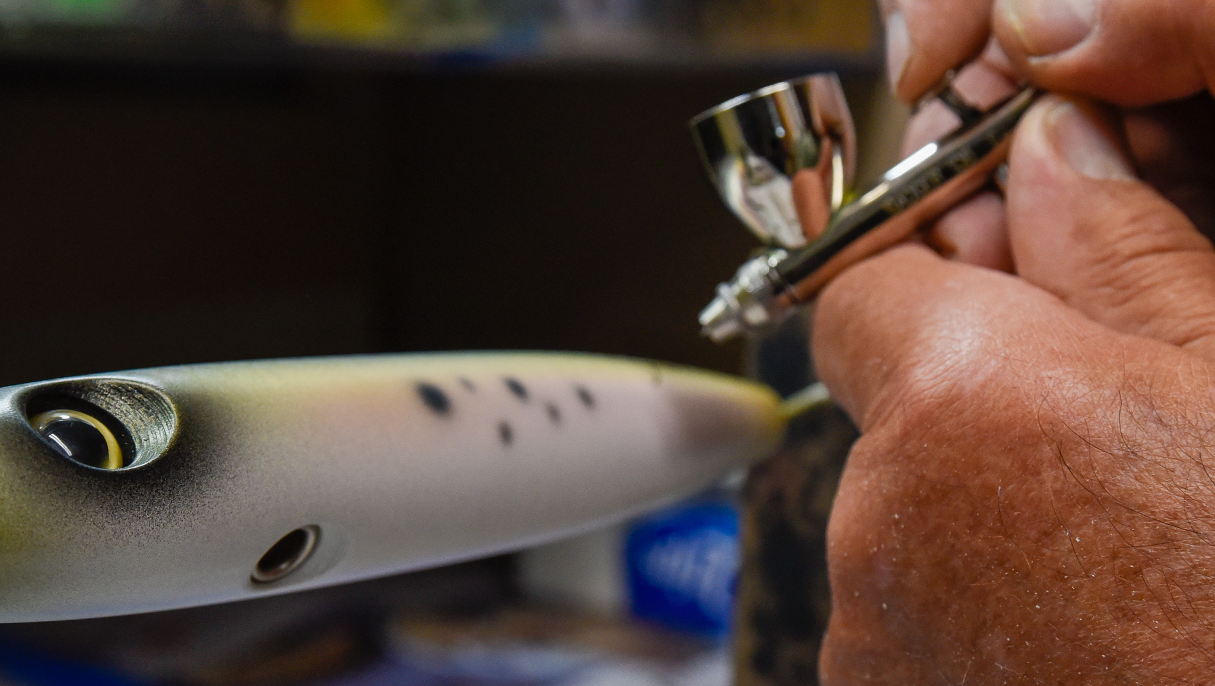
Tours of Manufacturer Facilities
.
Notes:
There are 2 major components of Partner with a Payer. 1st is manufacturer tours – note State and FWS participation at a manufacturer facility tour.
This is an opportunity to see American companies at work making the products that are taxed and that fund much of the conservation in the U.S..
Also, a chance to sit and talk with industry staff about the program and its successes and have them meet the state biologists who rely on this funding to do their daily jobs.
Meant to be structured but informal and focused on relationship building

Slide 17
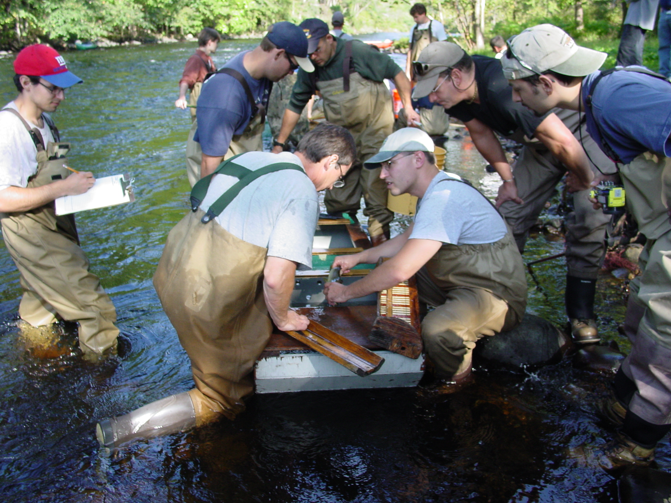
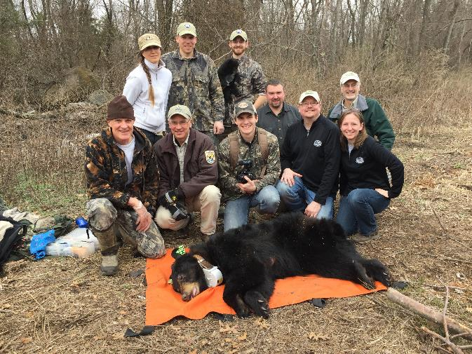
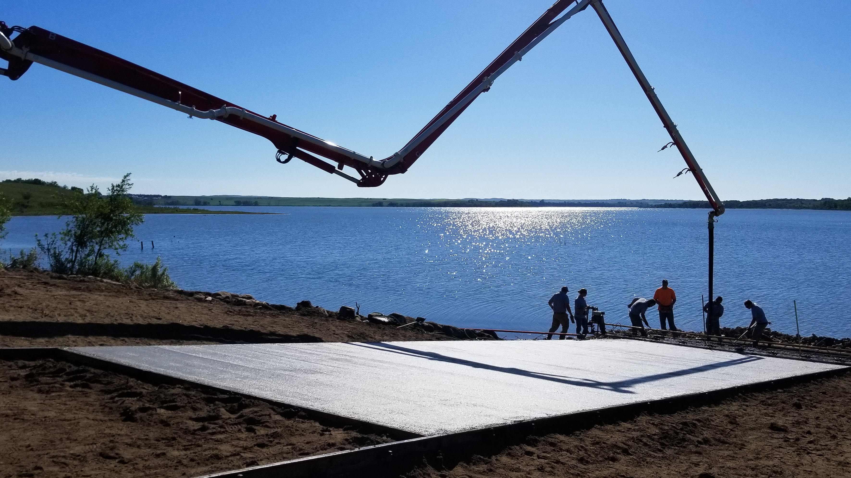
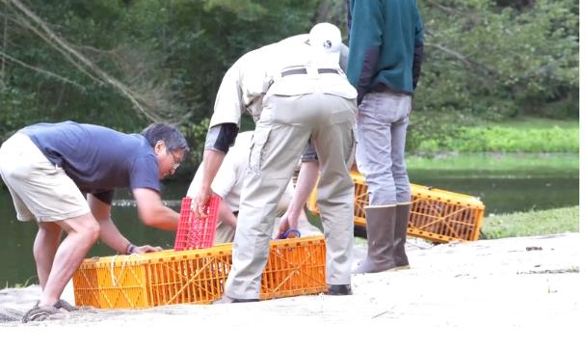
Field tours of PR/DJ- funded Projects
.
Notes:
2nd component of PwP is tours of WSFR funded projects
Wonderful opportunity for industry to get a chance to talk with biologists and get a first hand look at the accomplishments of the excise taxes and how the taxes benefit conservation, access and their bottom line.

Slide 18
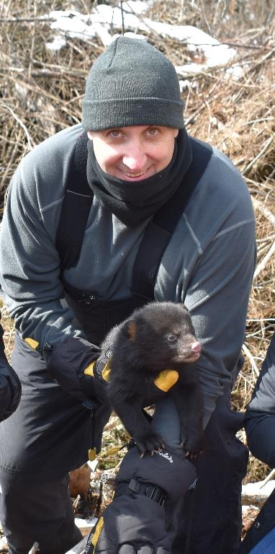
Partner with a Payer Events– Results
“With the support of USFWS and CT DEEP, I went out to a bear den…located 20 miles from our Headquarters…what a thrilling experience it was to see nature close-up…What an even greater gift, was the general thank you we received from the whole conservation team”
- Paul Spitale, Senior VP
Colt Firearms Manufacturing
Notes:
These events are an opportunity to connect emotionally and personally, with manufacturers and state agency staff.
And whenever I go on one of these tours I am always amazed at the comments I hear from state, service and industry employees such as this example.
Prior to Covid, we had held dozens of field and manufacturers events which engaged hundreds of people and many agencies and organizations. Due to covid we have had to put dozens more events on hold and have re-focused our efforts on a new website, and the production of success stories and videos until it is safe to hold events again.

Slide 19
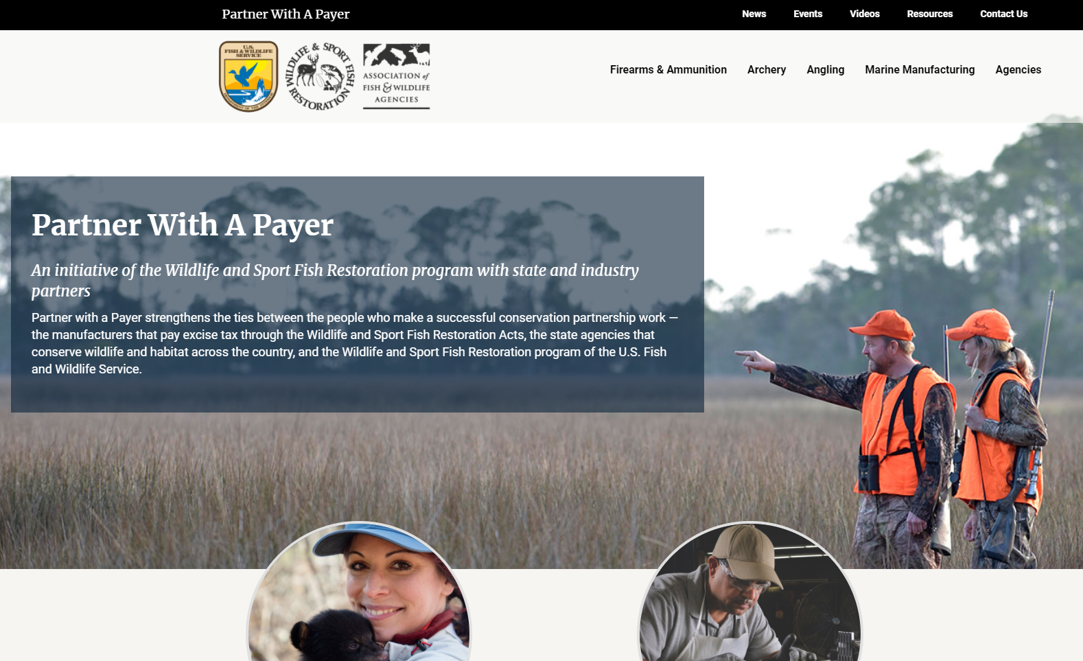
Partner with a Payor Website
partnerwithapayer.org
Notes:
Speaking of the new website, here are a few quick examples of the look and content of the new website.
Separate pages for each industry as well as for agencies.
News, events, videos, resources

Slide 20
Webite
Notes:
This content is changing all the time as new articles are written.

Slide 21
Angler Benefits
Notes:
Quick example of the marine manufacturers page

Slide 22
State and Federal Agencies
Notes:
Example of the agencies page. I encourage you to take a look at this new website as it has a different look and feel

Slide 23
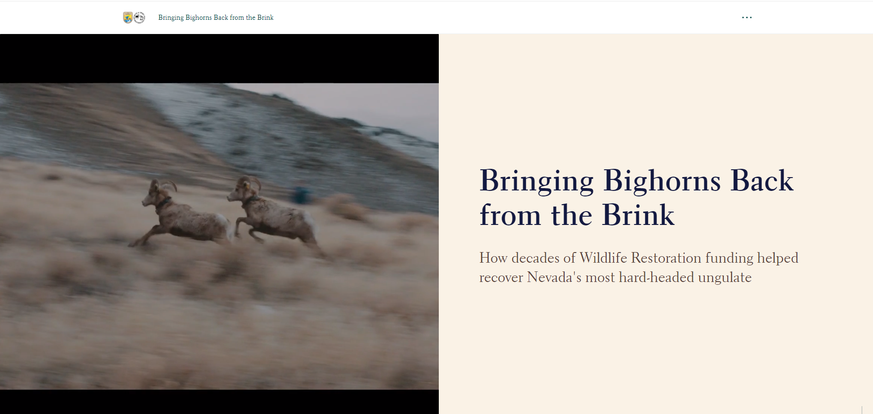
Bighorn Sheep Story Map
Sam add screen shot of Story Board sheep story here
Notes:
This next slide will show a story map of WSFR funded Bighorn sheep restoration in Nevada, a success story that Alan Jenne and Mike Scott from the Nevada Department of Wildlife shared with us on Monday.

Slide 24
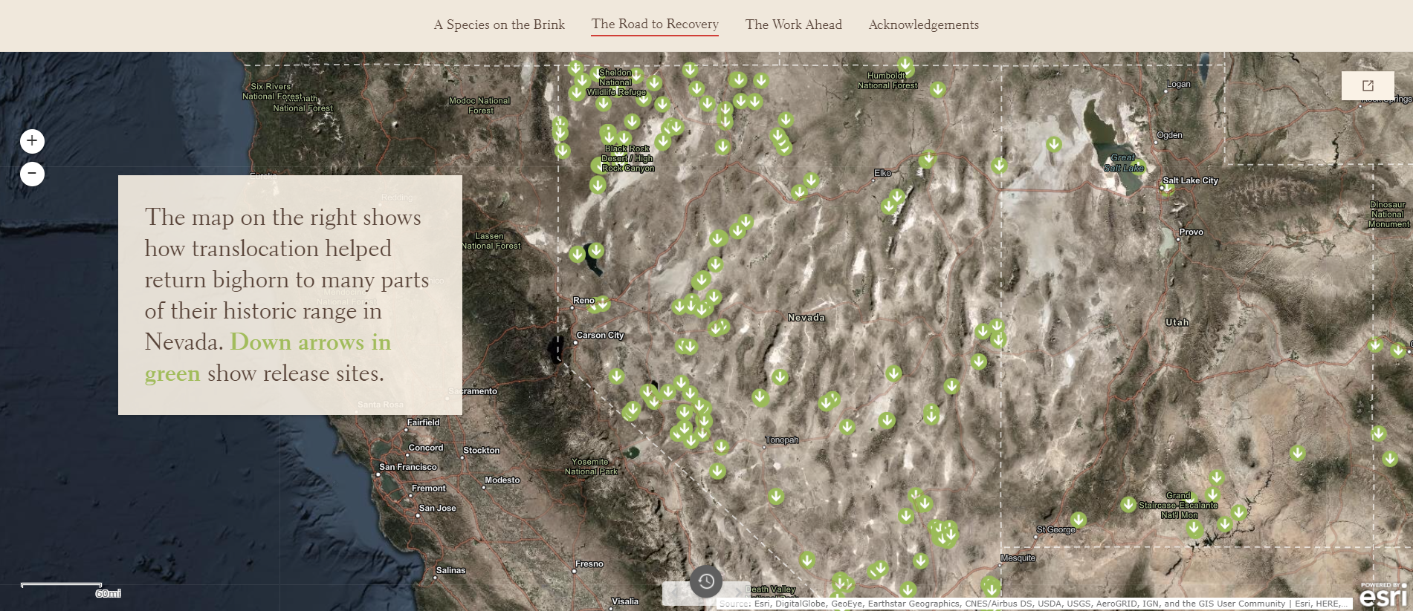
Story map
Sam add screen shot of Story Board sheep story here as well.
Notes:
This story map is another example of a communication medium being used by PwP. For those of you who don’t what a story map is, it is visual representation to show GIS data that in this case represents species restoration sites and identifies locations of either release or capture of big horn ship.
Animated map that can talk you through the story or you can click through on your own. Novel and entertaining way to learn and to tell a story.
Built in filter to keep people from knowing exactly where locations are.

Slide 25
This slide shows two of the many new brochures or one-pagers we have been working on that highlight the partnership and its success and benefits but does so in a different way then we have in the past.
Notes:
This slide shows two of the many new brochures or one-pagers we have been working on that highlight the partnership and its success and benefits but does so in a different way then we have in the past.

Slide 26
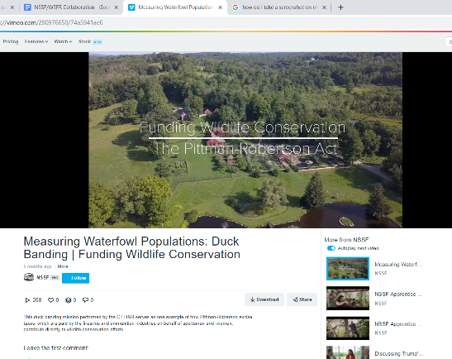
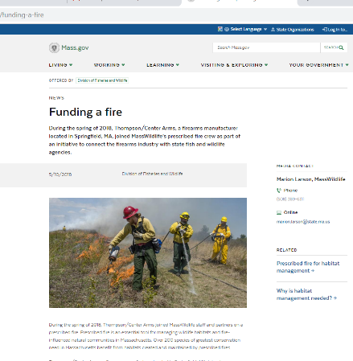
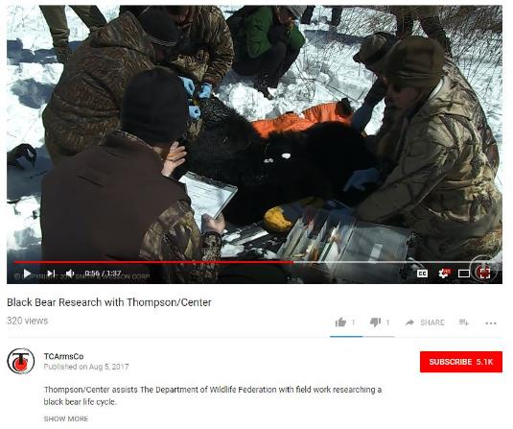
Joint Story Telling Opportunity
PwP Event Success Stories
Notes:
As I mentioned before, success stories can be created from PwP events or from knowledge of WSFR funded accomplishments. Here I am showing a few stories from PwP events.
Now these PwP events are a great opportunity for joint story telling that any of the WSFR partners can take the lead on or work together .
Firearms industry has been very proactive about producing their own communications on these events and as Tom mentioned they have incredible reach through their social media platforms..

Slide 27
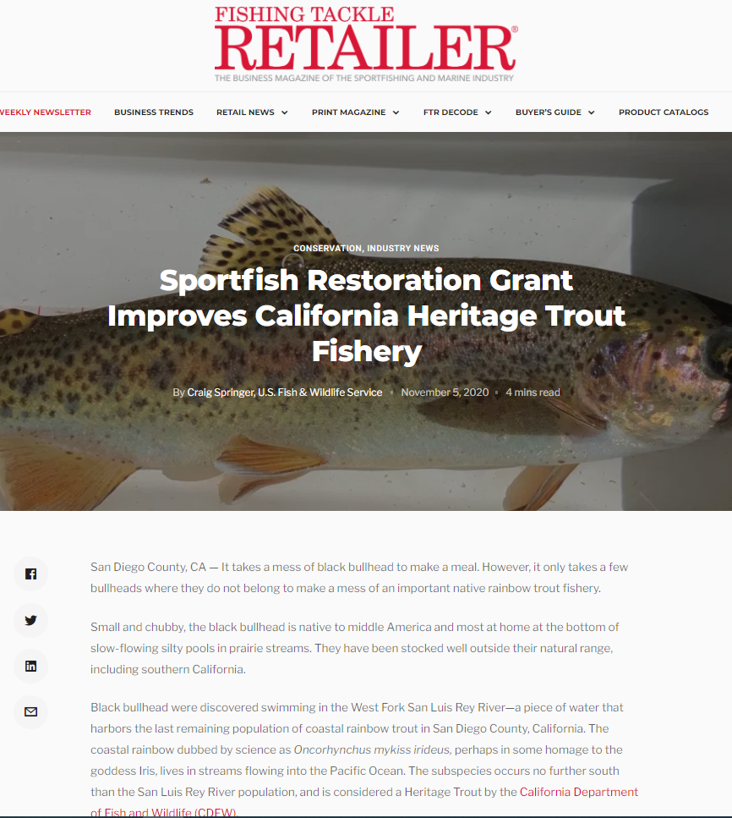
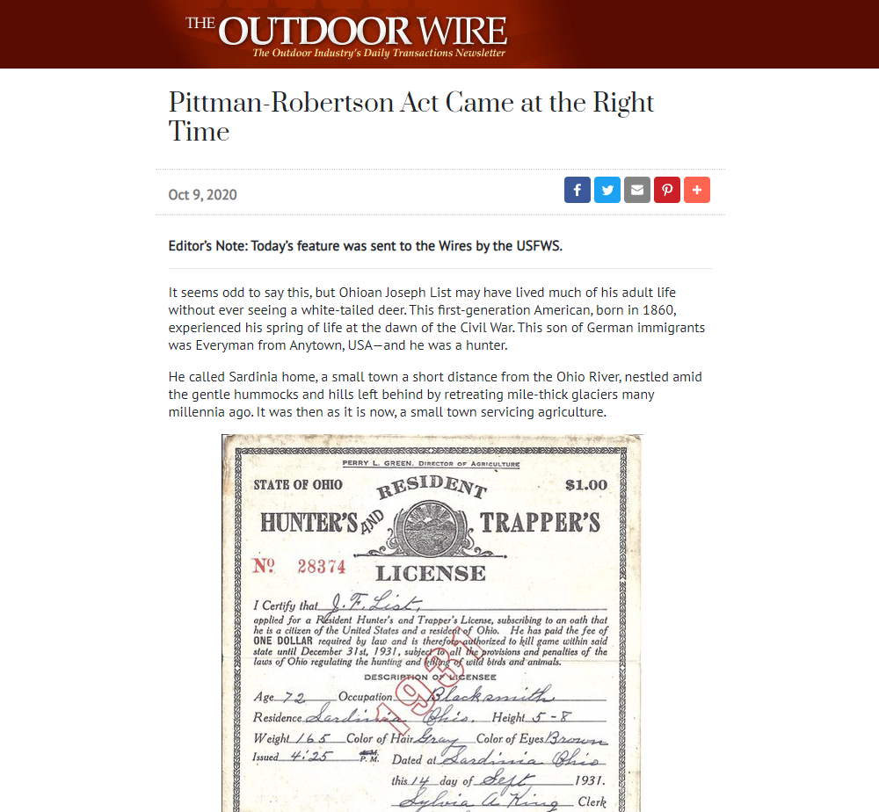
Grant Funded Success Stories
Notes:
So here is the other method we have been using to develop success stories, and that is using WSFR funded accomplishments by the state agencies to show the incredible benefits achieved by this partnership.
Thus far we have released dozens of PwP success stories through the outlets Tom mentioned earlier. Industry and state agencies have written some of these and on others we have used contractors and also our own USFWS writers. And speaking of that, we are lucky to have Craig Springer from EA currently on detail with WSFR for PwP and he has been doing a great job on these stories.
And we want to be clear, these are not my success stories, or Tom’s or Paul’s. Regardless of who writes them or who comes up with the idea, they are WSFR stories and as such belong to every person involved in the Partnership, be they state, federal or industry.

Slide 28
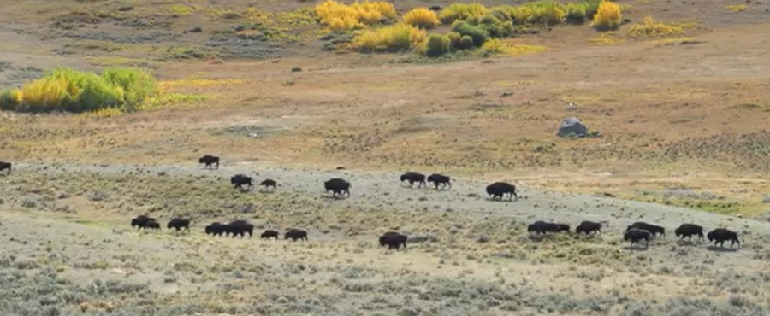
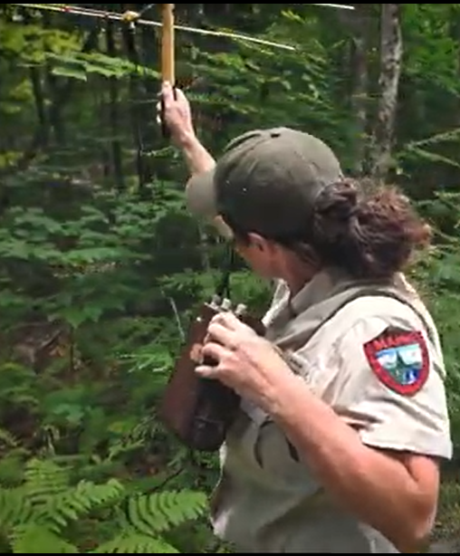
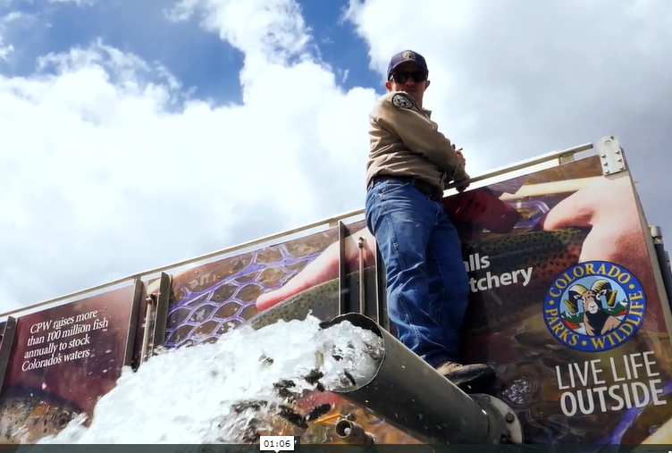
Success Story Videos
Notes:
We are going to now show you two short partnership videos we produced, one for DJ and one for PR.
WSFR and/or our industry partners have released over 10 PwP videos some of which have already reached over 250,000 people.
The commonality is all these videos highlight the strength of the partnership, its benefits and accomplishments and importantly how the program results in healthy f+w populations and access, thus benefiting all Americans and the companies that pay the excise taxes.
We are keeping our fingers crossed on these videos, but if the video quality is compromised by the number of people on this webinar and we have to stop them, we will send a link via the chat. They can also be found on the PwP website and I encourage you to take a look as they are great videos and definitely a new way of telling the WSFR

Slide 29
Closing
Notes:
TRANSITION
Thank you, Gabe,:
So my summary to you….. as you can see we have a well-developed plan, and a frame work and committed people to delivery it.
What are we communicating – our basic message is story telling – whose story…. Well it is our story, the people on this webinar, the state fish and wildlife agencies, the industries that are supporting us…. the partnership
And that story ….in its simplest terms WR and DJ literally change the nature of America. The partnerships have put fish and wildlife back in streams, the forests, the wetlands, prairies.
What started then changed the world and we continue the positive change related to the countries fish and wildlife. This is the legacy of our partnerships past and this is the stories or our NOW and future. Help us tell them.
I am confident that much of our story has yet to be written as we continue our work into the future. Our potential is high. Our story telling work is growing.
We are going provide an opportunity now through a breakout room. For you to provide us thoughts and insight, ask questions or reflect on what you have heard and think, offer suggestions.
In a minute you will all magically be transferred to one of three breakout rooms, there will be a discussion leader and assistant from the Tactical Team. The breakout room is optional, but the opportunity for us to hear from you is infrequent and we hope you join us and share any thoughts you may have.
Reminder, please keep you mikes on mute, raise your hand or use the chat to ask questions. After your breakout discussion is over your webinar is completed. And I wanted to thank you for your committing part of your day today with us.

