Slide 1
Wildlife and Sport Fish Restoration

Slide 2
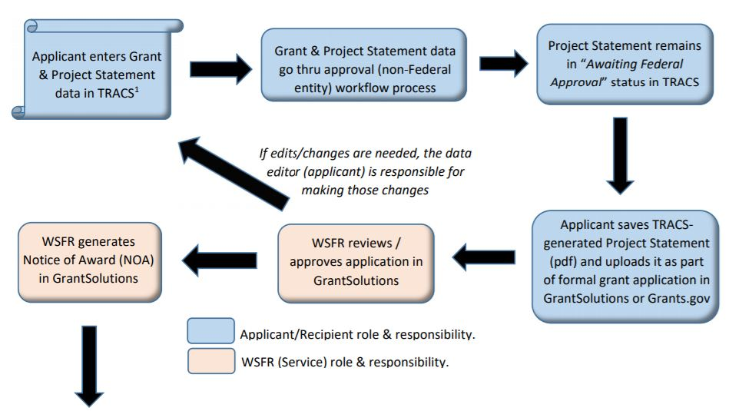
TRACS – Suggested Process
TRACS Process Workflow Diagrams:
wsfrtraining.fws.gov>TRACS Training>TRACS Resources & Job Aids

Slide 3
TRACS – Project Titles
Don’t Forget the Naming Convention!
e.g.: AL – Opelika Community Archery Range
Use the training resources @ wsfrtraining.fws.gov!
TRACS Training>TRACS Resources & Job Aids

Slide 4
TRACS Strategy Fact Sheet Example

Slide 5
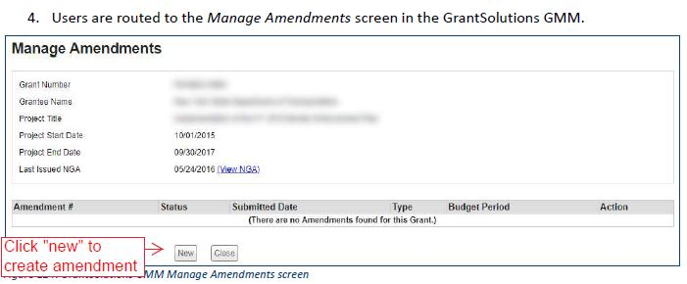
GrantSolutions – Amendments CONT.

Slide 6
GrantSolutions - Amendments
Final Reporting – 120 Days
May not be updated for smallest grant programs but can be modified by WSFR
Reporting Cycles
Updated for primary programs
Budget Year default (should be changed by WSFR to FY or CY if not compliant)
NOA Conditions
Base Award will continue to reflect all applicable conditions
Amendment NOAs will only reflect conditions that are NEW to the award.

Slide 7
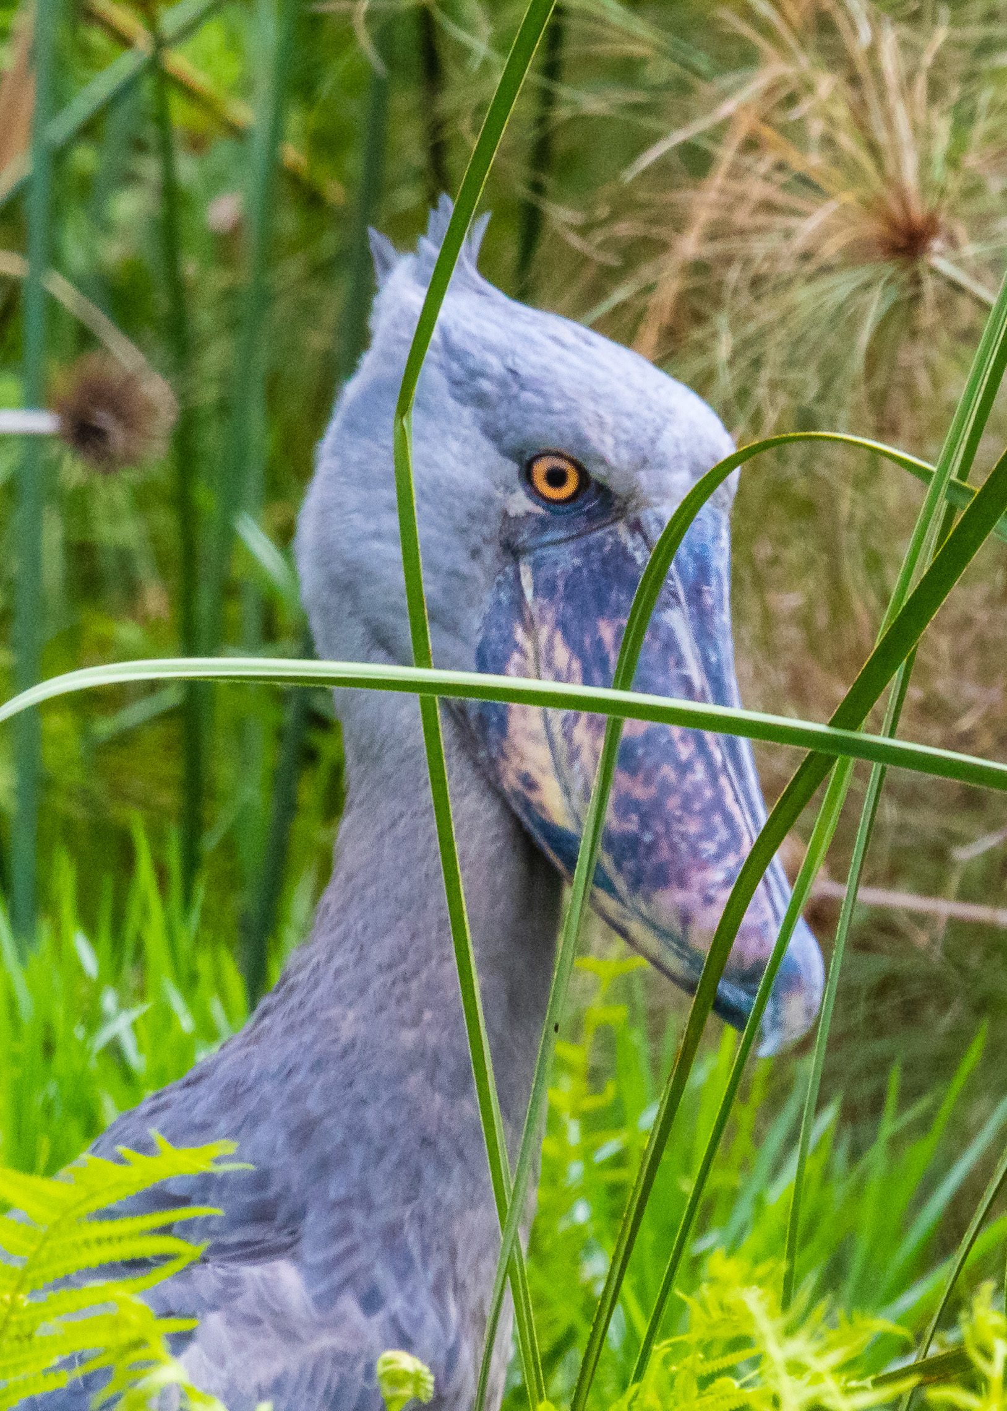
GrantSolutions and Tracs
Q&A, Open Discussion, and
Airing of Grievances

