Slide 1
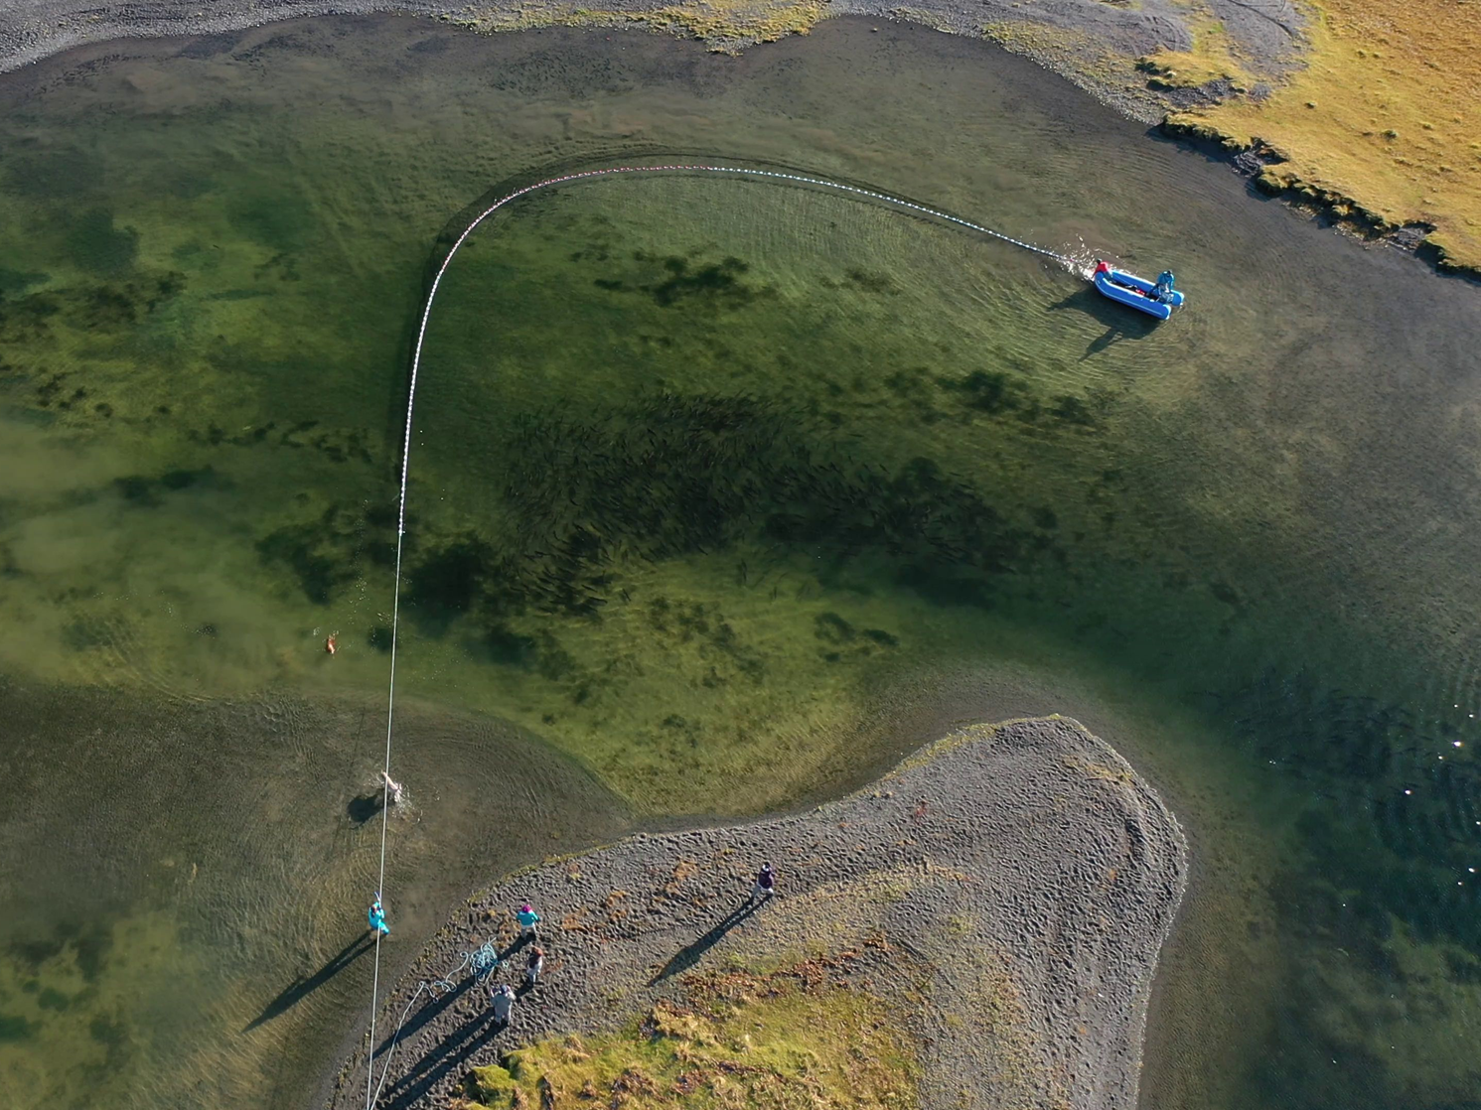
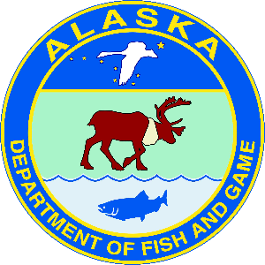
Drones, Dogs and More in a Coho Salmon Mark-Recapture Project on Kodiak Island
Tyler Polum
Alaska Department of Fish and Game
Sportfish Division
Kodiak, Alaska
Notes:
Hi my name is Tyler Polum with the Alaska Department of Fish and Game in Kodiak, Alaska. I’ll be showing you about a mark-recapture study on coho salmon in the Pasagshak River drainage and some unique, or perhaps, odd innovations we’ve developed in the project.

Slide 2
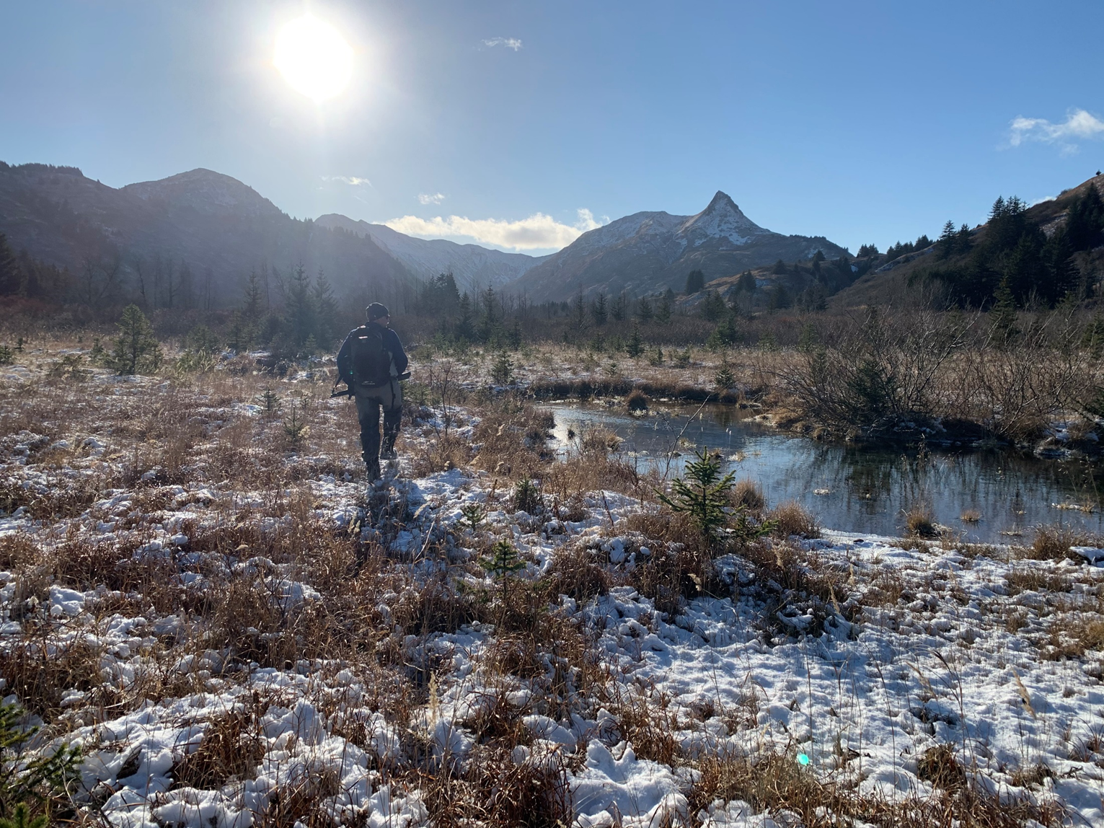
Image of drainage
Notes:
For the last 30 years, we’ve surveyed tributaries of the drainage to assess the coho salmon run but recent environmental changes in the drainage have made for sporadic and unreliable counts. So we knew there was a problem we had to address to be able to continue to assess the coho run.

Slide 3
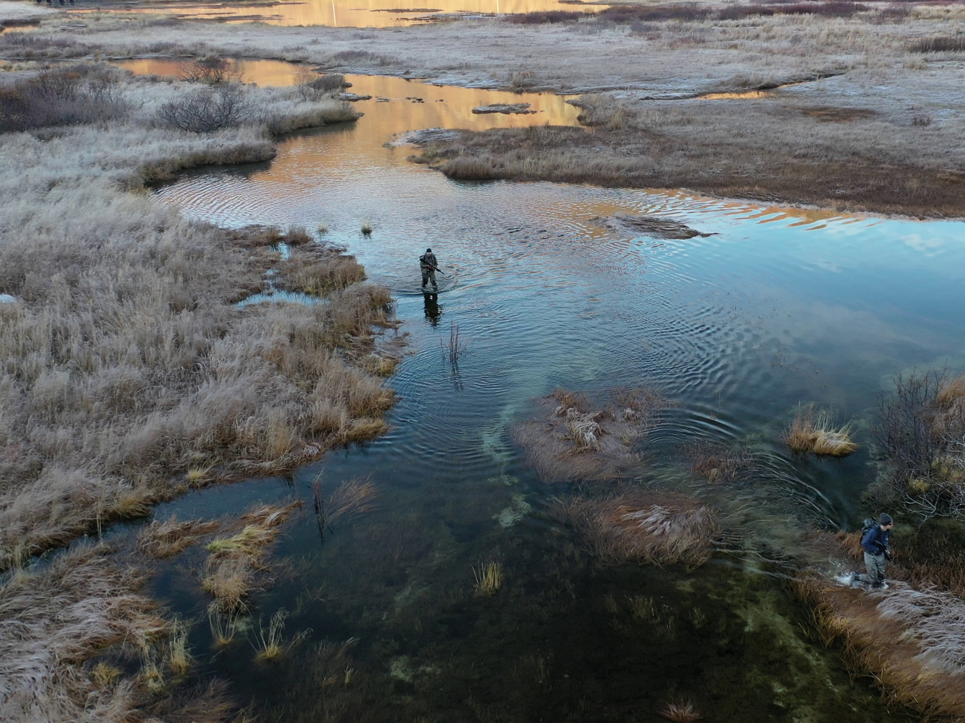
Image of lake
Notes:
Several years ago, during a separate project, a coworker showed us some drone footage and we wondered if that could help us solve our problem? Our first thought was, what if we could get the drone to fly a pre-programmed path and collect the video for us, perhaps we could get more surveys in in a season?

Slide 4
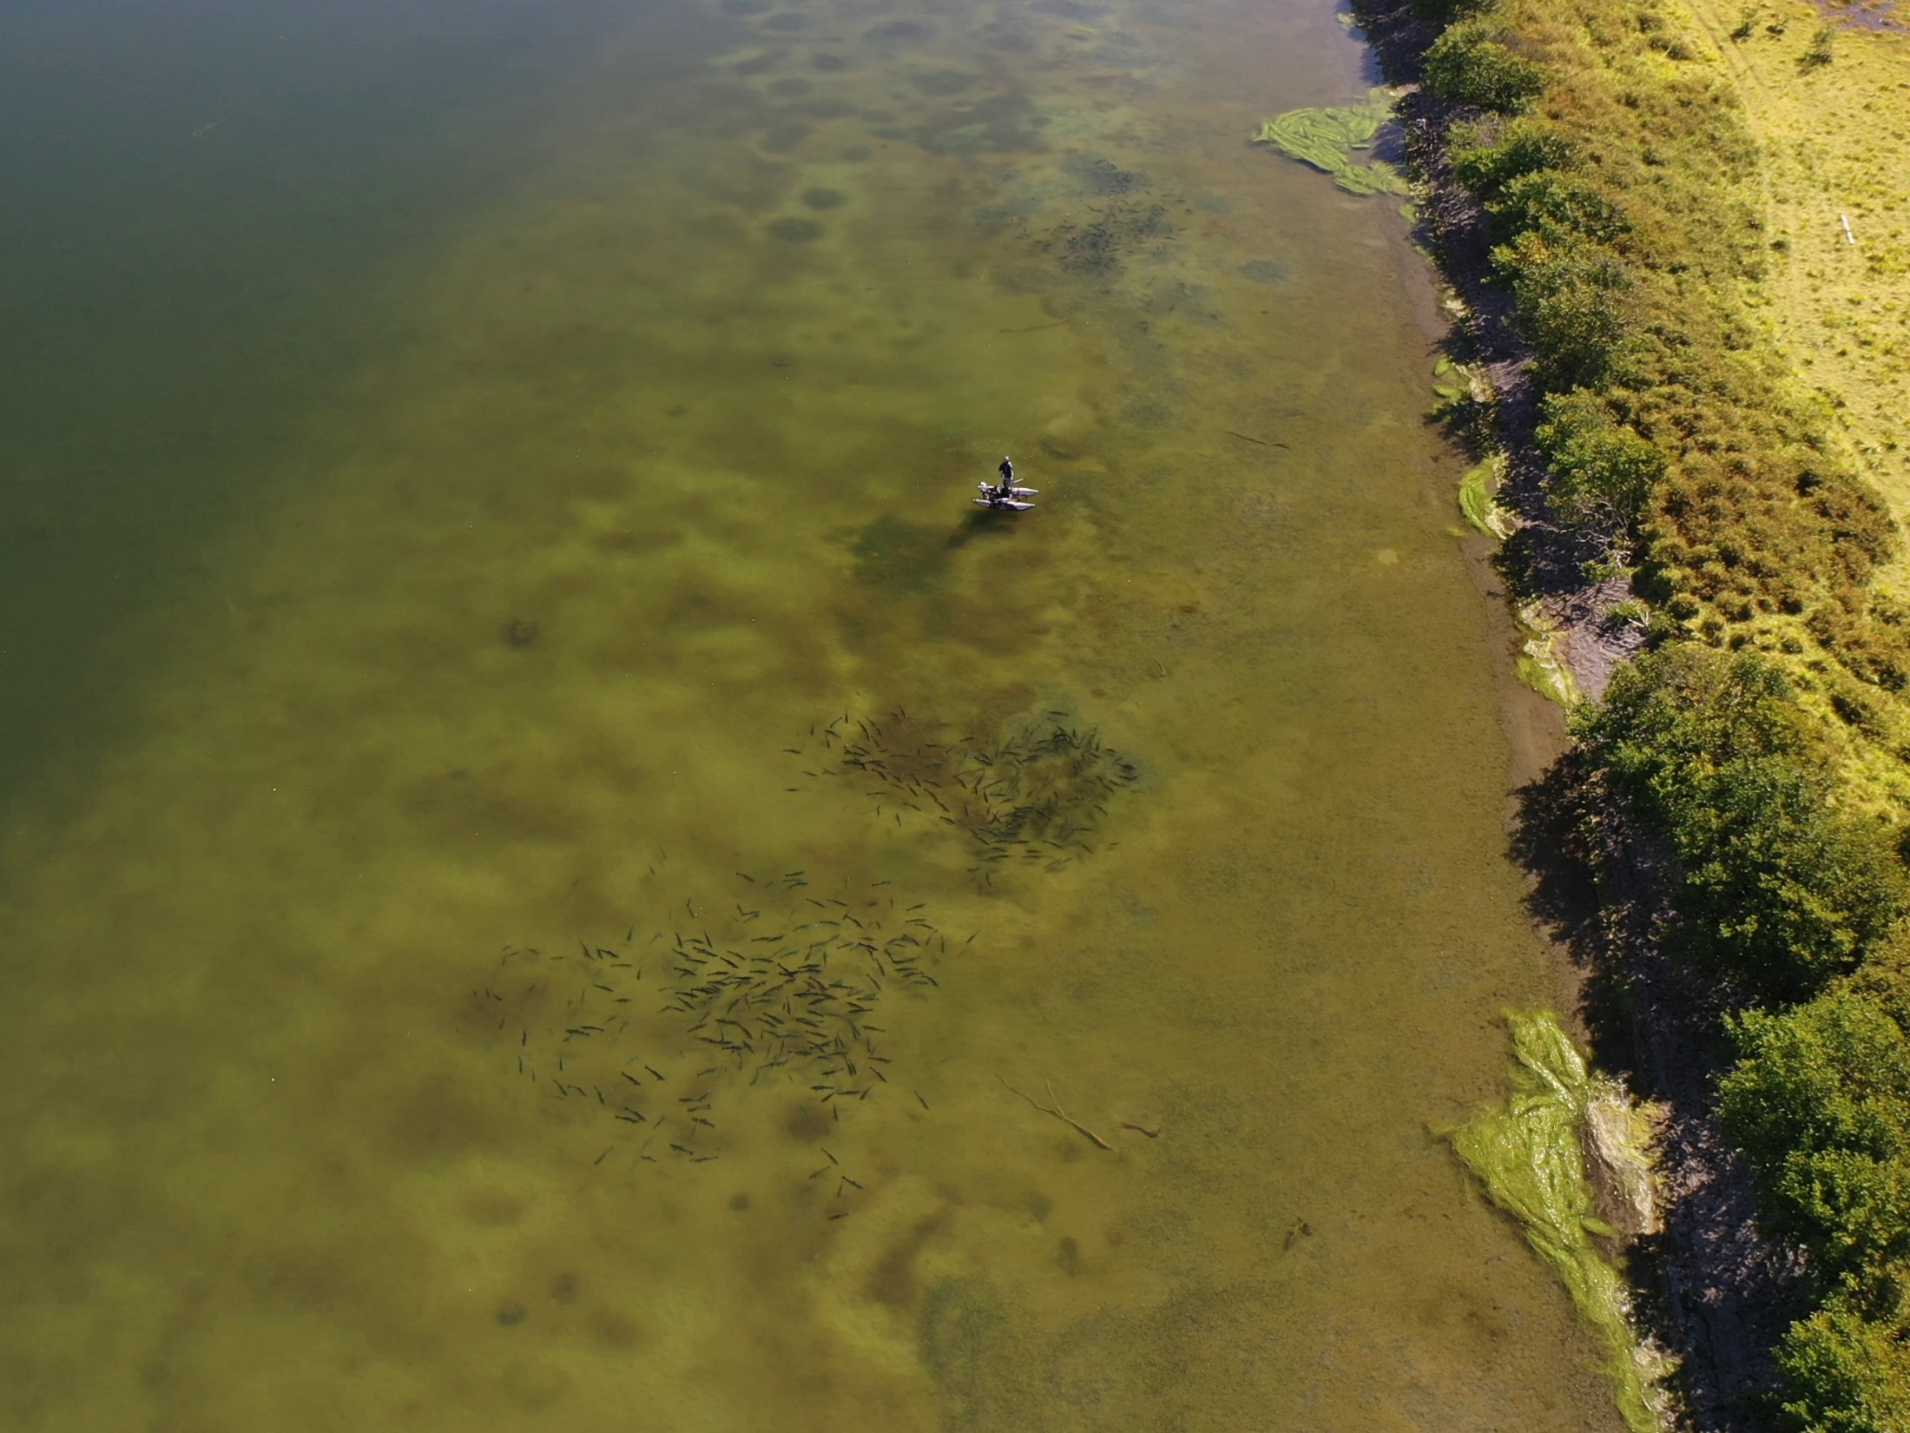
Drone image of water body
Notes:
So, we got a drone and as it turns out we couldn’t actually see in the tributaries very well and flying autonomous paths is still not quite practical for us, as well as not following FAA regulations too. But we could see fish in the lake, surprisingly, and well enough to get really good counts from the air.

Slide 5
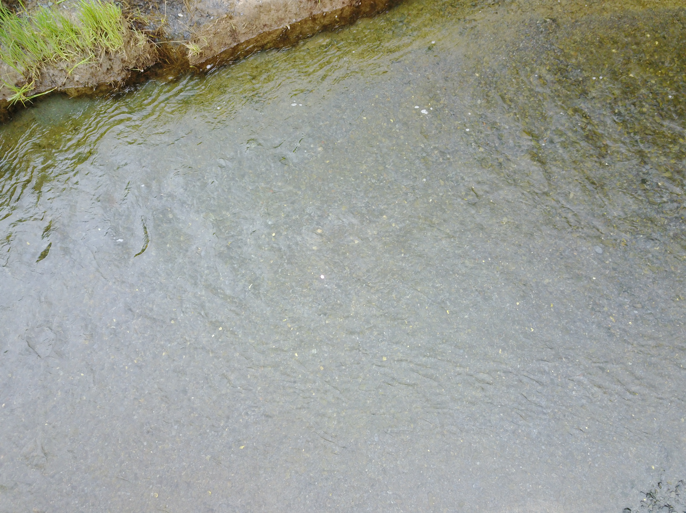
Lake tags
Notes:
So, we thought, could we see tags in the lake too? Could we ‘recapture’ them with the drone? Could we take it even further than just counts and get an actual estimate of abundance using a mark-recapture? If you look close you can see a tag the creek when we were testing this idea. It wasn’t exactly confidence building but enough for us to give it a try.

Slide 6
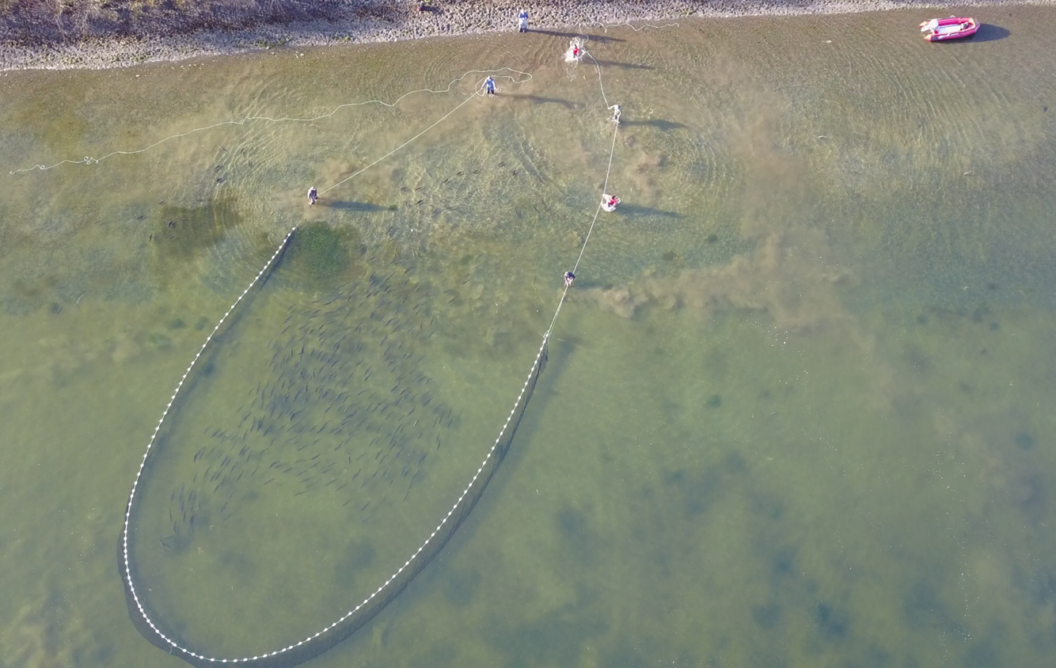
Fish visible in drone footage
Notes:
So, that fall, we tried it out as a pilot study. We discovered that we could also see fish really well in real time at the lake and could use the drone to direct our seining efforts. So, we began using the drone like a spotter pilot, with the drone operator directing the boat driver and the folks handling the seine.

Slide 7
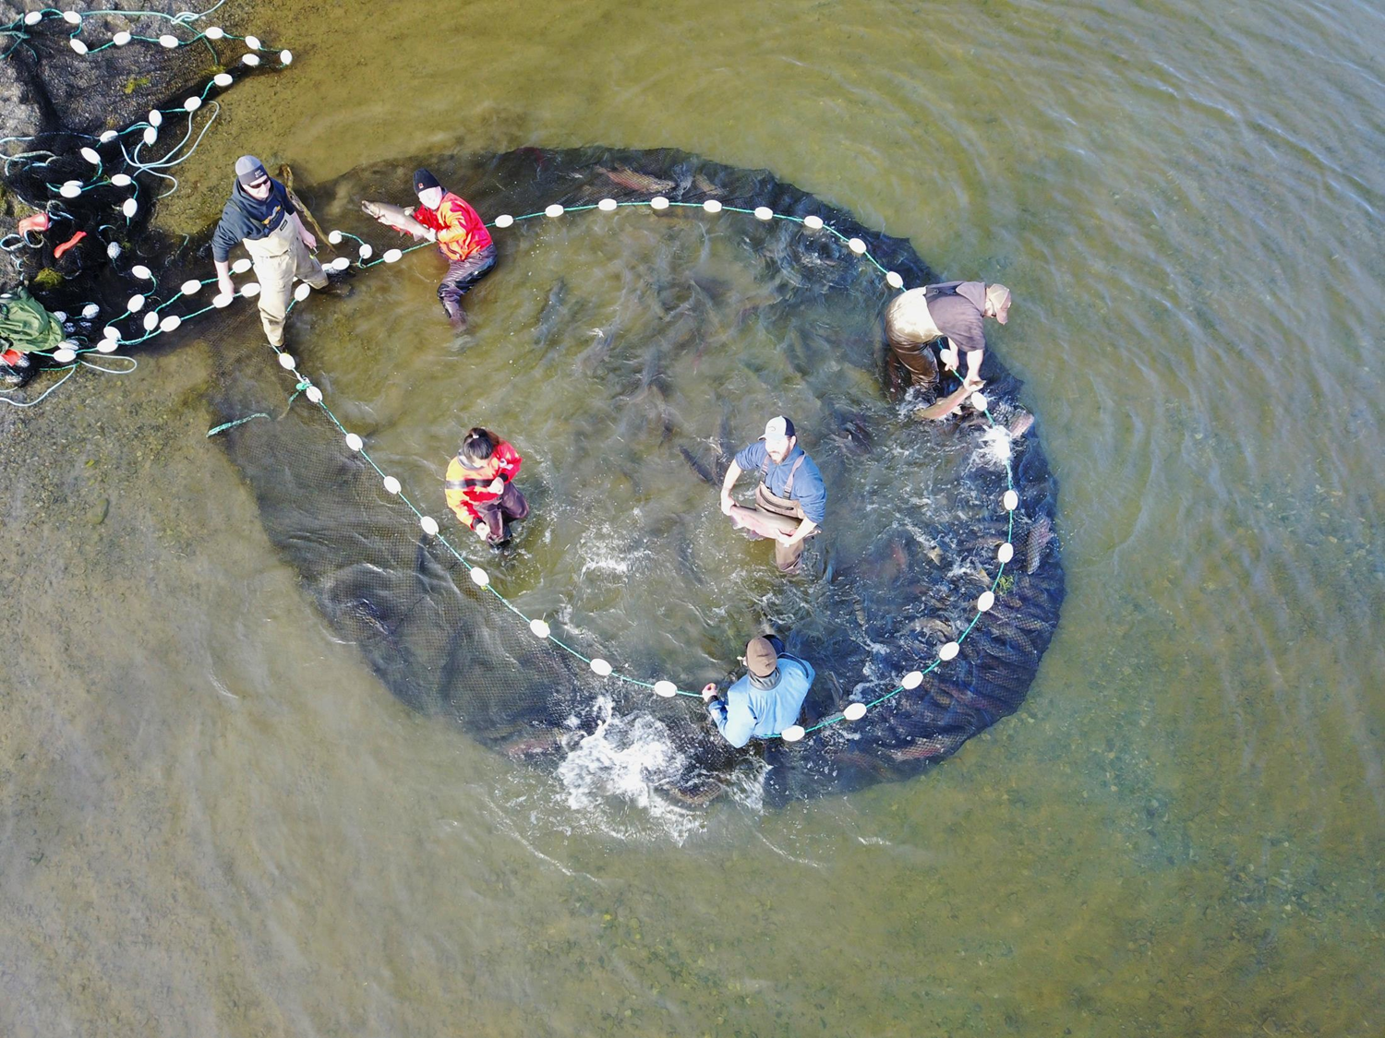
Net tagging
Notes:
It worked really well and we set to work tagging. This involved using needle nose pliers to force a stainless-steel pin through the fish to connect the disc tags together on the backs of the fish. It was tedious, but we were able to get our tagging goal done in a single day, much less than expected.

Slide 8
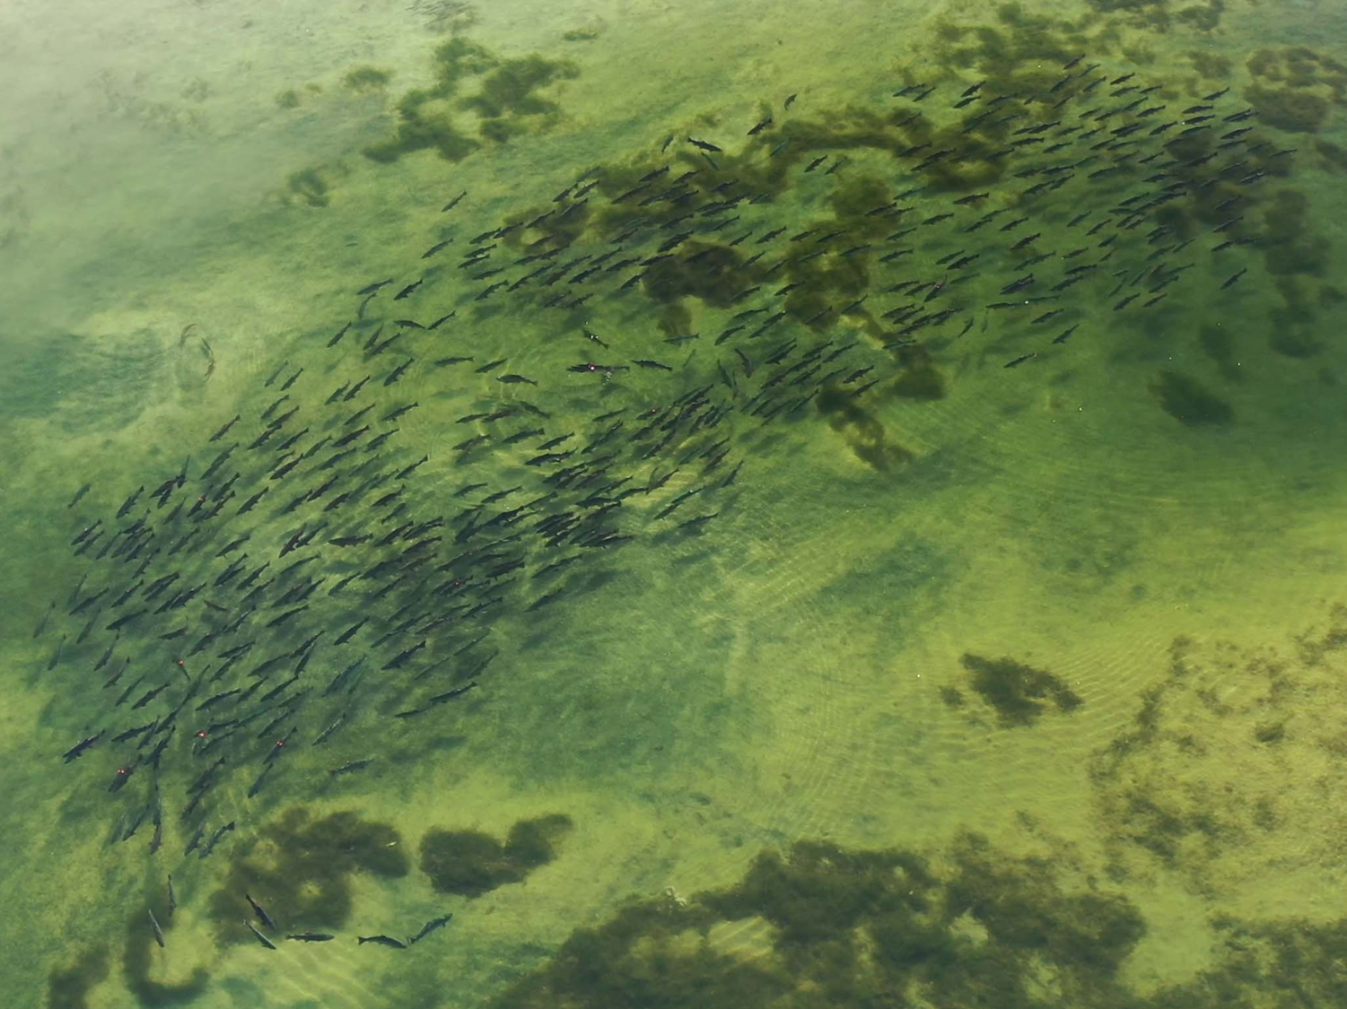
Image of fish visible through water
Notes:
A few days later, we found out we could see the tags from the air, and see what color they were, something we weren’t expecting. So we thought: if we had multiple colors we could also assess mixing and migration patterns of the fish in addition to an estimating abundance.

Slide 9
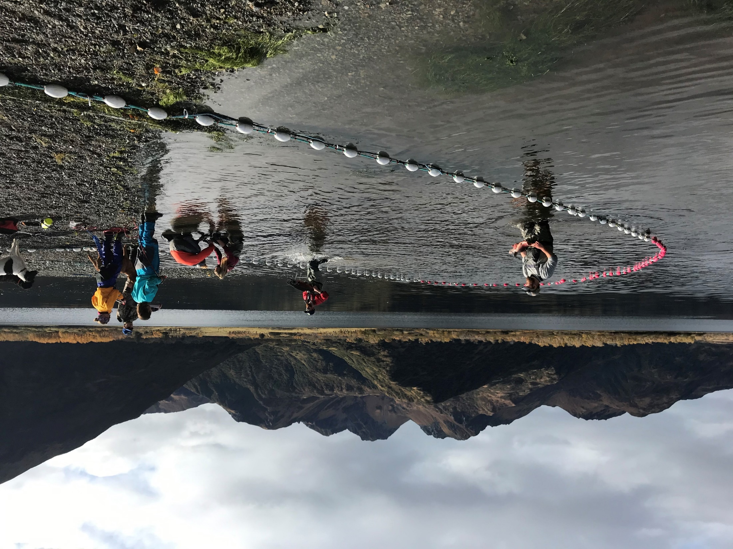
Fish tagging image from ground
Notes:
Now, I mentioned that tagging these fish was tedious. So, we joked ‘what if we had a drone mounted tagging gun?’ More realistically though, my co-worker, Mark, thought he could come up with something handheld that would speed the tagging process up as well as being much easier on the fish.

Slide 10
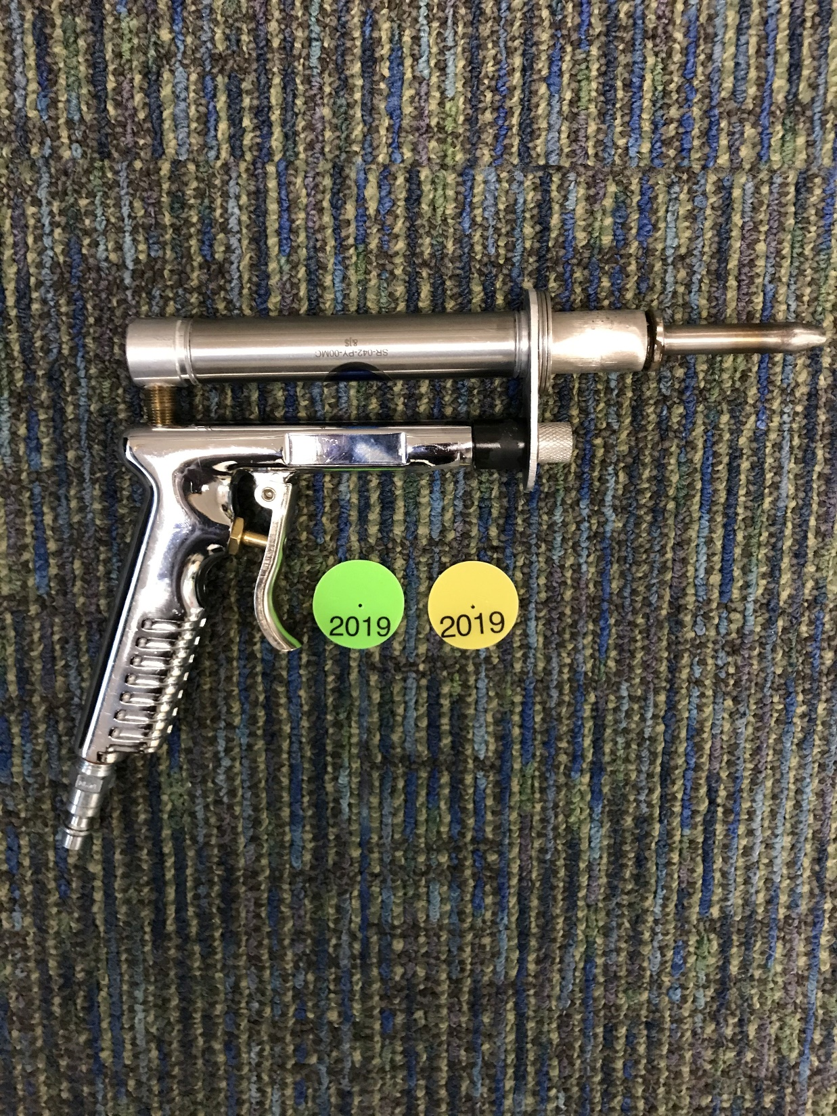
Tagging gun
Notes:
So he came up with this, a pneumatic tagging gun. Now, at this point it hits me that 10, or probably even 5 years ago, I never would have imagined using a real time, eye-in-the-sky fish spy camera and a metallic, alien looking tagging gun. As sci-fi as it looks though, it worked really well.

Slide 11
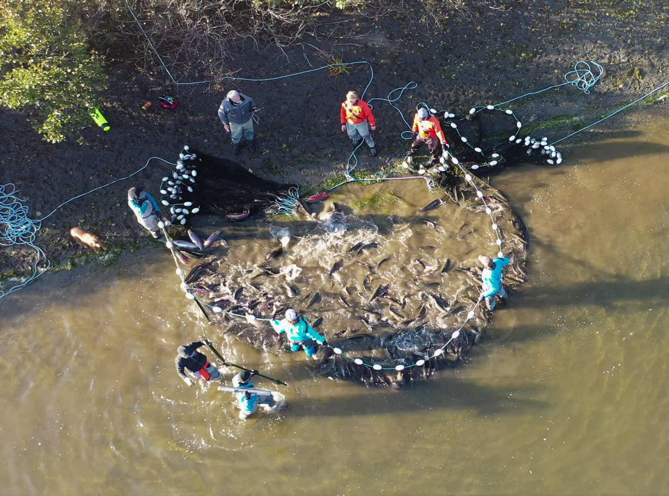
Arial image of fish net
Notes:
After some practice, we were able to tag 100 fish in about an hour. We were actually so fast at tagging that we had time to get a couple drone flights in. We found out that they mix pretty evenly with other schools almost immediately after tagging and disperse fairly randomly too.

Slide 12
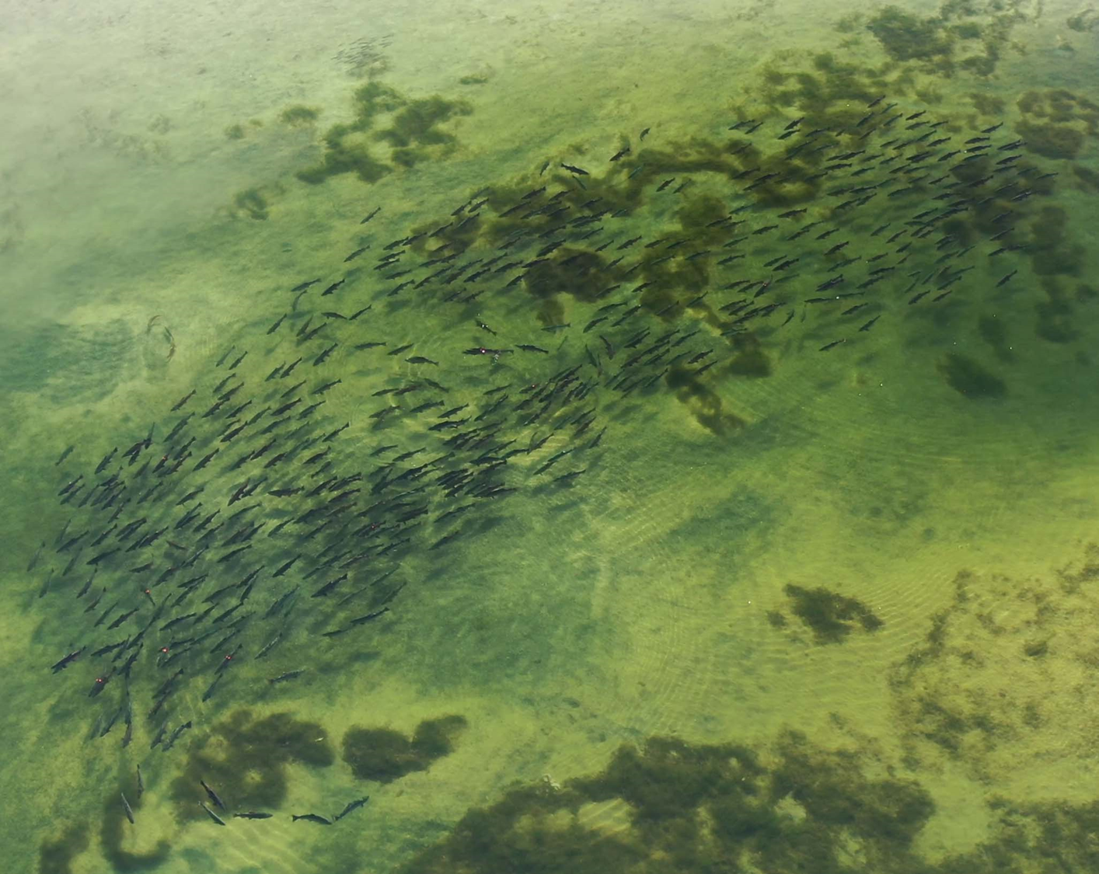
Fish 2
Notes:
Next, in going through the video, we tested how repeatable our counts were using multiple counters. And we found out counting a school with multiple layers of fish in the water column, distinguishing between injuries on fish and the tags and counting large schools was more difficult than we expected.

Slide 13
Fish marked on computer
Notes:
So, we marked the fish again on the computer. Most fish got a yellow mark, but the tagged fish were marked corresponding to the color of the tag they were given. And for the really big schools, the images get stitched in photoshop together using the shoreline and other lake features as reference points.

Slide 14
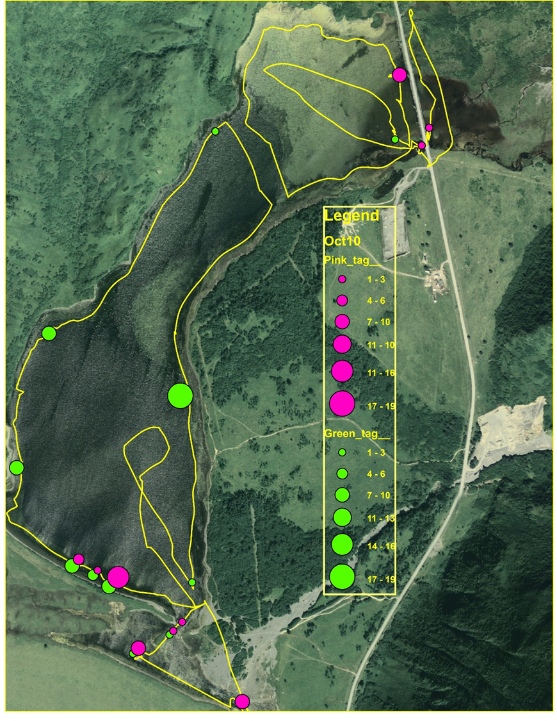
Map of tagging sites
Notes:
Next, we found out we could download the track of the flight path of the drone in 3D. This allowed us to assess the area of the lake covered by each flight, and we also discovered that if we vary the altitude over a school, we can mark schools of fish on the path as well as get clearer images of the school.

Slide 15
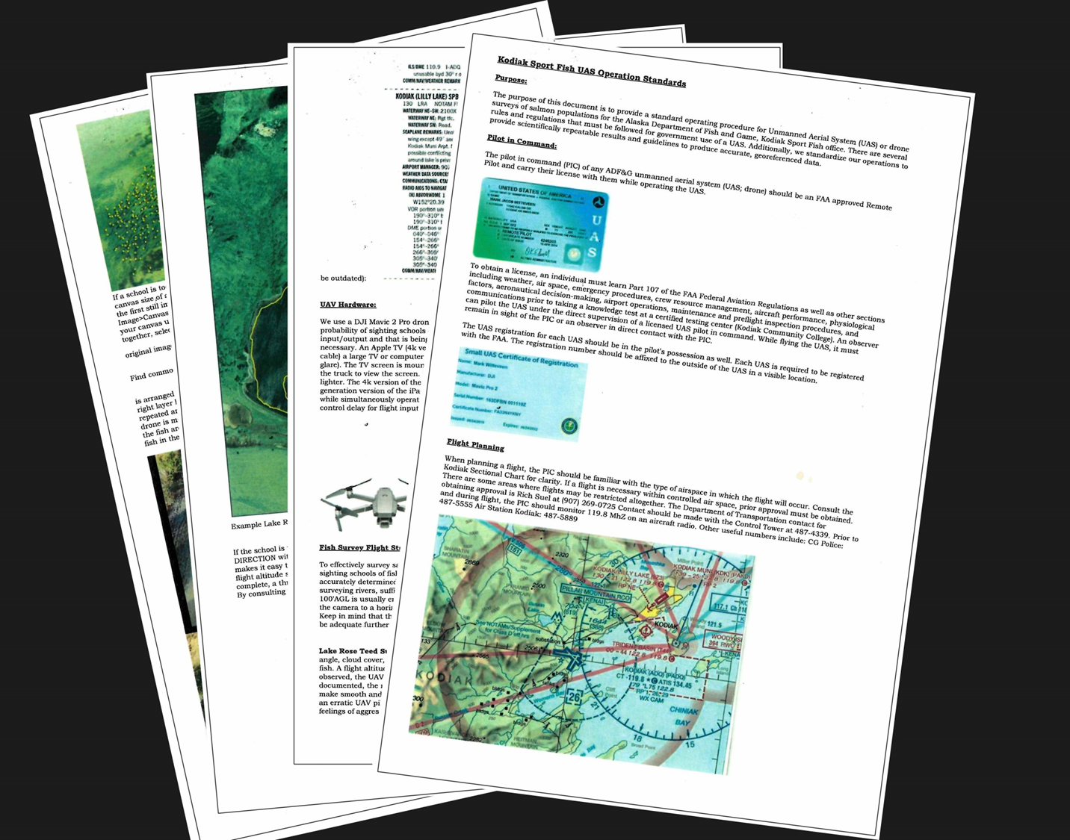
Best Practices
Notes:
Fortunately, our go-to drone pilot, Mark, took it upon himself to synthesize the information into a document that outlines not only the best practices we figured out, but also how to abide by FAA regulations.

Slide 16
Arial photo of lake
Notes:
After viewing quite a bit of footage of seining, we realized pretty quickly we were only catching a small piece of the coho schools we were after. So we tried something new, we brought out a couple of energetic, water-loving dogs and gathered up a couple piles of sticks.
You should be able to see a video of this playing now. I’ll include a link to another video of this in the chat. It works pretty well, but keeping the dogs entertained the rest of the day is another story. Our catch rates did go up considerably. So now we’ve got drones, dogs, pneumatic tagging guns, terabytes of video footage. We had a new problem: keeping all of the fish we were catching in the net so we could tag them.

Slide 17
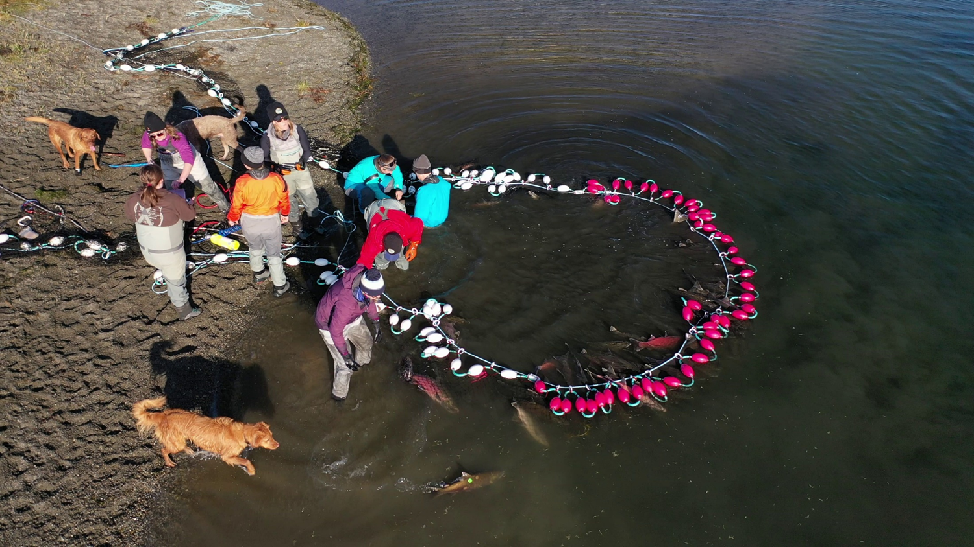
Crew at cork line of net
Notes:
So we put a purse line on the cork line of the net. It works really well and even has locking line holders so it doesn’t need anyone to hold it after its pursed. It keeps the fish corralled in the net and in the water with a minimal number of people needed to manage them while they are tagged.

Slide 18
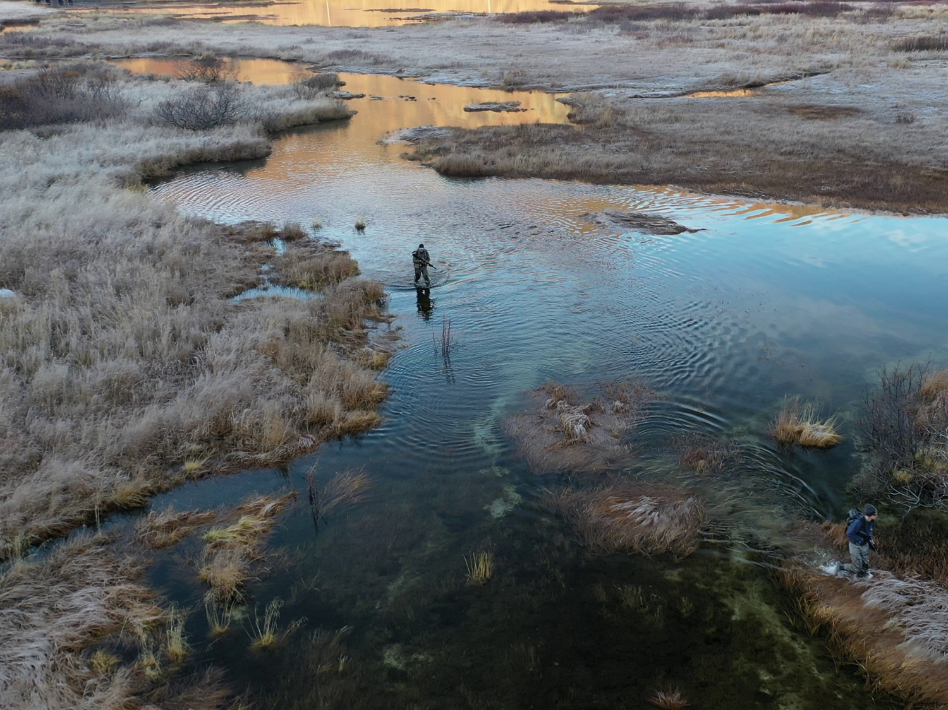
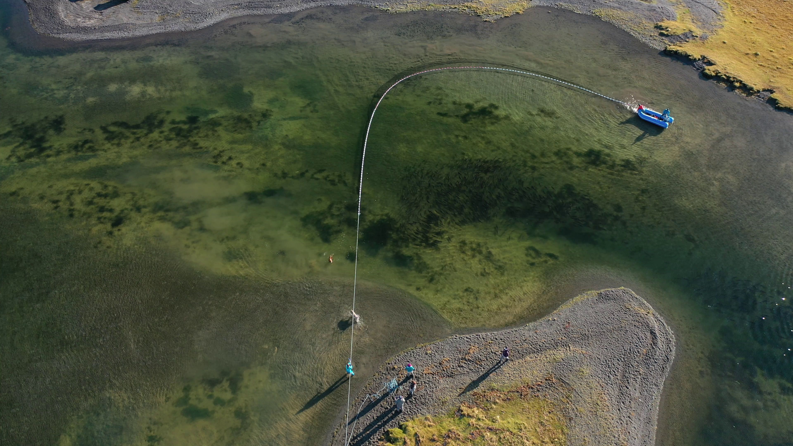
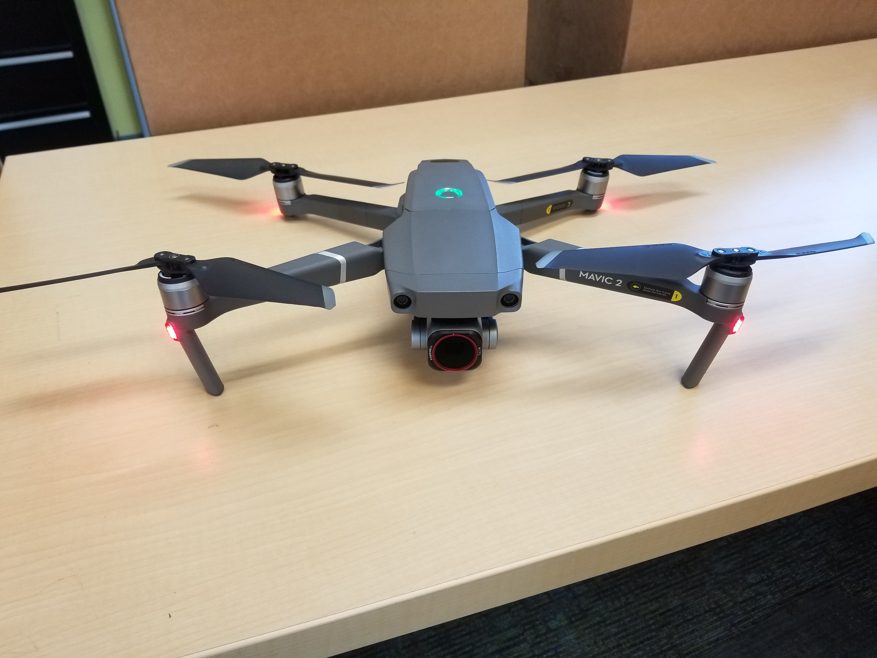
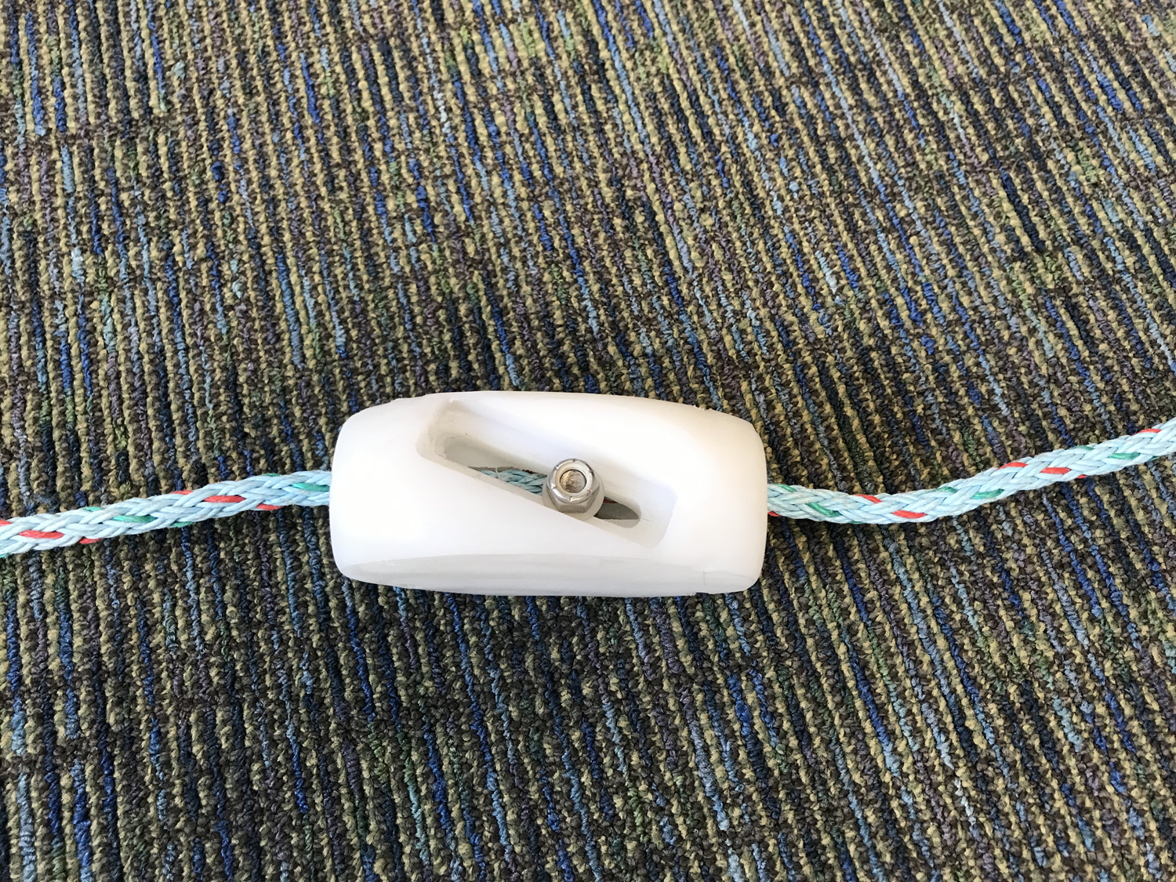
Equipment
Notes:
We’ve got several other ideas in the works right now but the drone and other developments have allowed us to create a low-cost, repeatable estimate of coho salmon abundance and the project has ended up being a proving-ground of sorts for ideas and techniques that we’ve been able to leverage in our other projects. And I can’t end with out thanking Mark Witteveen and Kelly Krueger, who have done the majority of the leg work in developing this project.

