Slide 1
DJ Fisheries Research in Idaho:
Lessons Learned from Hatchery Trout Evaluations
Phil Branigan
Fisheries Research Biologist
Idaho Department of Fish & Game
phil.branigan@idfg.idaho.gov

Slide 2
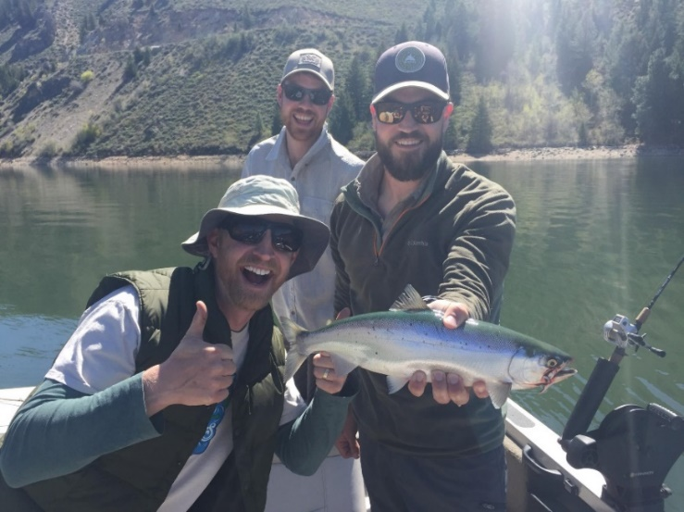
Structure—DJ Research Program
One Principal Research Biologist (program oversight)
Three Research Biologists (specific projects)
  Lakes and Reservoirs
  Wild Trout
  Hatchery Trout
Overall goal: make fishing better
Specific evaluations determined democratically
  Over 60 fisheries professionals propose & vote

Slide 3
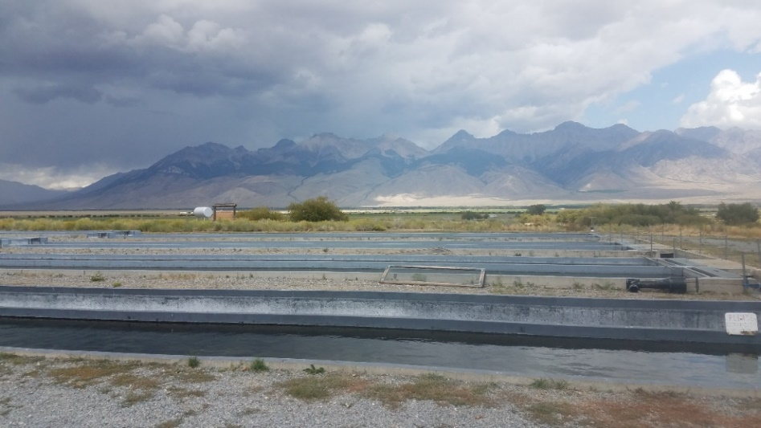
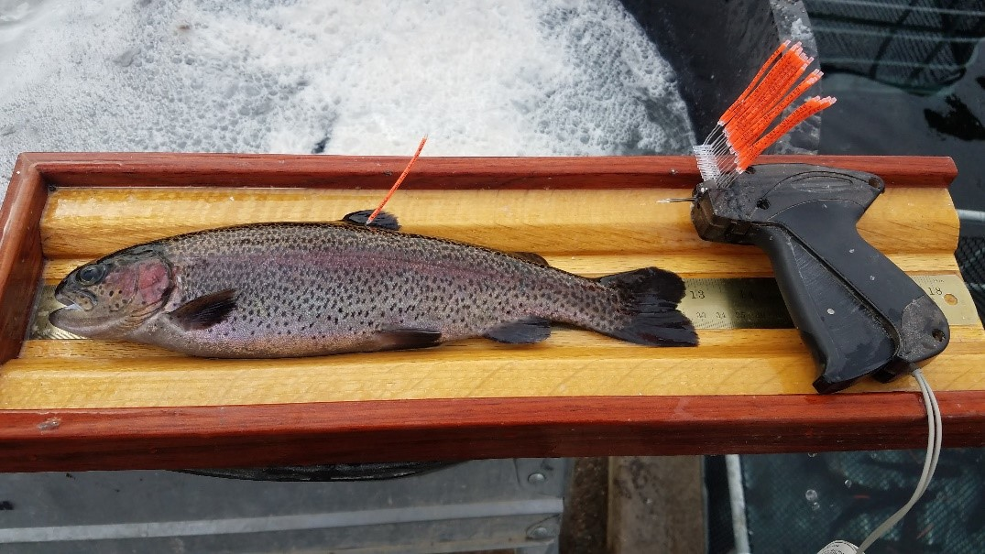
Hatchery Trout Evaluations: Past and Present
General conclusions—
  Low survival with fingerling releases
  Variable performance with strain
  Triploidy works; utility in many populations
  Fish tagging studies are very valuable…

Slide 4
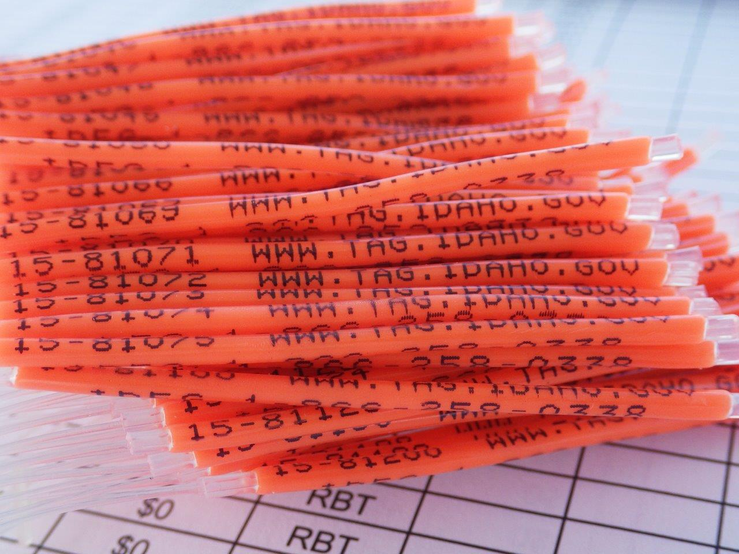
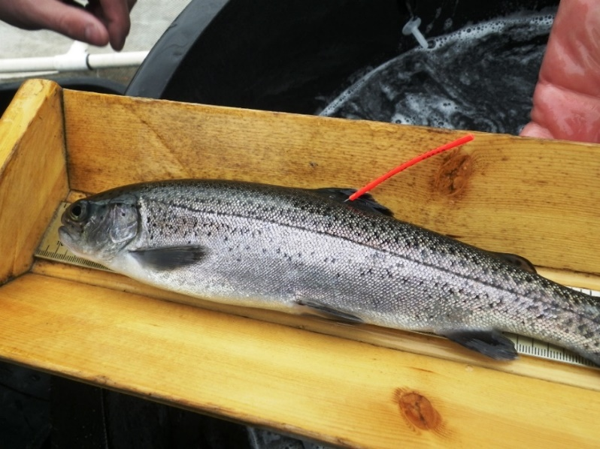
Tag! You’re It! (est. 2006)
Conduct experiments in-hatchery
  Treatment/control design (production scale)
  Rearing density, raceway baffles, etc.
Conduct surveys post-release (i.e., tag reports)
  > 350k tags released
  > 41k tags reported

Slide 5
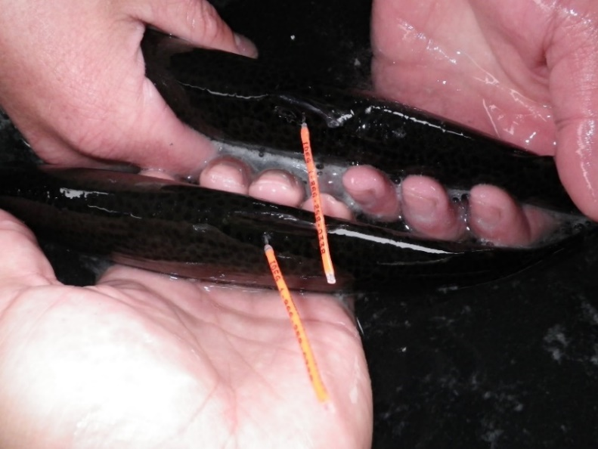
  Do larger catchables return-to-creel better than smaller catchables?
    Static budget & rearing space = fewer trout produced
    Tag loss? Reporting rate?
    Costs? Benefits?

Slide 6
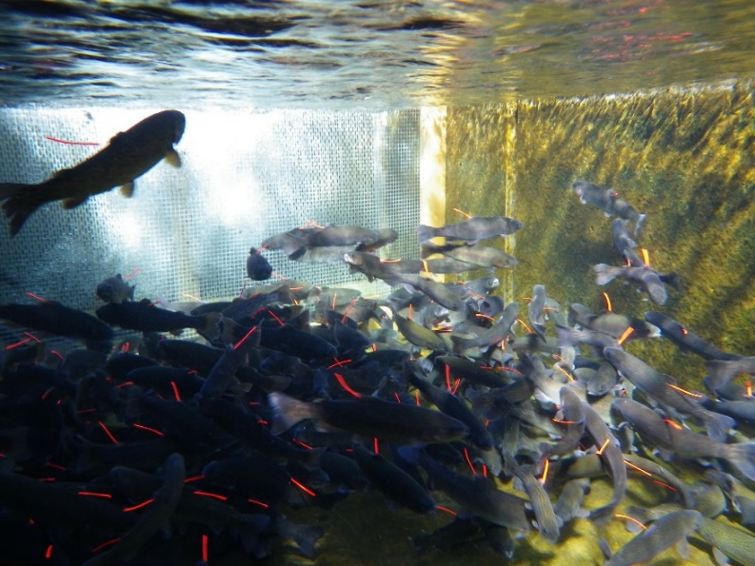
Catchable Size-at-Release: Methods
Randomized controlled design
  ‘Standards’: 10”
  ‘Magnums’: 12”
  Equal biomass
  Feed costs tracked
2 hatcheries, 3 years
Equal numbers stocked
  29 Lakes
  19 Rivers
Tag! You’re It!
  >21,000 tags released
  At-liberty 2 years

Slide 7
Release and Return

Slide 8
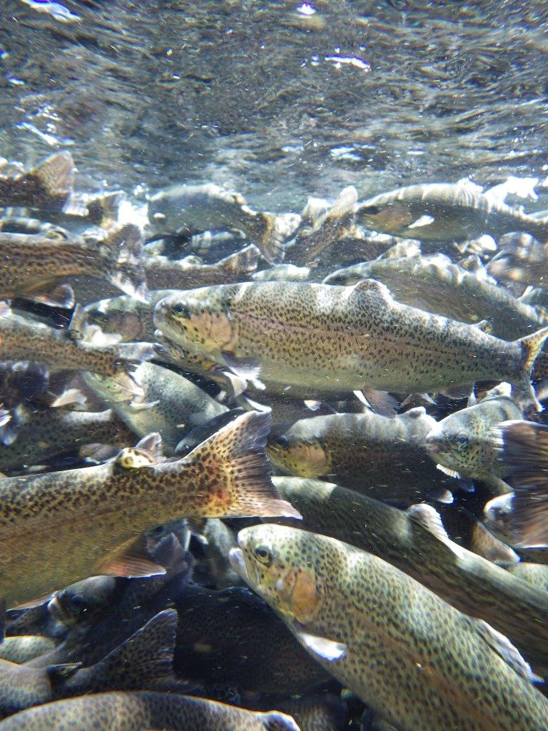
Catchable Size-at-Release: Results
No difference RR or TL
Feed costs: + 47%
  Standards: $0.30/fish
  Magnums: $0.44/fish
Angler catch rate: + 103%
  Standards: 13.7%
  Magnums: 27.8%
What about individual length?
  Disregard categorical “raceway” effect

Slide 9
10”
12”

Slide 10
Probability of Return
10”
12”
Total length (inches)

Slide 11
What about feed costs?
13.7%
27.8%

Slide 12
Percentage return
±$0.62

Slide 13

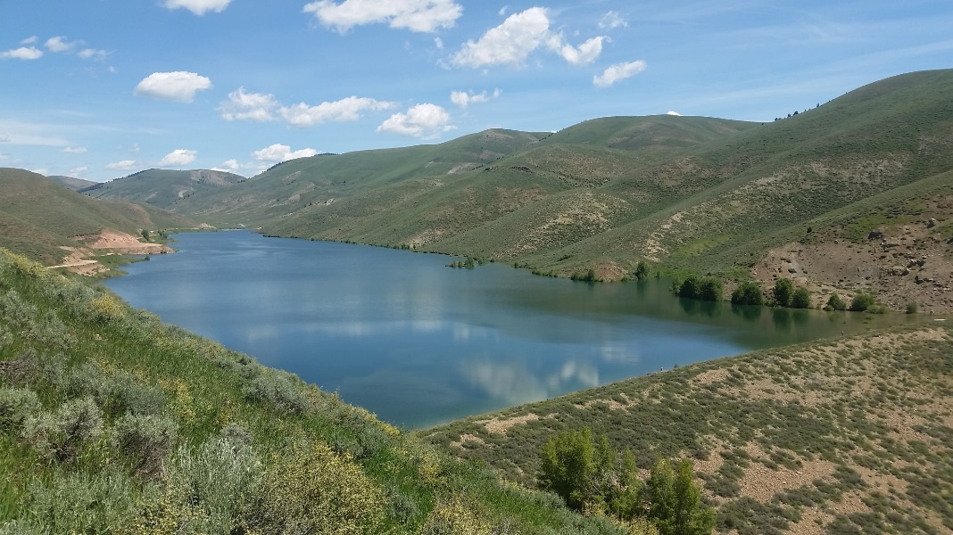
Summary: Catchable Size-at-Release
Larger catchables return at higher rates
Rearing container is irrelevant
  12” fish = 12” fish = 12” fish
Returns higher in lakes than in streams
Economically sound to stock magnums

Slide 14


phil.branigan@idfg.idaho.gov

Slide 15
2019 DJ Prioritization Results
42 questions proposed
  >50% votes allocated to top 7 questions
Top questions:
  Can we improve RBT broodstock strain as measured through in-hatchery and post-release performance of progeny? (9% total vote)
  Do fingerlings outperform catchables in large waterbodies? (8% total vote)
  How have recruitment patterns and growth patterns of black basses changed through time? (7% total vote)

Slide 16
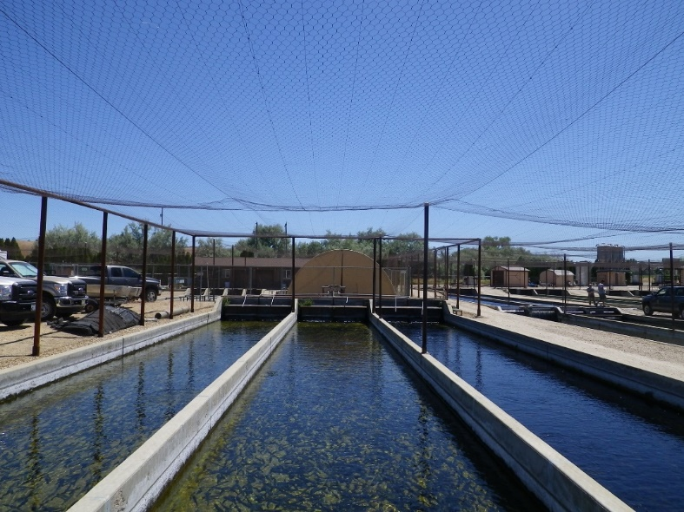
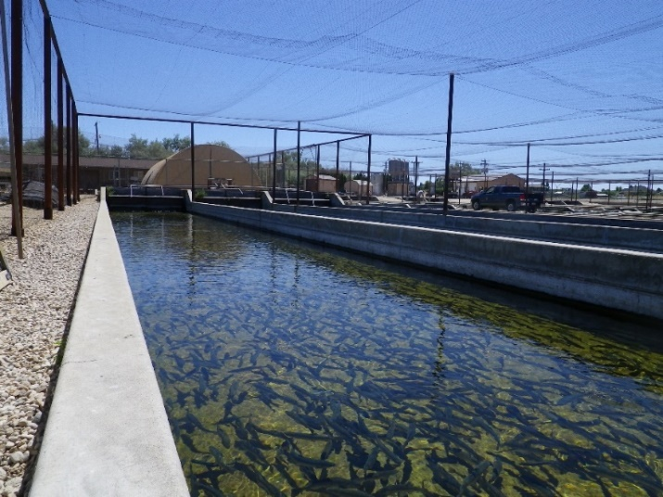
Hatchery Trout Evaluations
1990s: Fingerlings vs catchables; domestic strain
2000s: Triploid induction, fish tagging (dev. years)
2010s: Triploid trout and kokanee, Tag! You’re It!
2020s: Tag! You’re It!; broodstock improvement, catchable size-at-release

