Slide 1
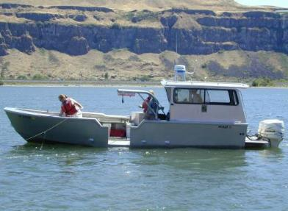
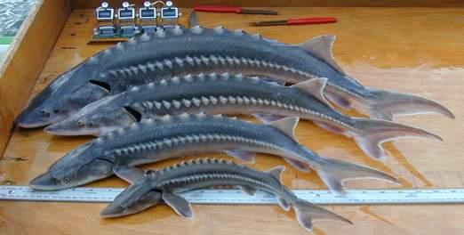


White Sturgeon Population Assessment in the Lower Columbia River
Philip C. Simpson, Project Leader
Oregon Department of Fish and Wildlife
March 31, 2021
Wildlife and Sport Fish Restoration Conference

Slide 2
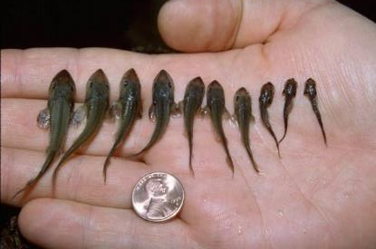
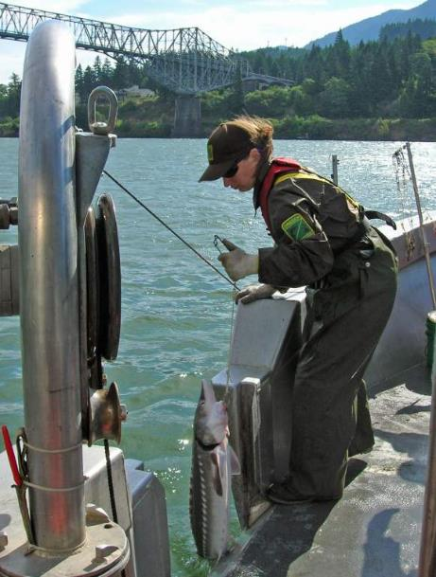
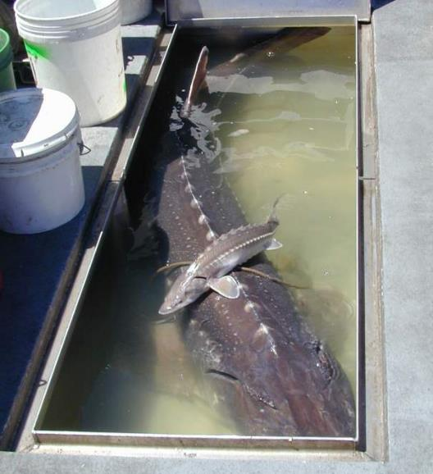
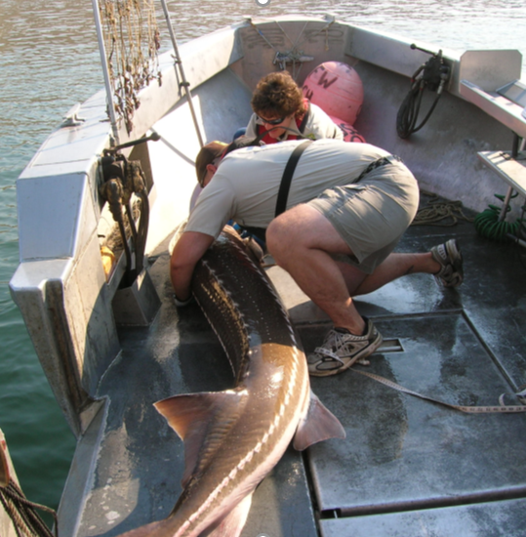
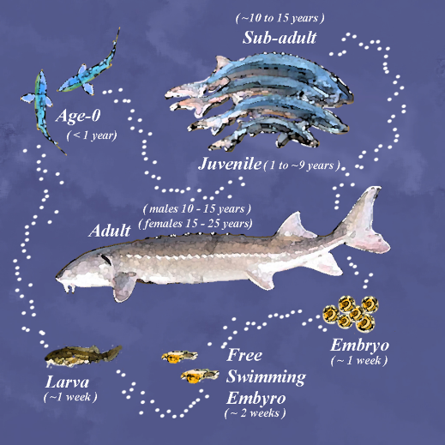
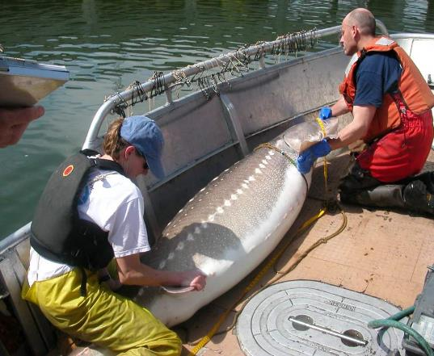
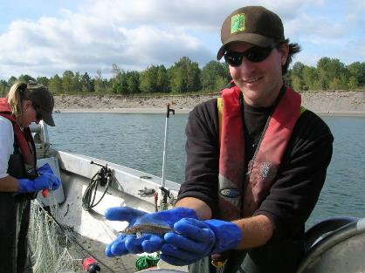
Columbia River White Sturgeon
Anadromous
Freshwater spawners
  Male = age 10 – 15
  Female = 15 – 25
  Broadcast spawners
  Intermittent spawning
2-4 years before entering marine environment
Sub-adults: seasonal migrations
  Relatively slow growth

Slide 3
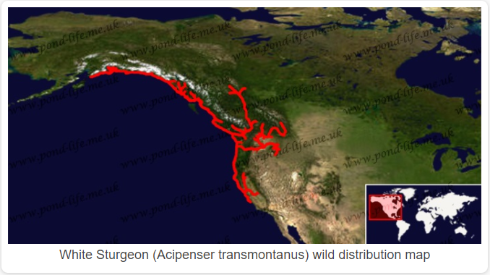
White Sturgeon Range
www.pond-life.me.uk

Slide 4
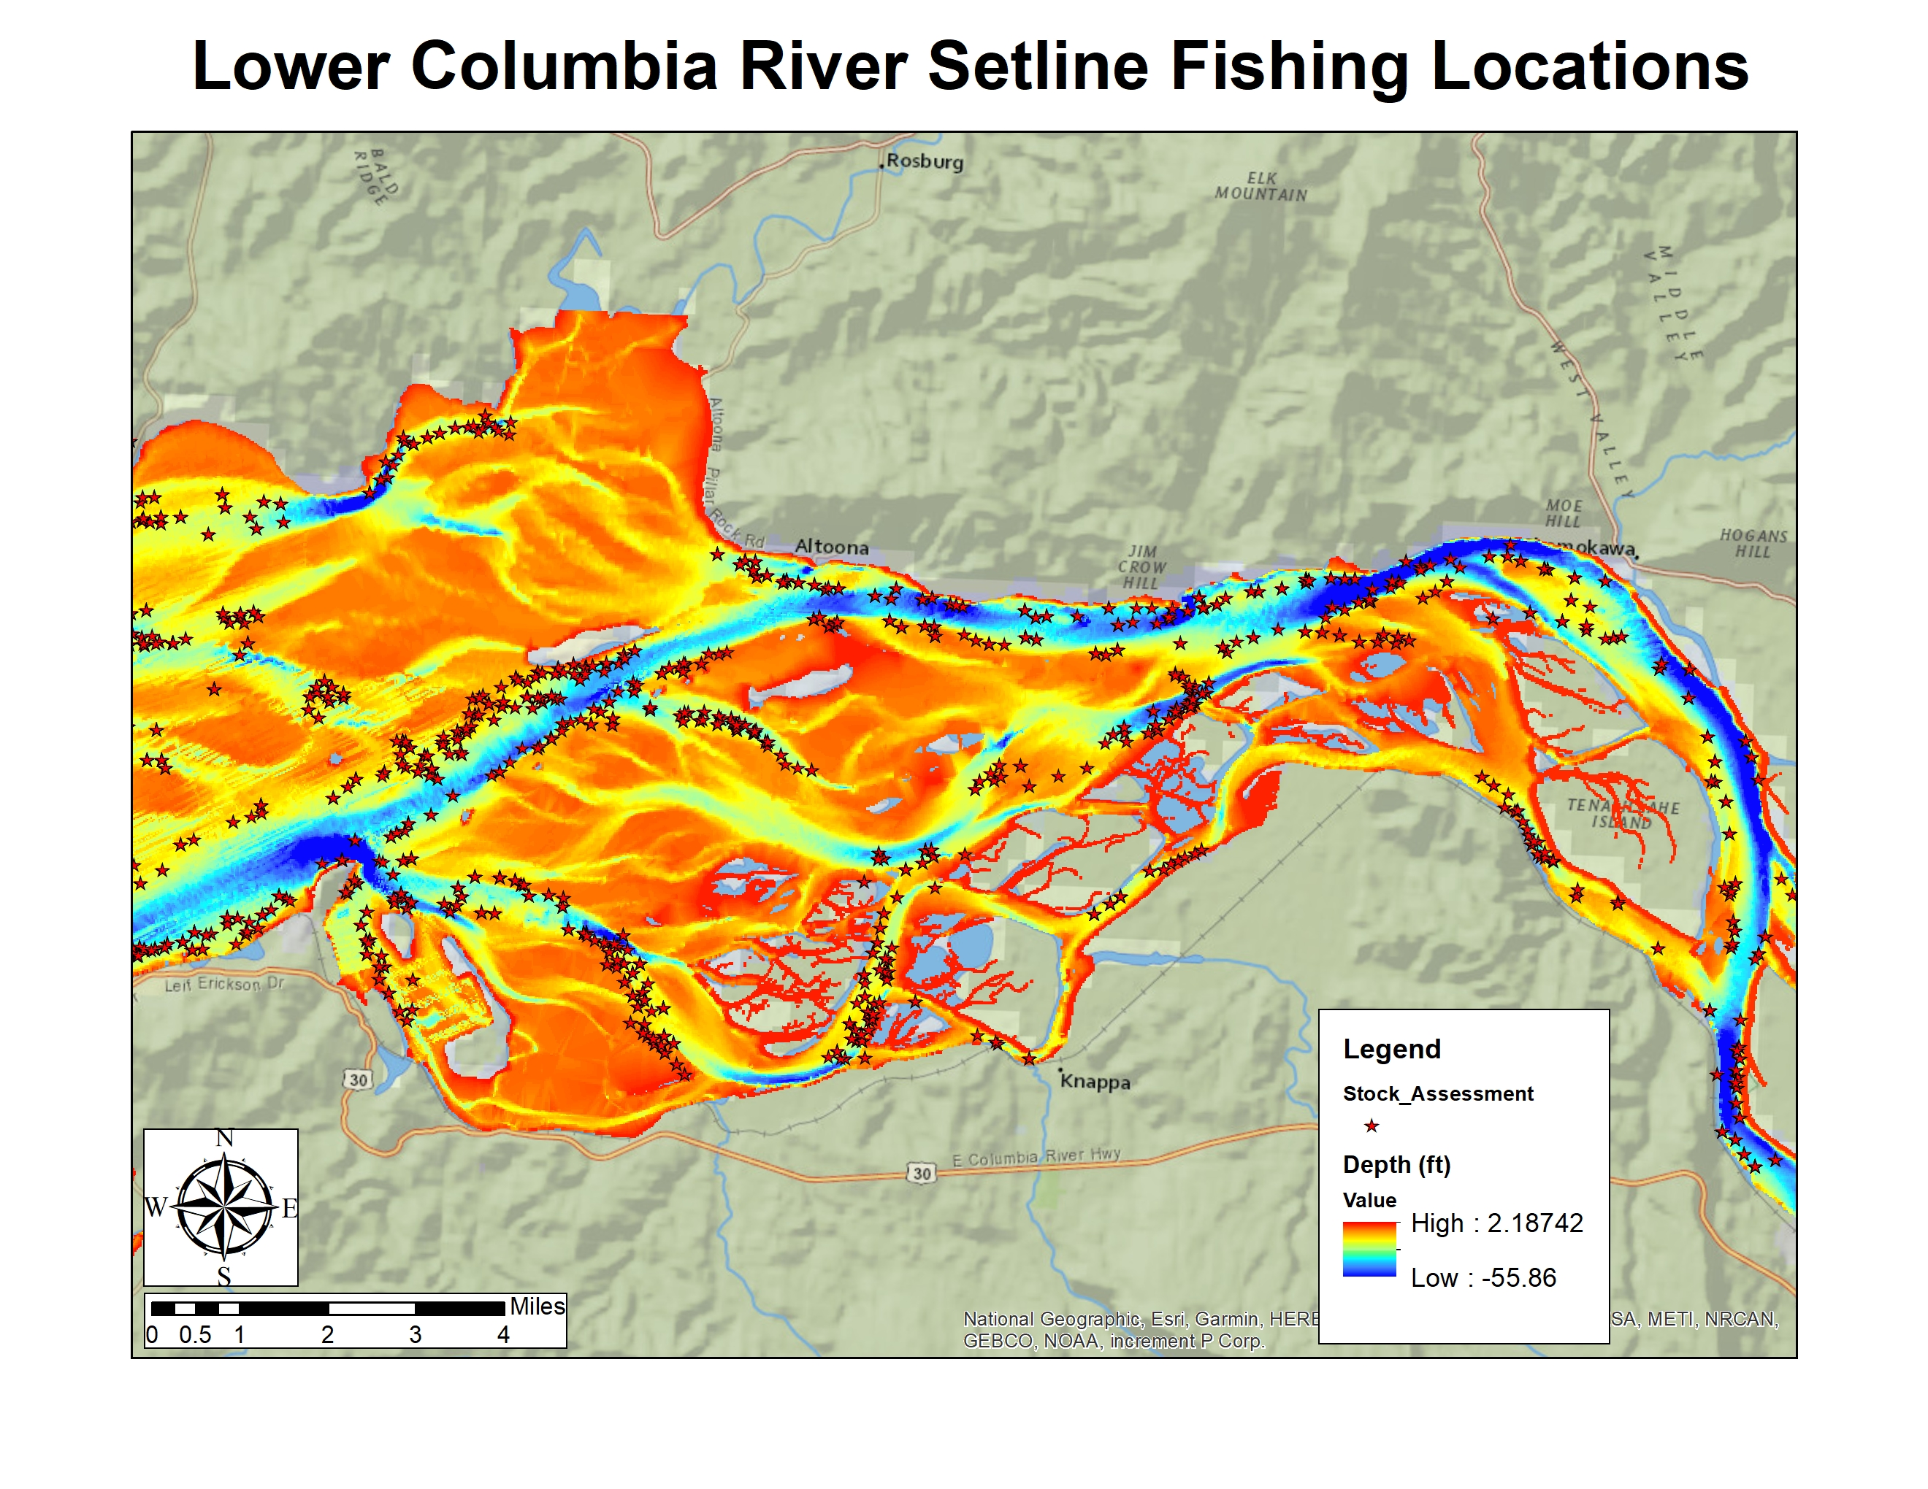
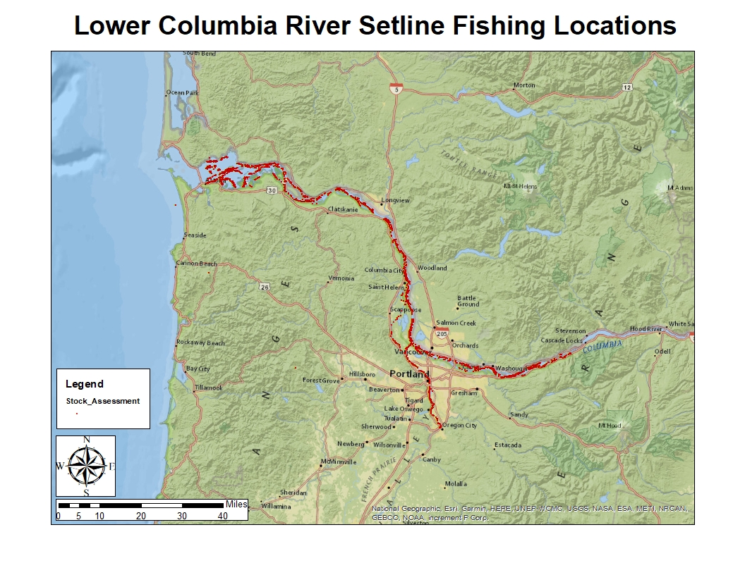
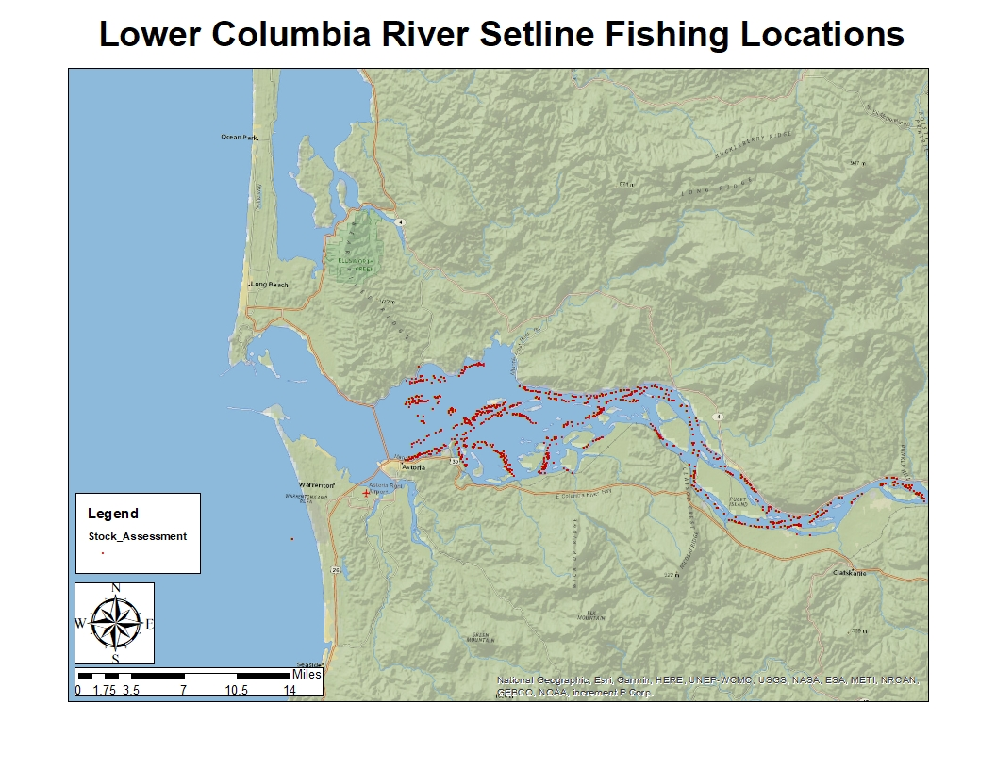
Lower Columbia Rover Setline Fishing Locations

Slide 5
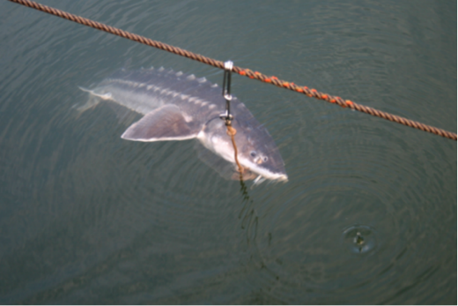
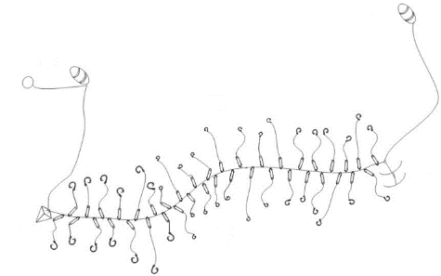
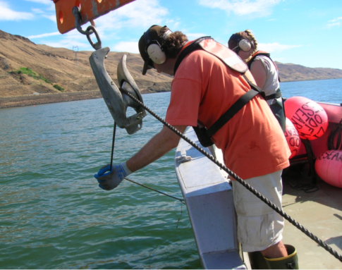
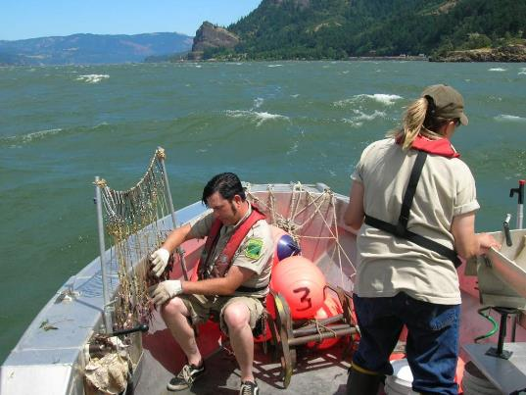
M-R Setline Sampling
40 baited hooks of varying sizes over 600’ setline
Retrieved after ~24 hrs

Slide 6
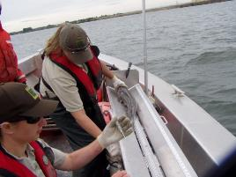
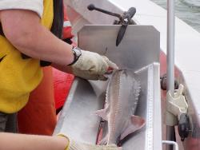
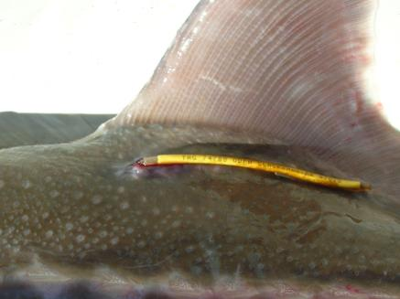
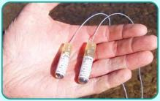
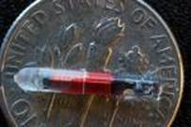
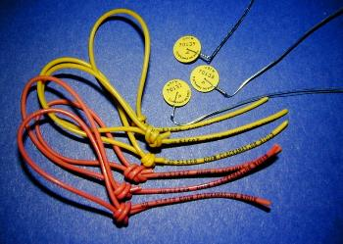
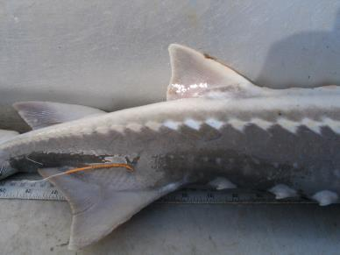
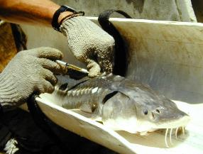
Sturgeon markings
Notes:
Sturgeon captured over the years were marked with different combinations of tattoos, barbel clips, oxytetracycline injections (which left a bone mark for ageing verification), scute removal patterns to signify the year handled, spaghetti tags, anchor tags, radio tags, acoustic tags, and PIT tags. Over the years we applied a little over 10,000 external tags and a little over 81,000 PIT tags.
We no longer use only external tags and mark fish almost exclusively with PIT tags because unlike external tags, they can last the lifetime of the fish which is often decades.

Slide 7
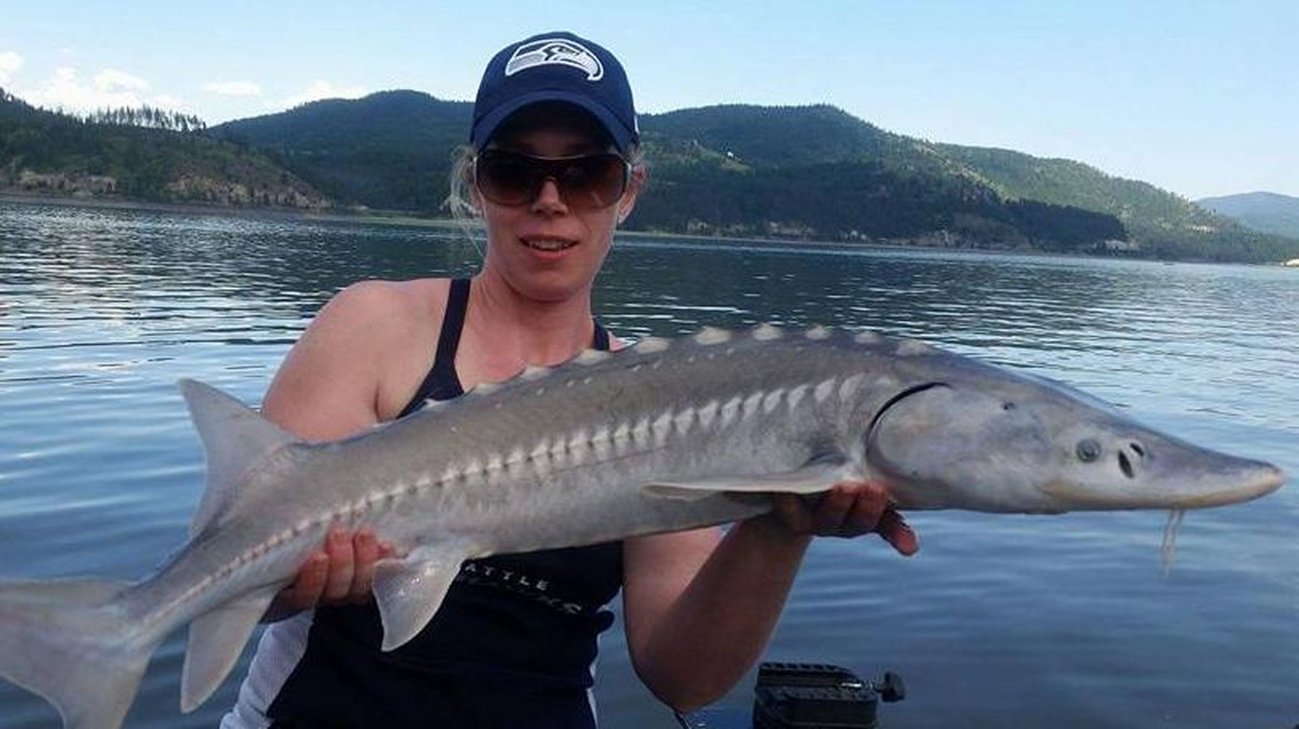



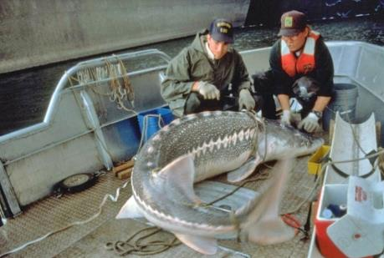


Management Implications
Commercial Harvest
CRITFC/CRM: Initial mark via gillnet
Natural Mortality
Harvest Regulations
Sport Harvest
Abundance Estimate
Projected Abundance
ODFW/WDFW
Long line sampling/ mark recapture
Spawning
Natural
Recruitment
Growth Rates
Escapement to broodstock

