Slide 1
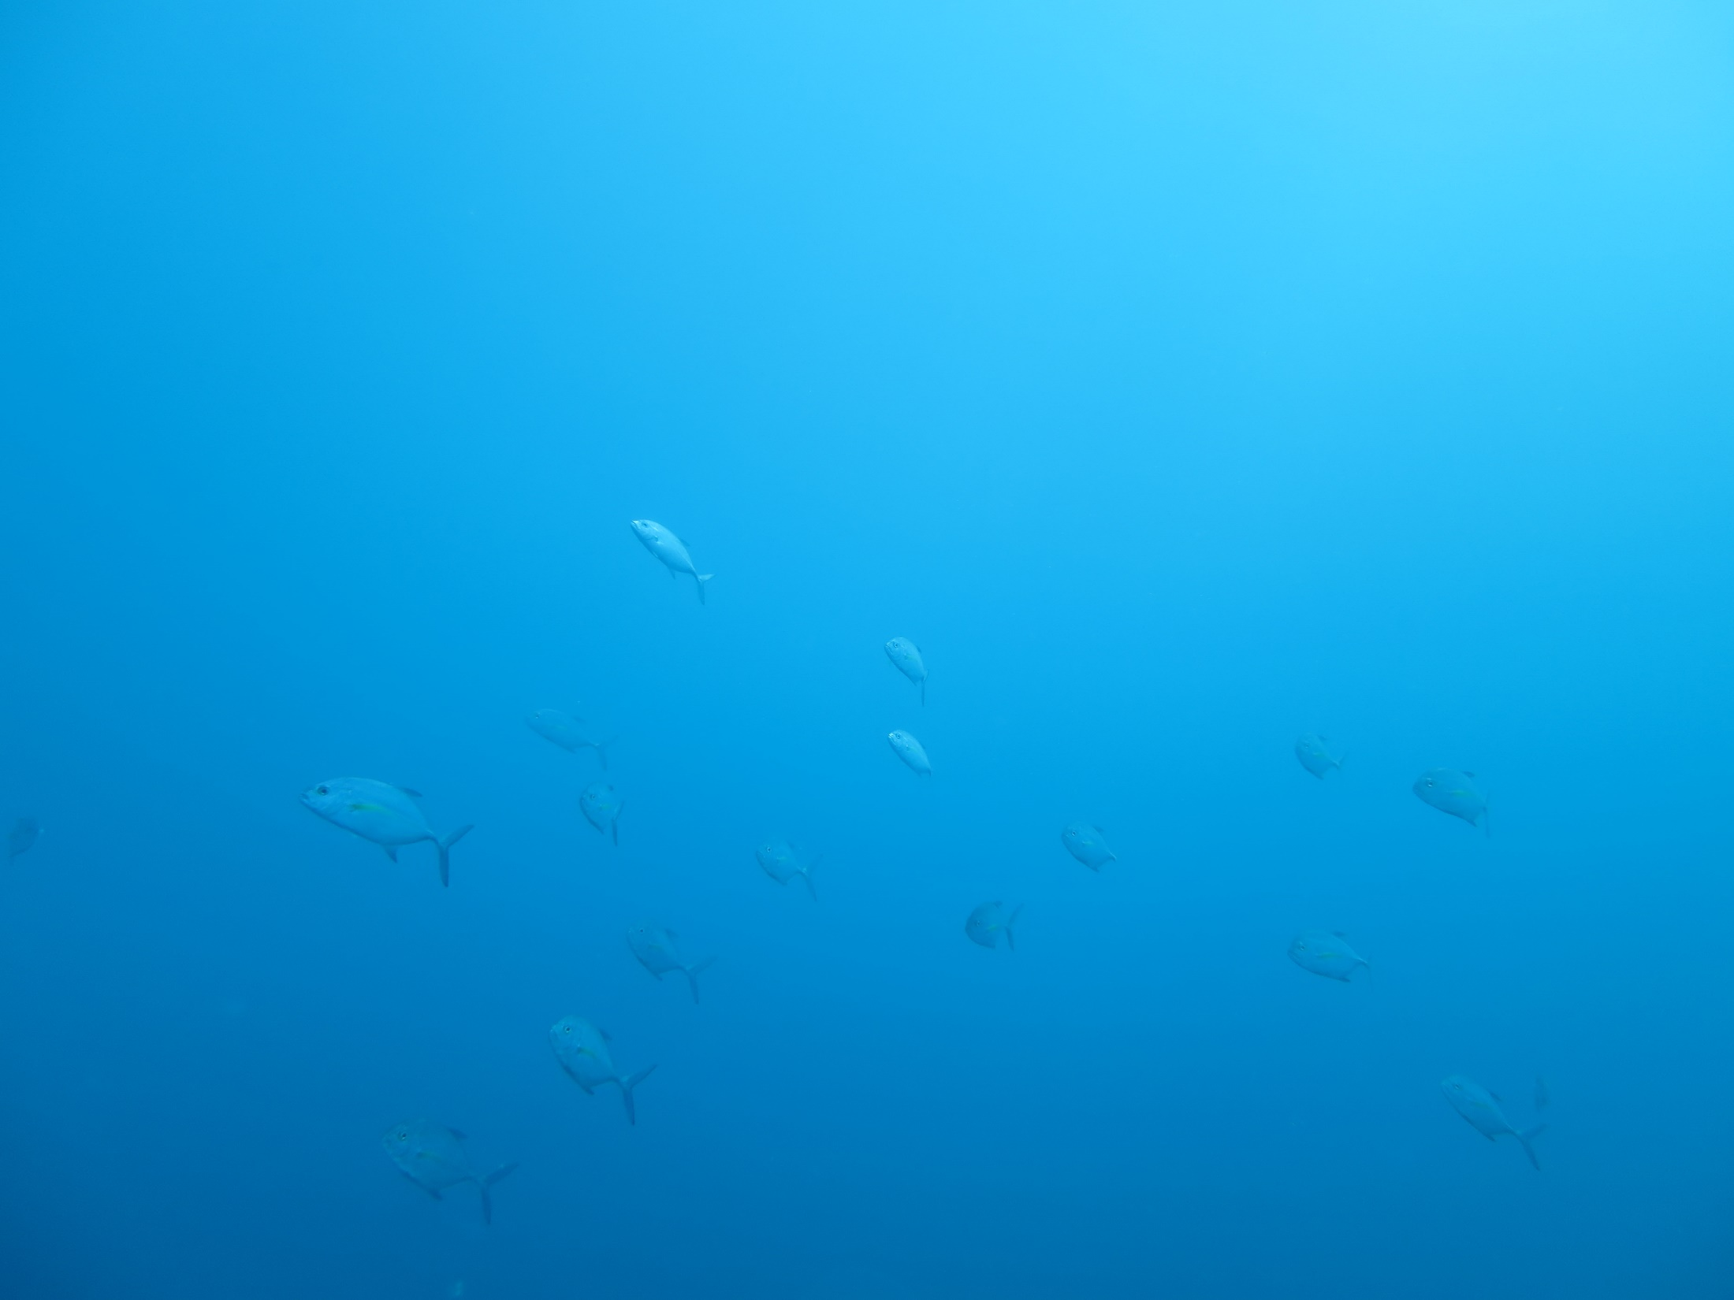
Applying an emerging tool to monitor juvenile sport fishes in Hawaii
Kim Peyton, Troy Shimoda, Troy Sakihara, Tim Shindo,
Skippy Hau, Jody Kimmel, Laura Gajdzik
State of Hawaii
Department of Land and Natural Resources
Division of Aquatic Resources

Slide 2
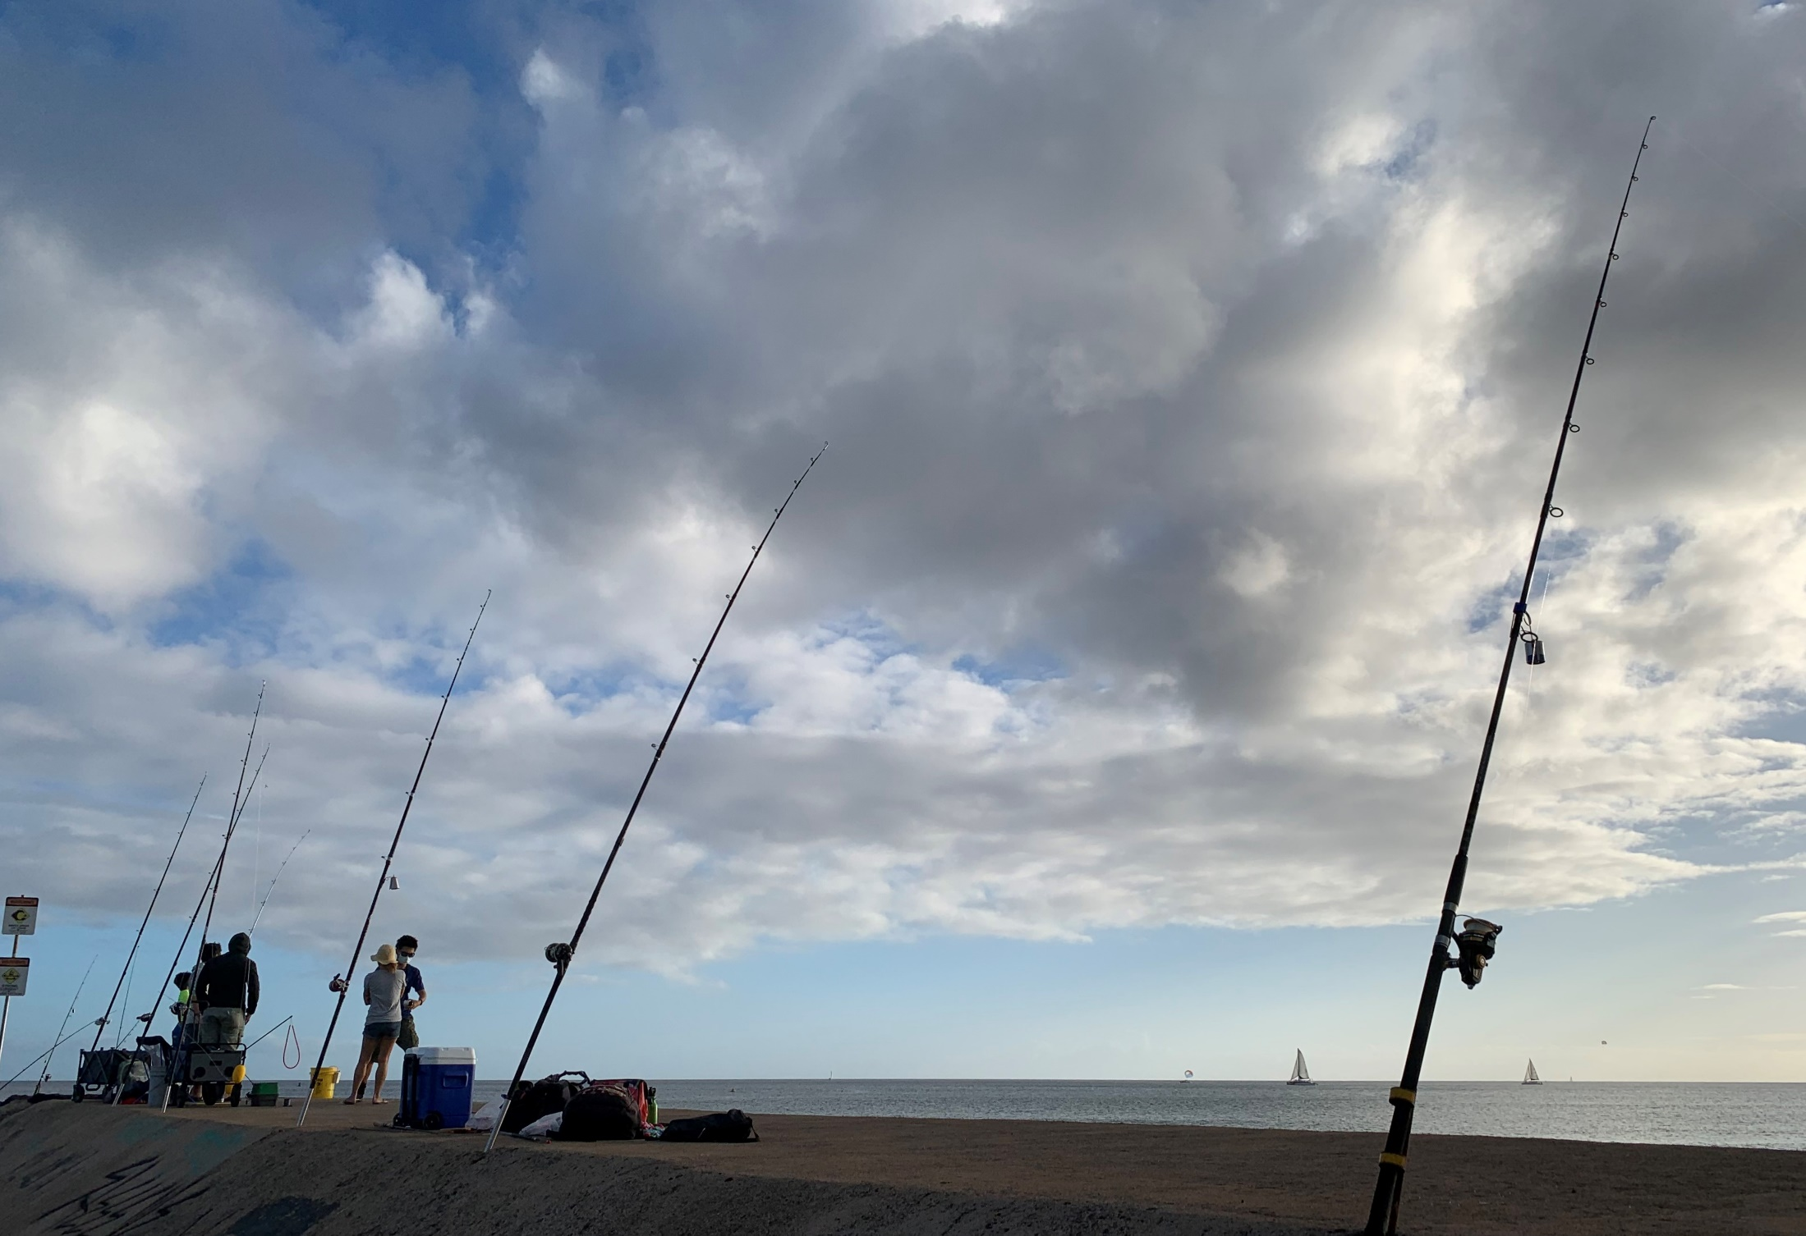
Healthy estuaries support sustainable fishing.

Slide 3
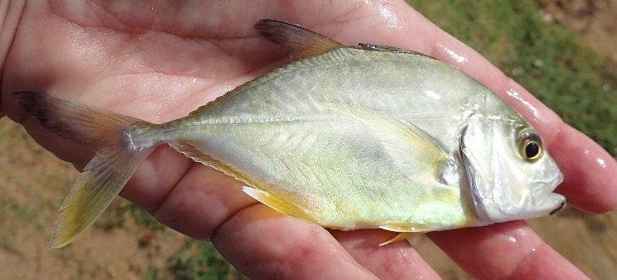
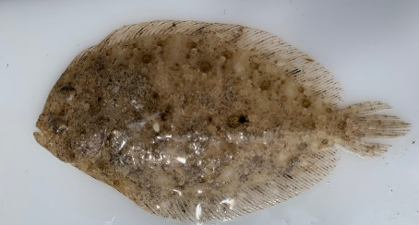
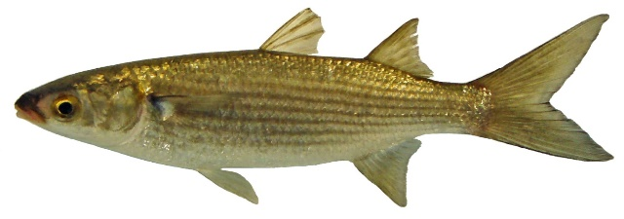
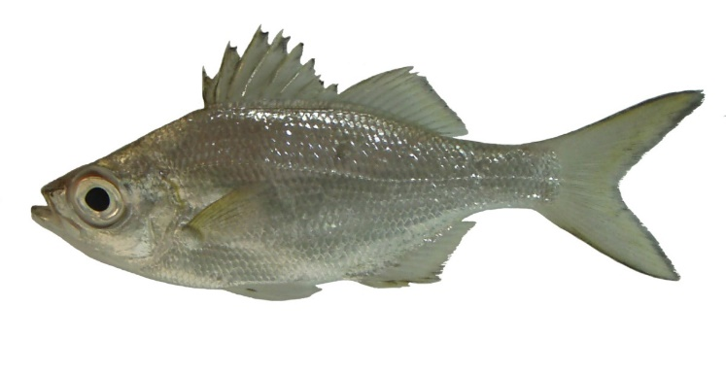
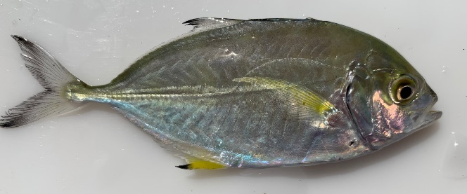
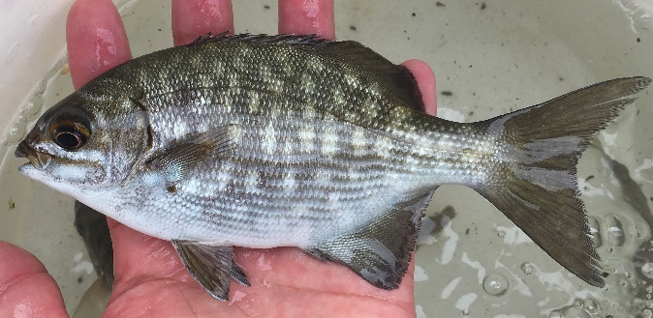
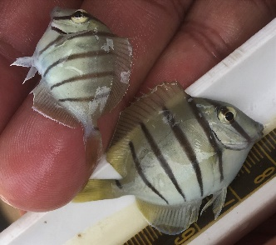
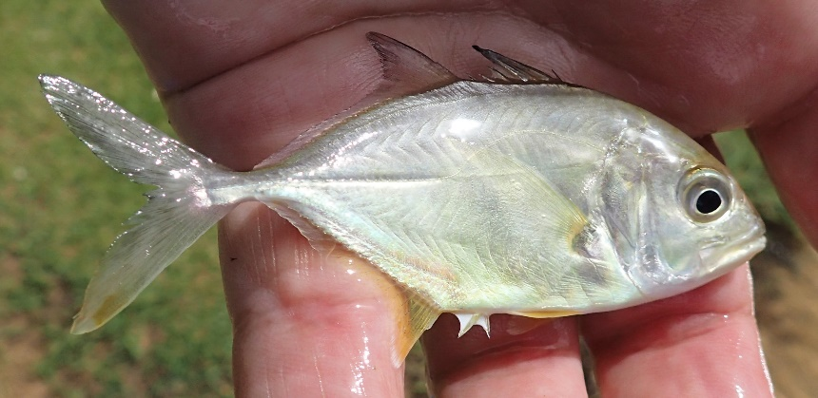
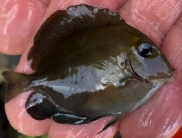
Healthy estuaries support sustainable fishing

Slide 4
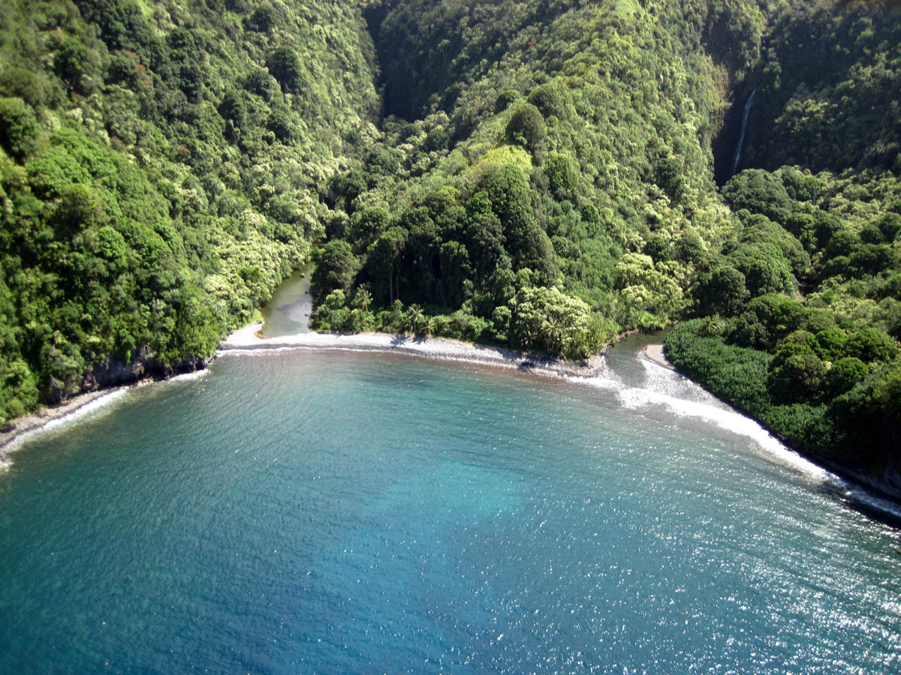
Estuary Photo
Notes:
)

Slide 5
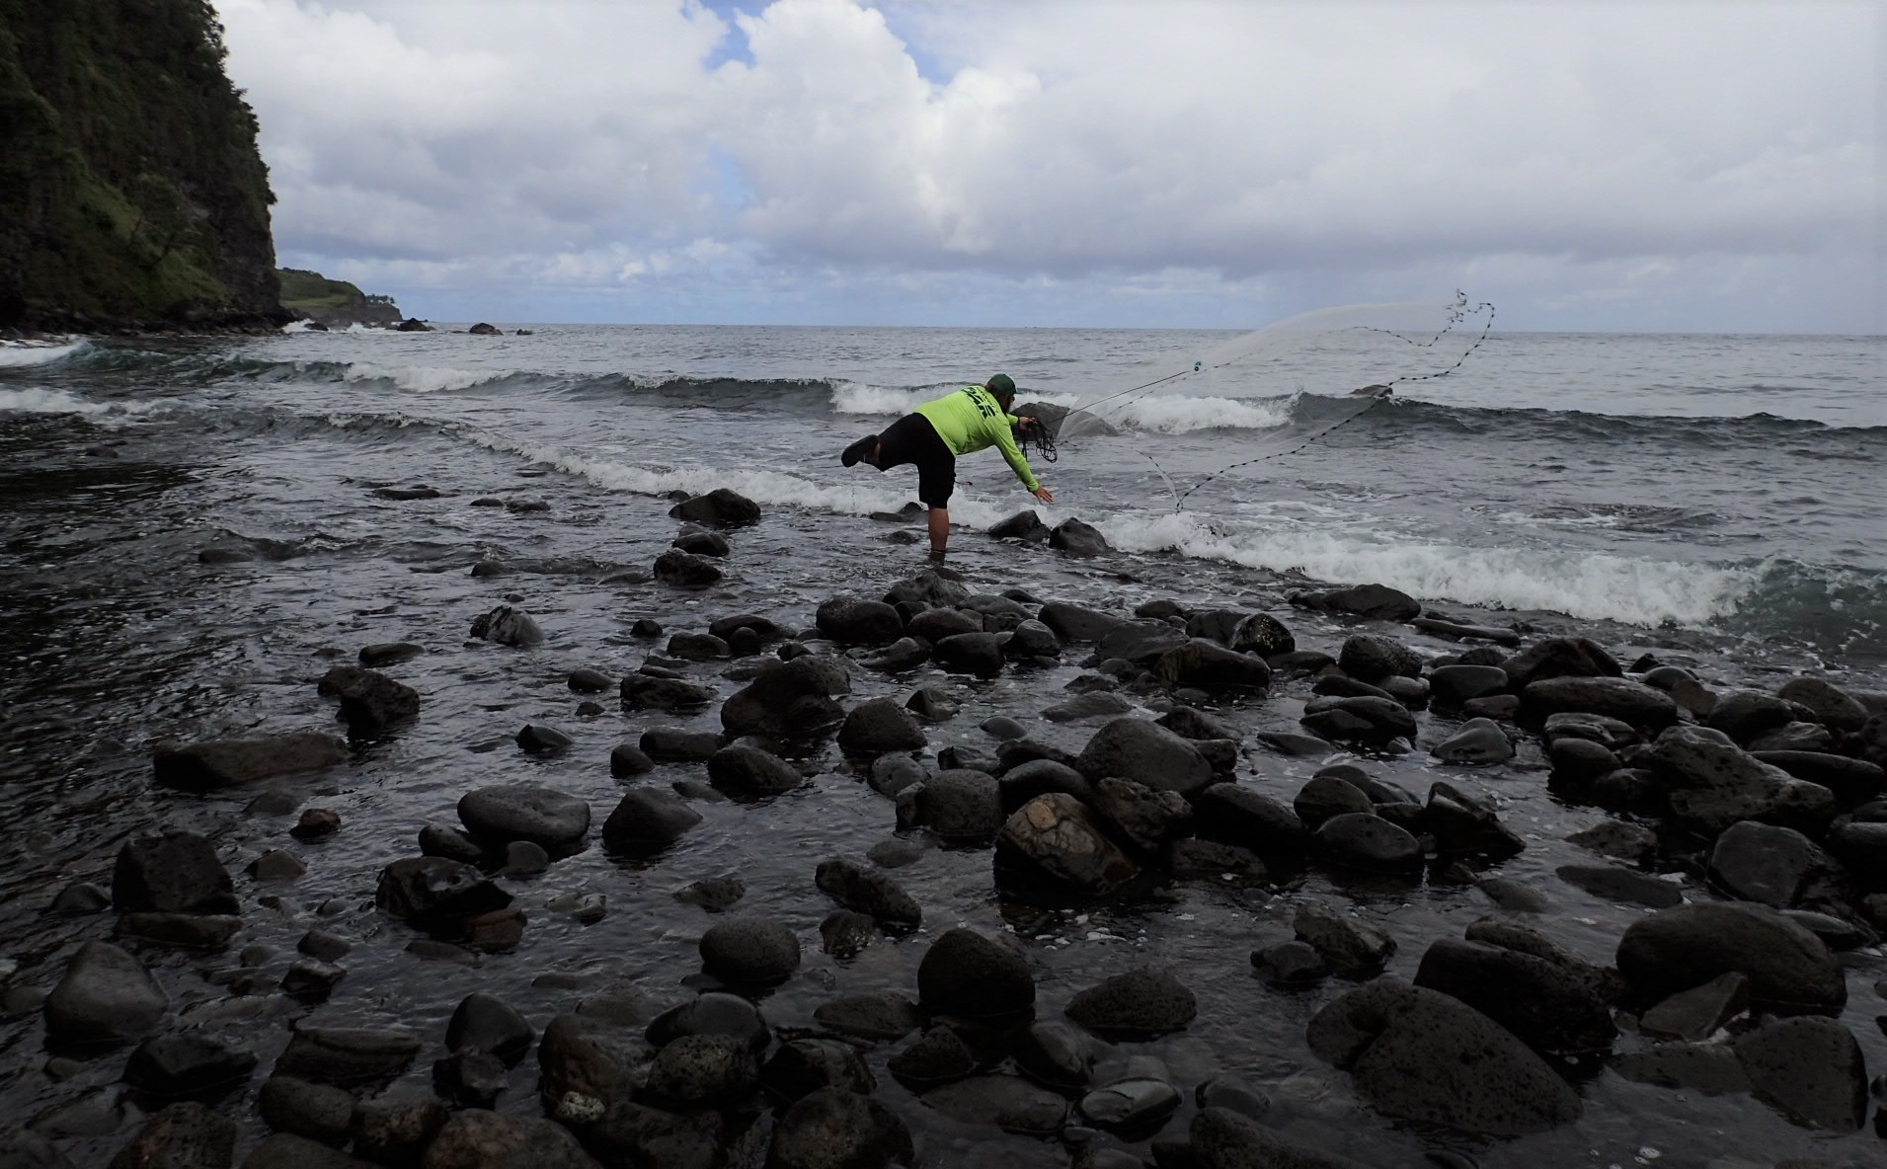
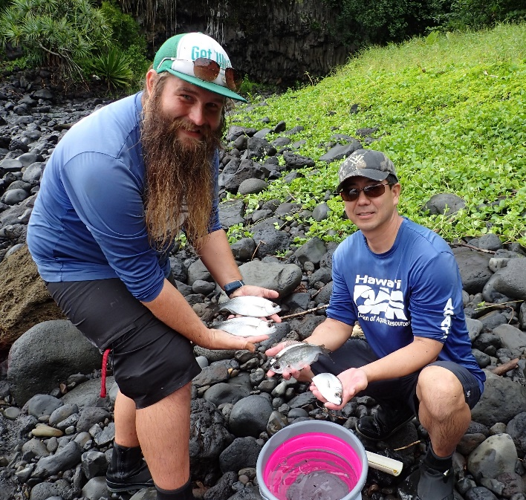
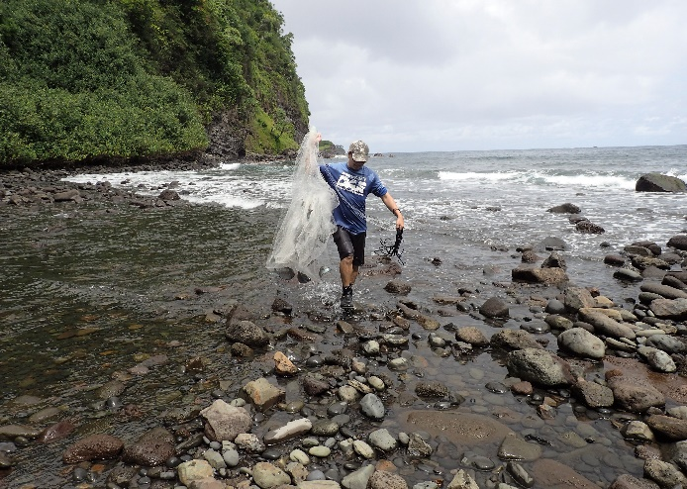
Traditional Monitoring

Slide 6
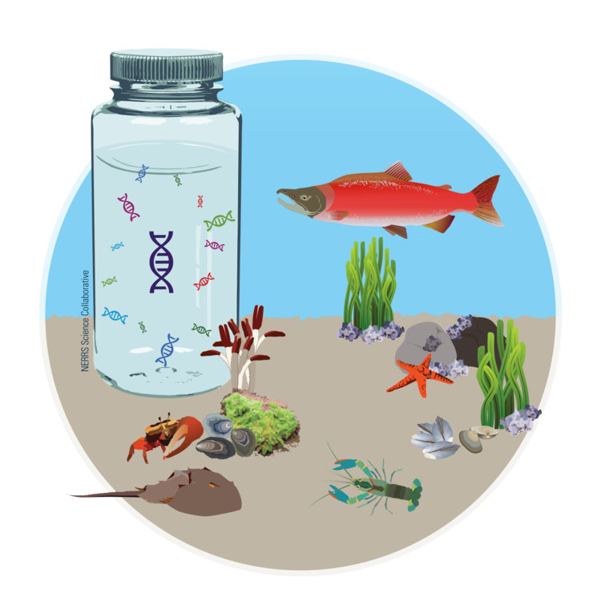
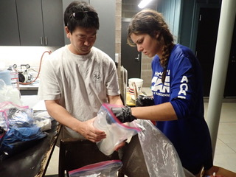
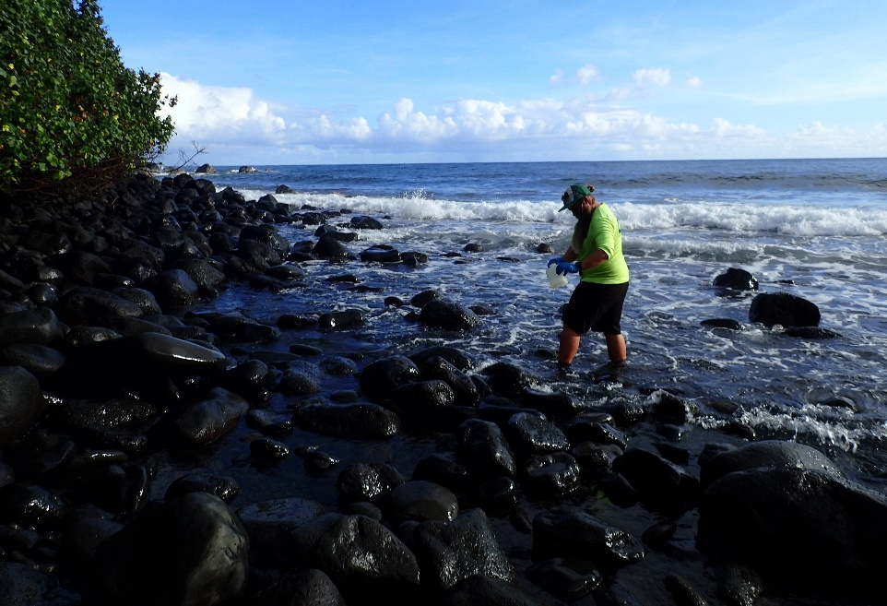
Monitoring with environmental DNA

Slide 7
Monitoring with environmental DNA continued

Slide 8
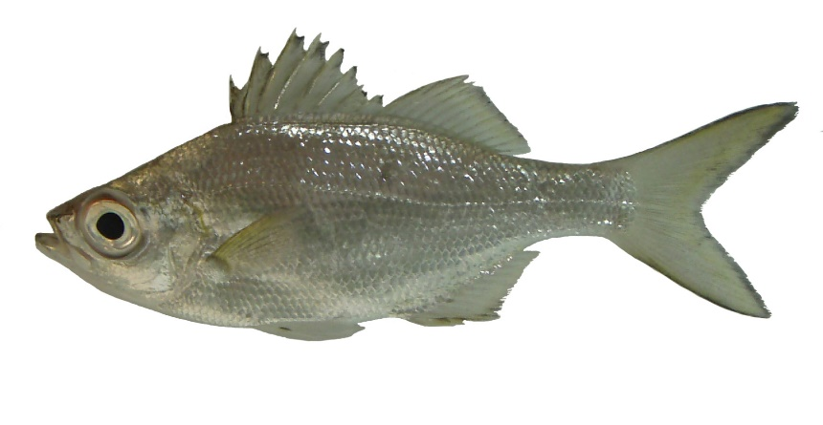
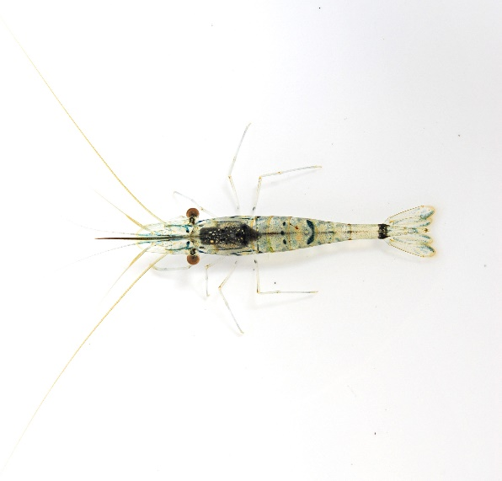
Tally of species
Two estuaries had >50 native fish species,
biodiversity on par with coral reefs.

Slide 9
Tally of species continued
Two estuaries had >50 native fish species,
biodiversity on par with coral reefs.
Two streams that feed these estuaries had the highest invertebrate biodiversity.
Invertebrates are critical in food webs.

Slide 10
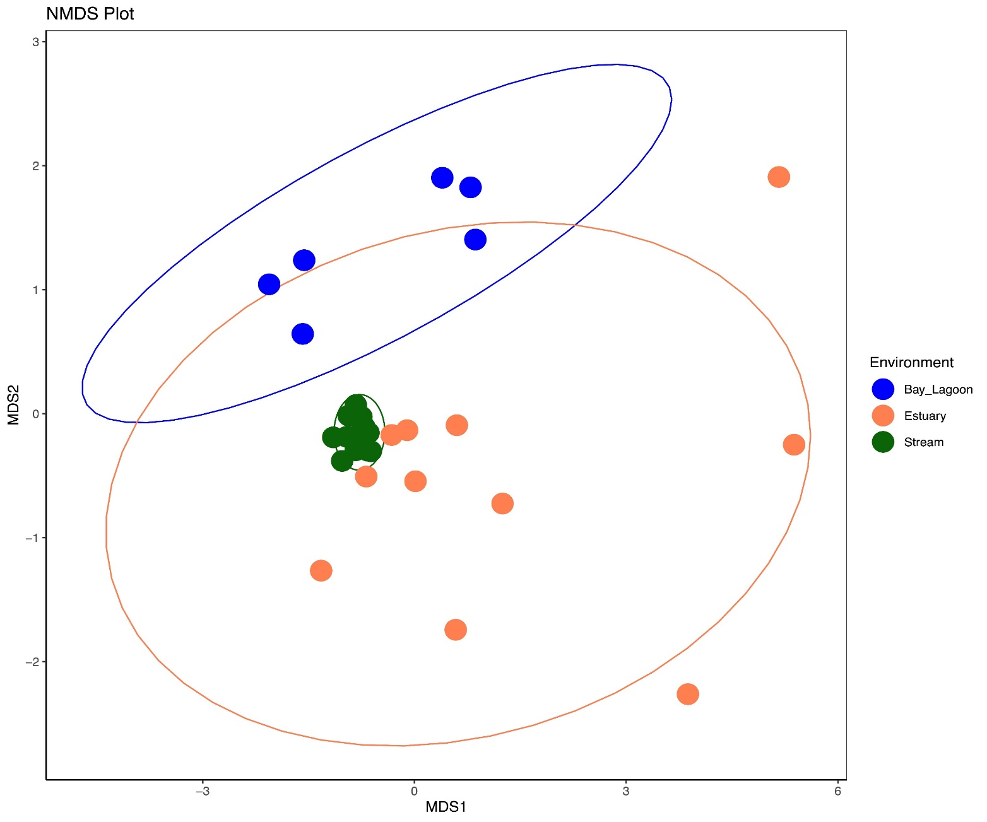
eDNA reveals 3 different fish communities

Slide 11
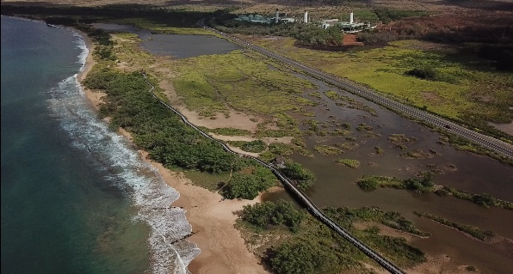
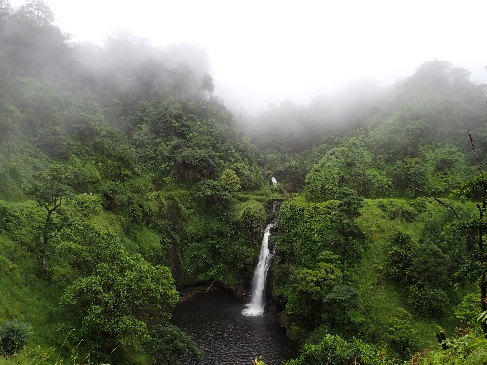
eDNA reveals 3 different fish communities cont.

Slide 12
eDNA reveals 3 different fish communities continued

Slide 13
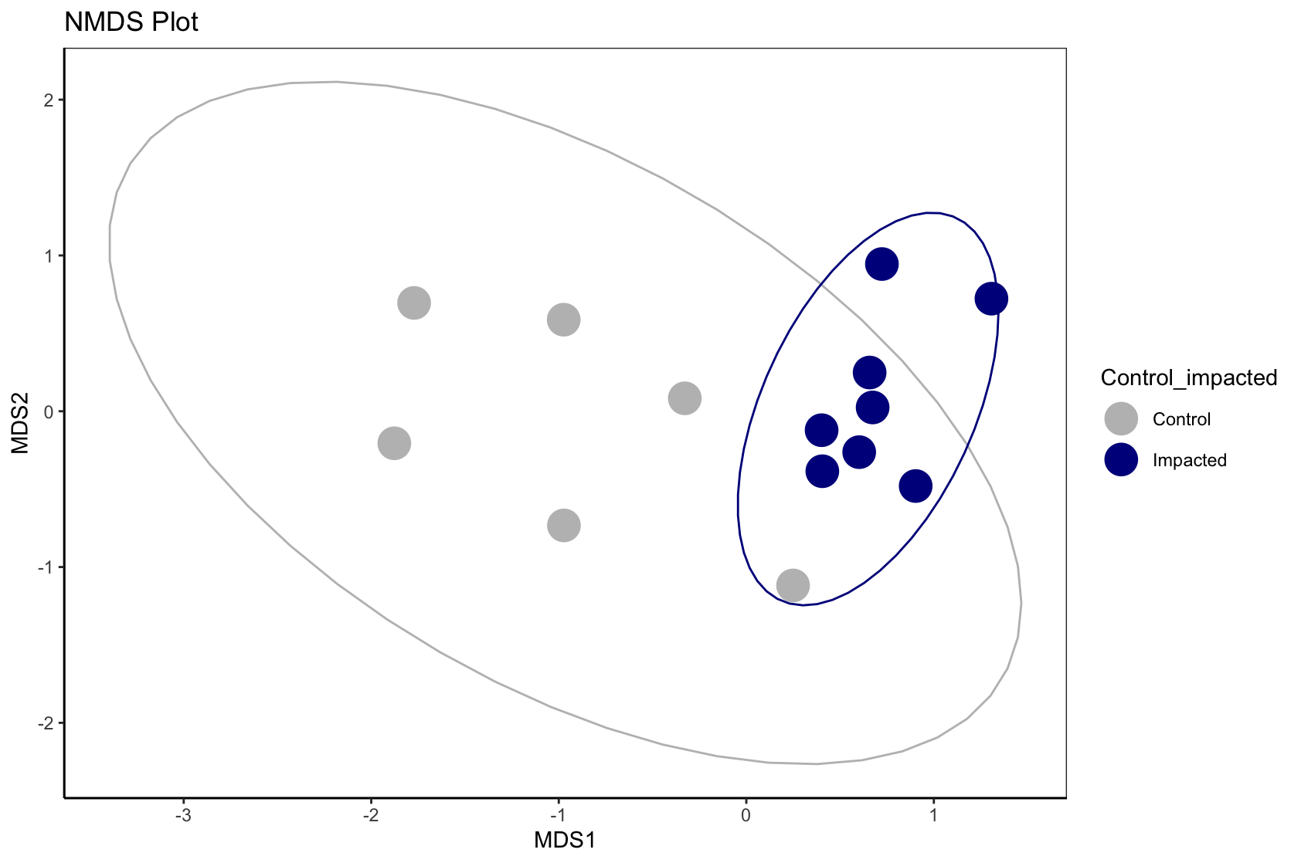
Fish communities in restored streams distinct from those in reference sites
Stress values = 0.05
Notes:
)

Slide 14
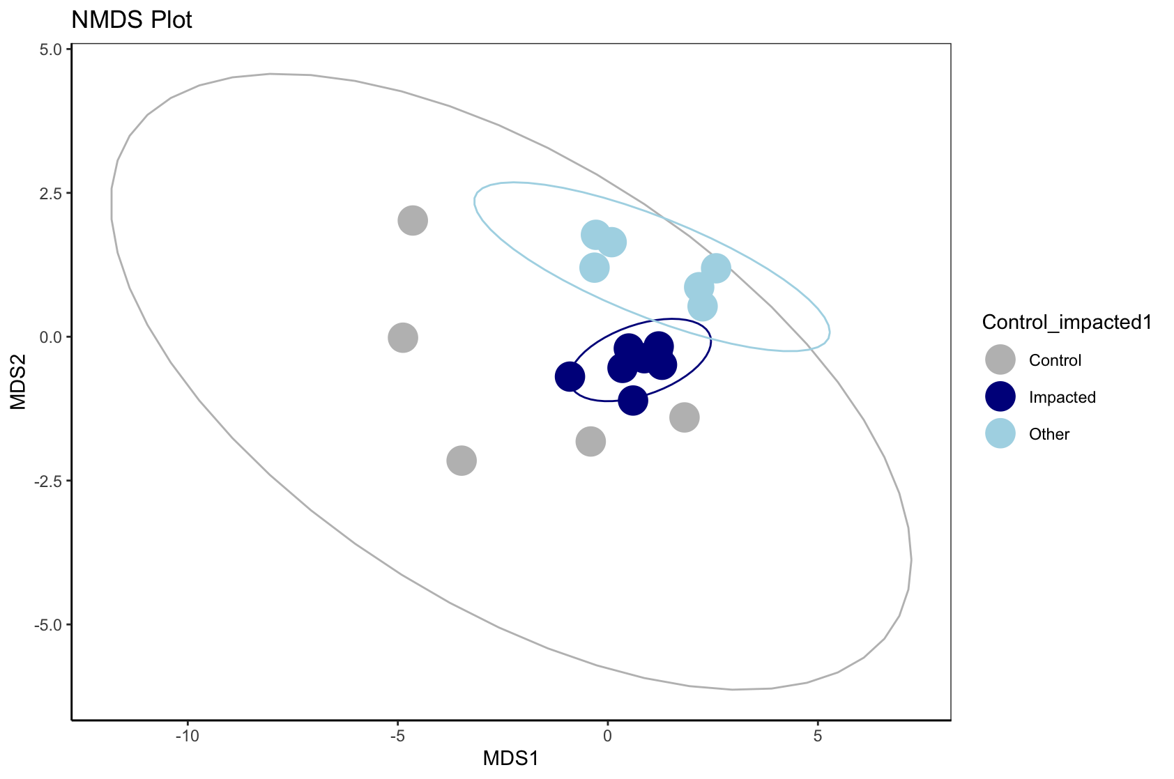
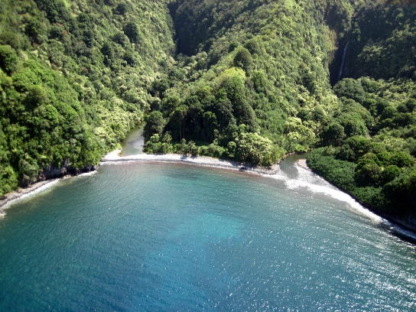
Fish communities in restored estuaries are also distinct.
Stress values = 0.09
Reference
Restored
Reference- other

Slide 15
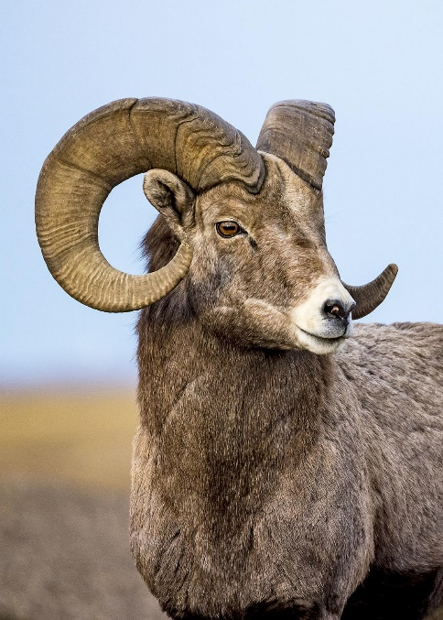
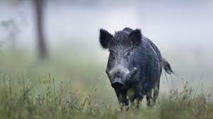
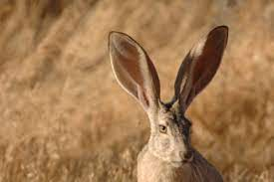
Sharing lessons learned
eDNA in aquatic systems can uncover terrestrial species

Slide 16
Sharing lessons learned: DNA
Using eDNA to detect target species
False positives
False negatives

Slide 17
Sharing lessons learned: solution
Using eDNA to detect target species
False positives
False negatives
Solution: Temporal sampling in monitoring design

Slide 18
Sharing lessons learned: biodiversity
Using biodiversity (eDNA) as an indicator of ecosystem conditions
Global biodiversity hotspots – Hawaii, Guam, American Samoa, CMNI

Slide 19
Sharing lessons learned: biodiversity solution
Using biodiversity (eDNA) as an indicator of ecosystem conditions
Global biodiversity hotspots – Hawaii, Guam, American Samoa, CMNI
Under-reporting species present
Solution: Take steps to determine needed sample size
Field
Laboratory

Slide 20
Sharing lessons learned: solution cont.
Using biodiversity (eDNA) as an indicator of ecosystem conditions
Global biodiversity hotspots – Hawaii, Guam, American Samoa, CMNI
Under-reporting species present
Solution: Take steps to determine needed sample size
Field
Laboratory

