Slide 1
Jason Omick
Wildlife Biologist
Game Program Coordinator
Hawaii Department of Land and Natural Resources
Division of Forestry and Wildlife
Jason.d.omick@hawaii.gov

Slide 2
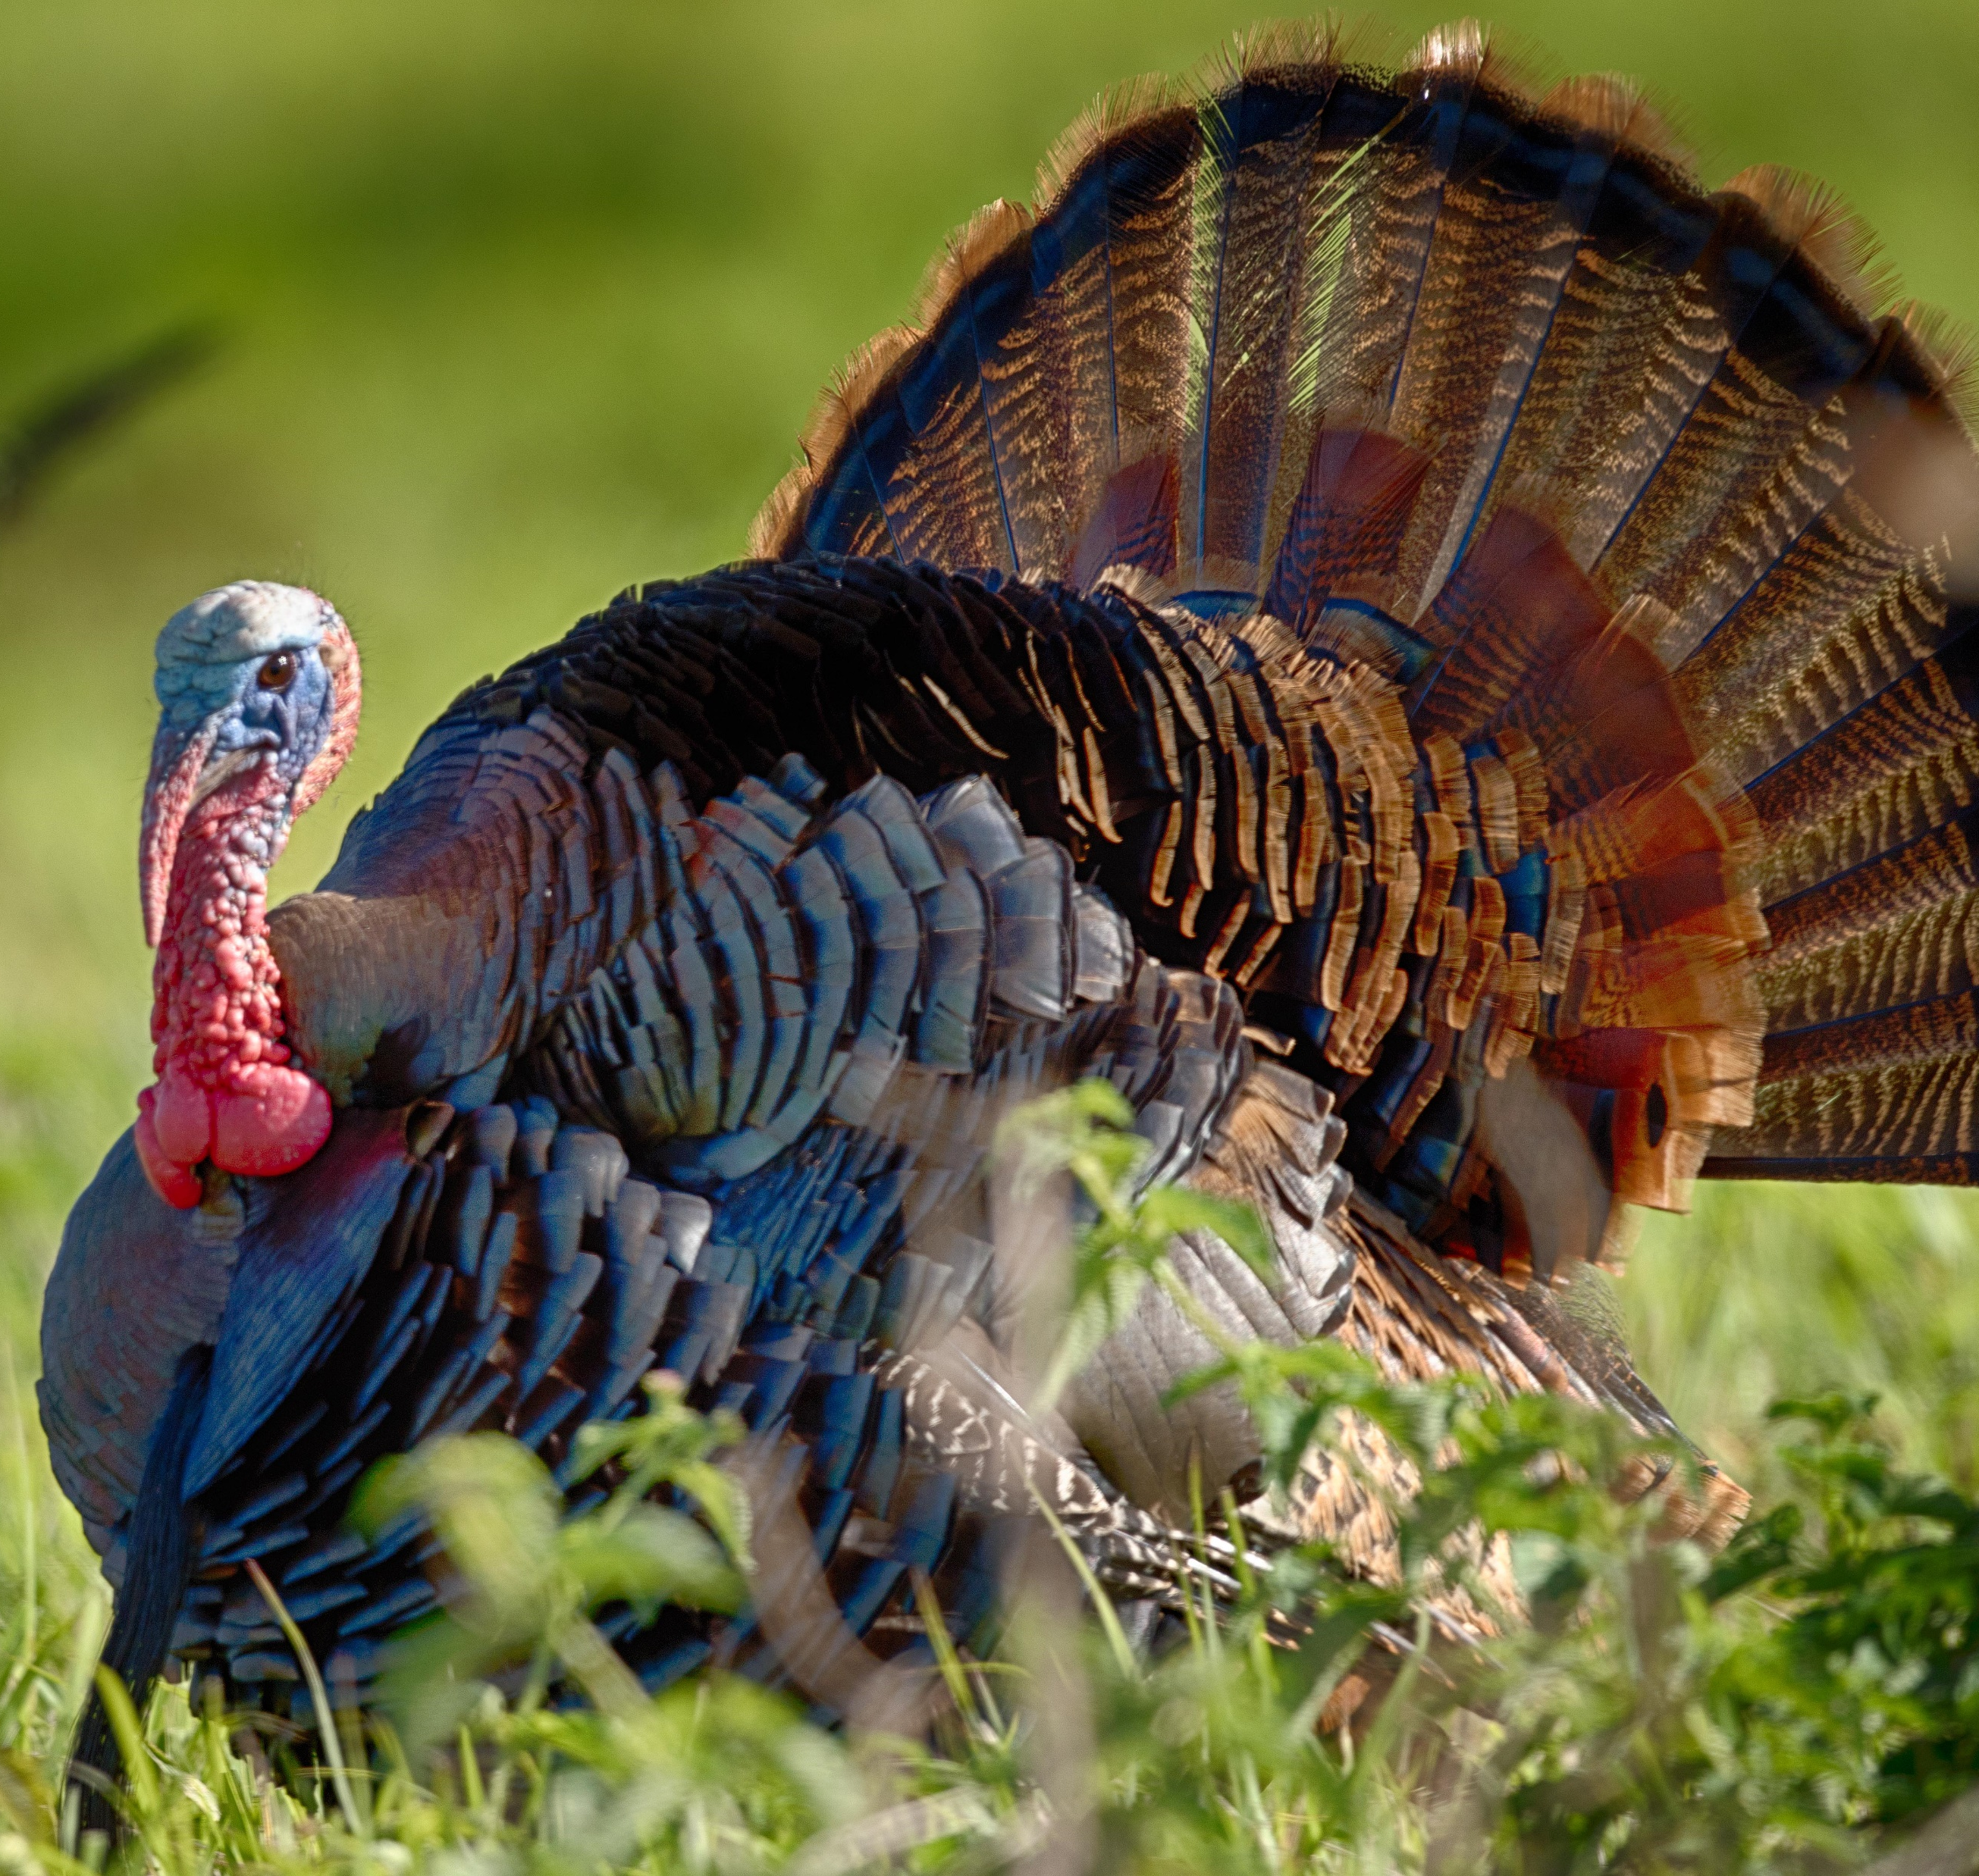
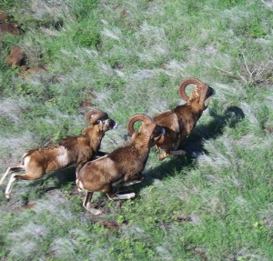
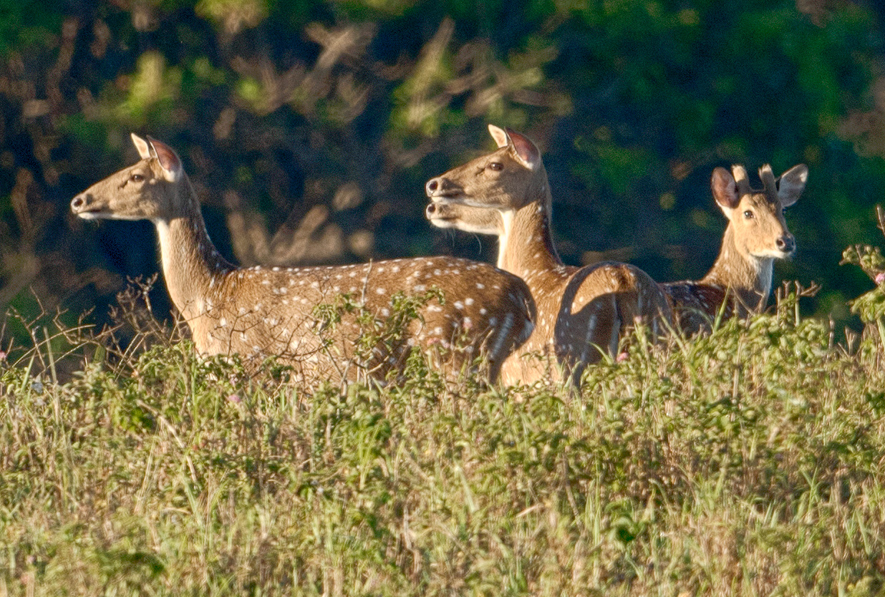
Steering Document for Lāna‘i Cooperative Game Management Area Grant #F19AF00421
Why? To provide a comprehensive overview of the management and research needs with in the LCGMA and to establish a path to a long-term lease.

Slide 3
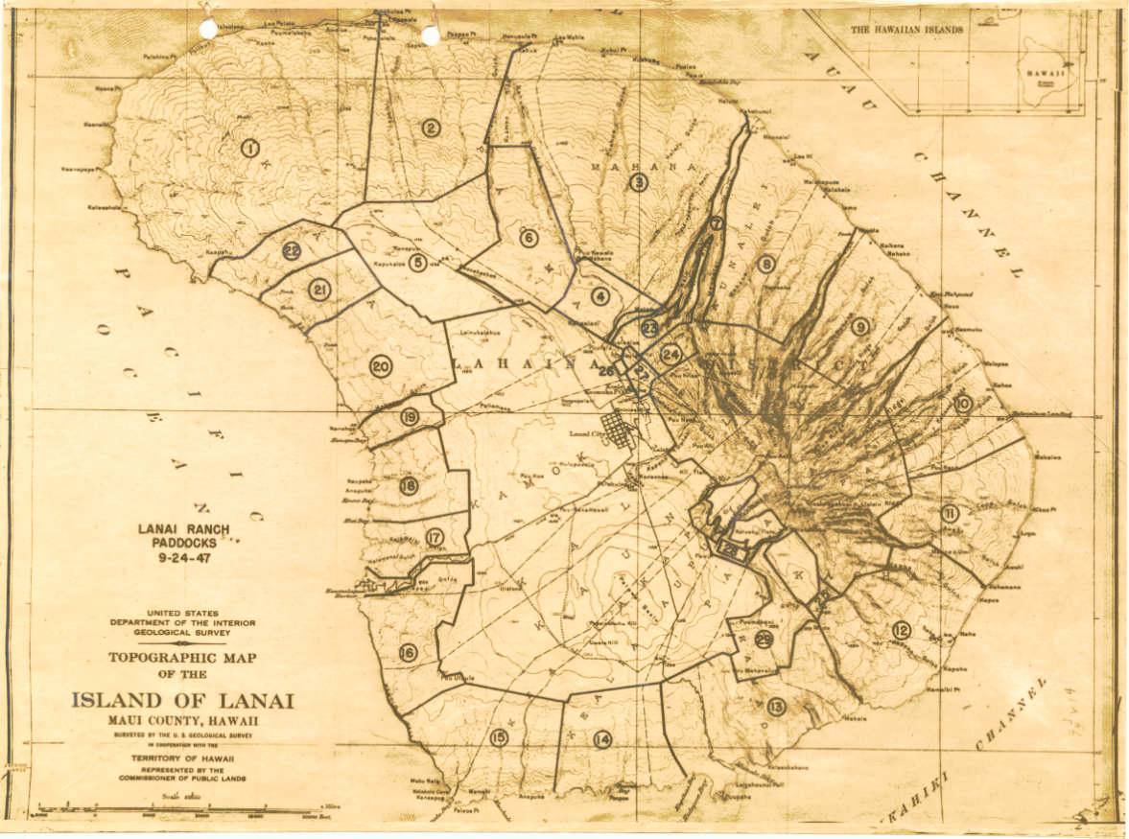
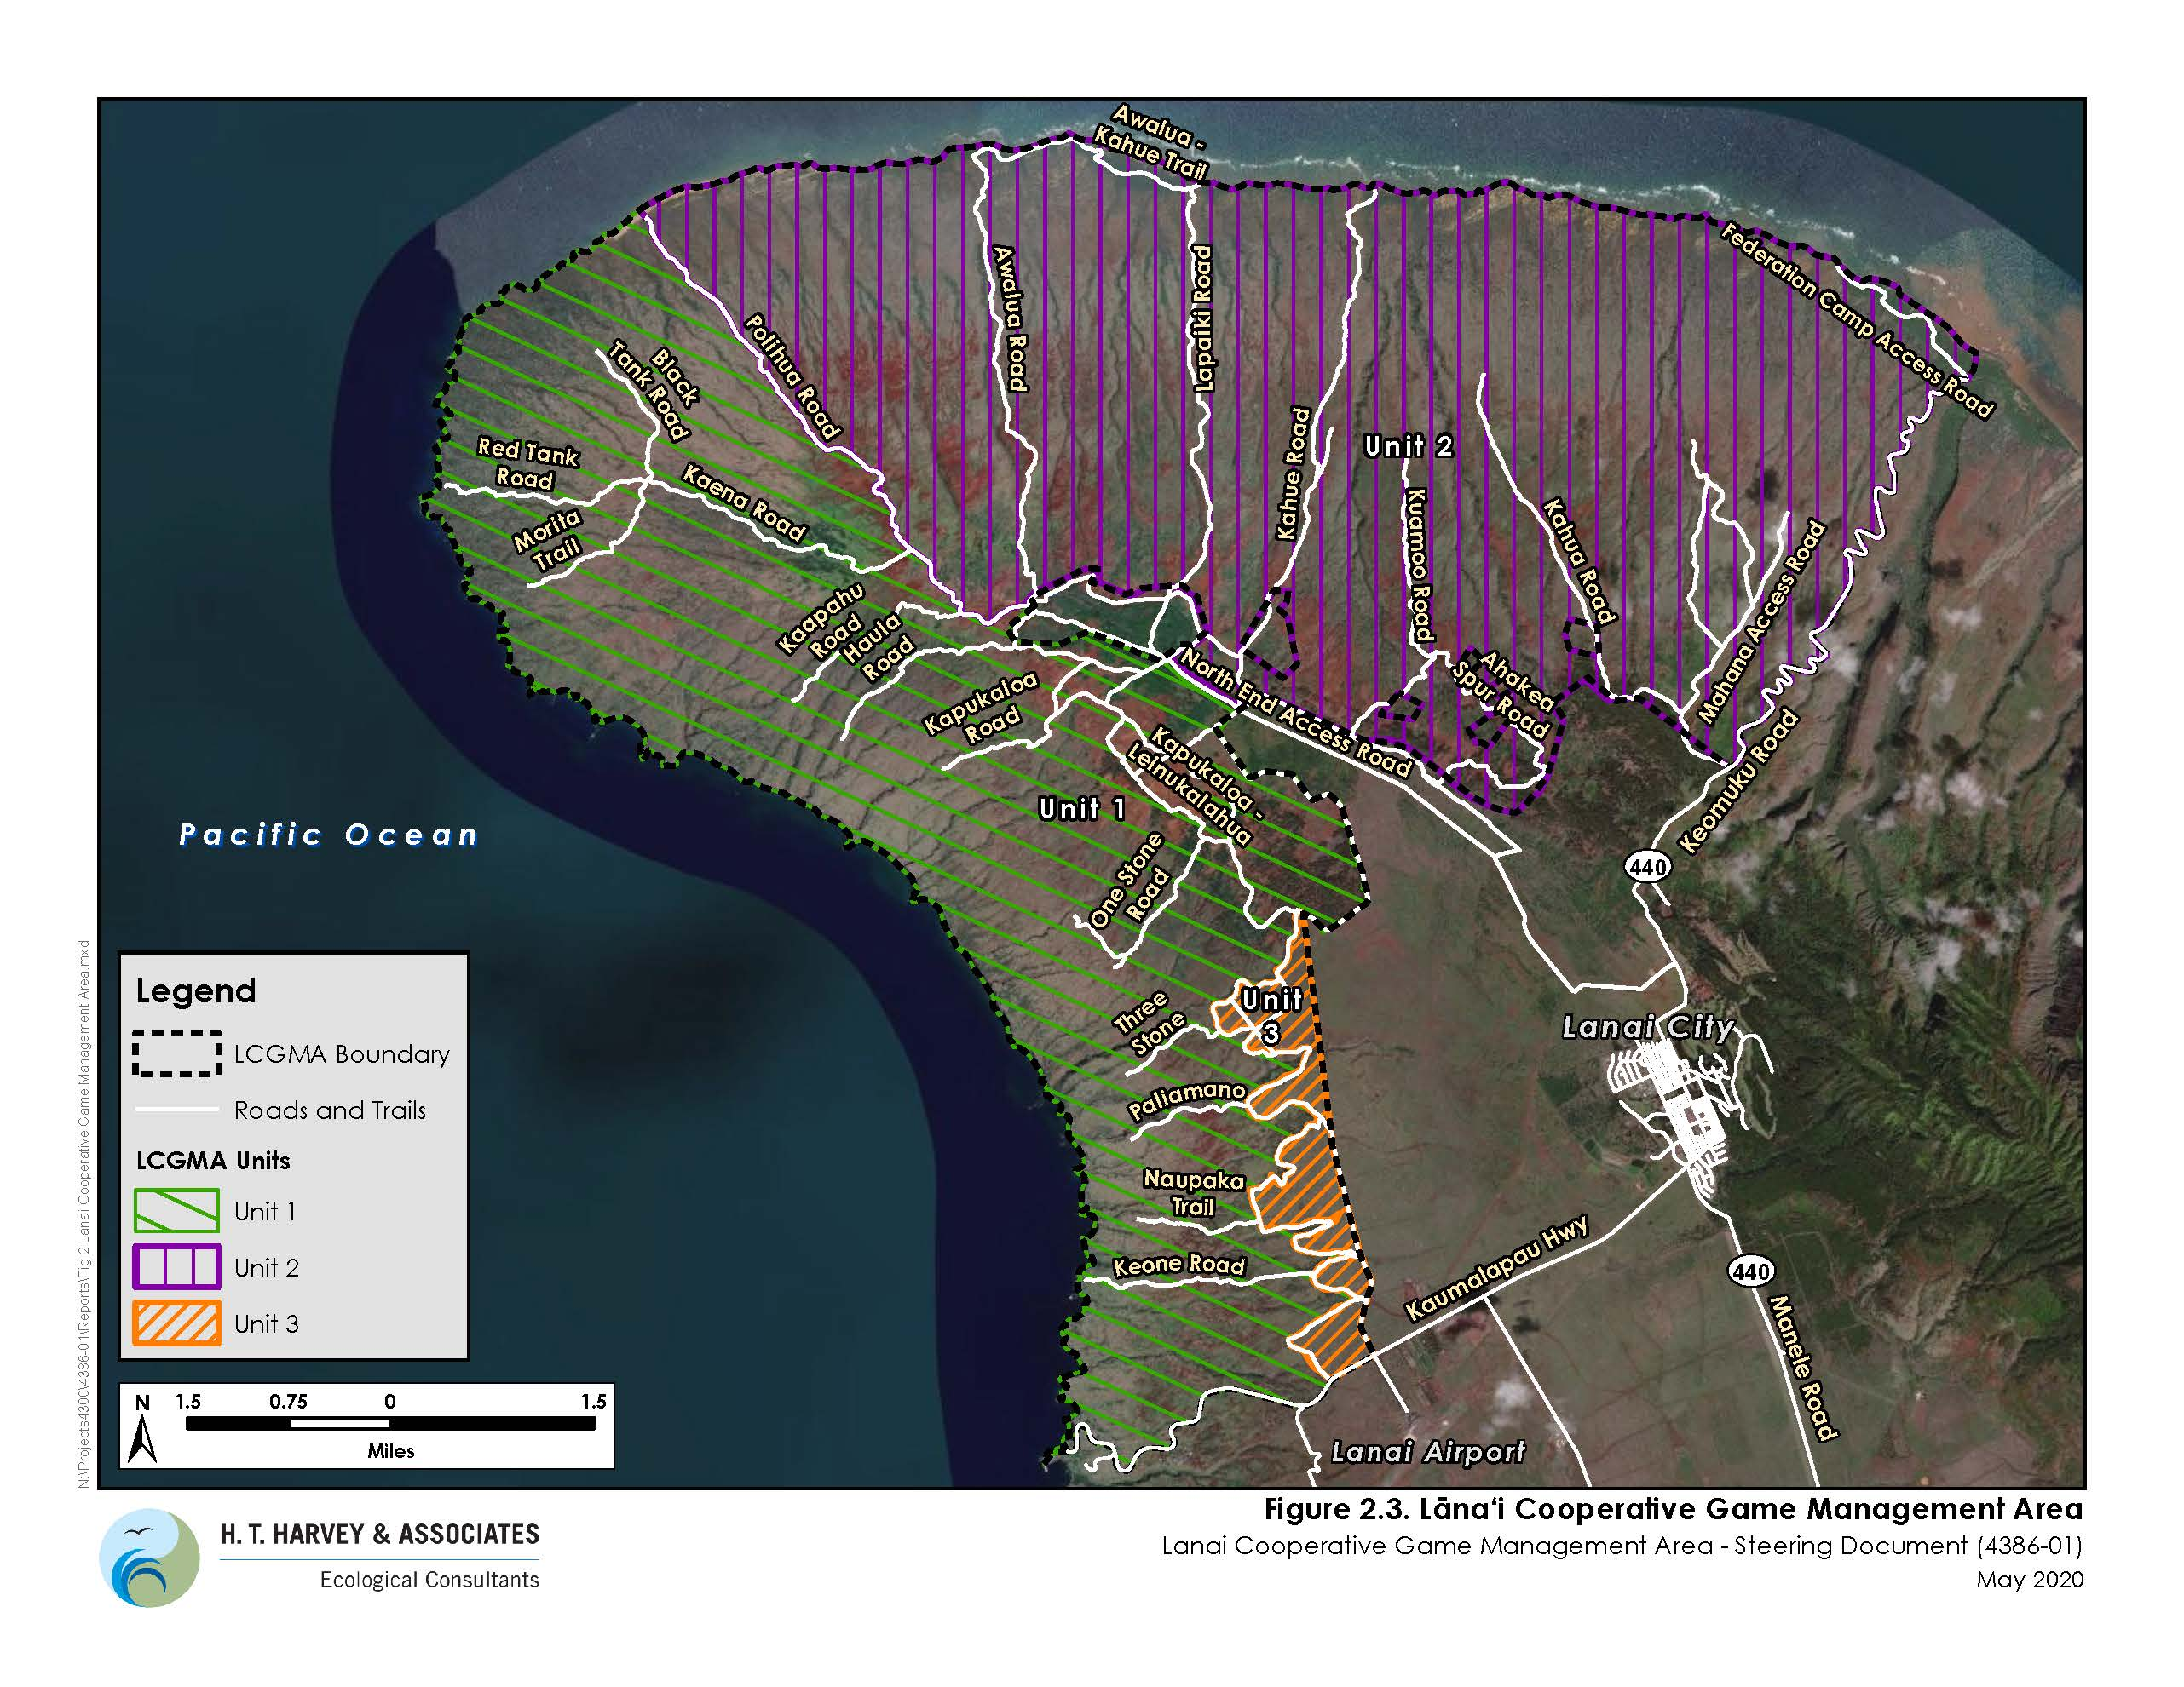
LCGMA Unit boundaries and roads
Purpose and Scope
gathering and analyzing available biological and cultural data and information that will facilitate drafting of the comprehensive strategic management plan for the LCGMA, and
identifying possible future management strategies, research, education and outreach goals, objectives, and approaches that we should consider when developing the comprehensive strategic management plan for the LCGMA.
Most of Lāna‘i in the 1940s was Ranch Paddocks used for Private Hunting but closed to Public Hunting.

Slide 4
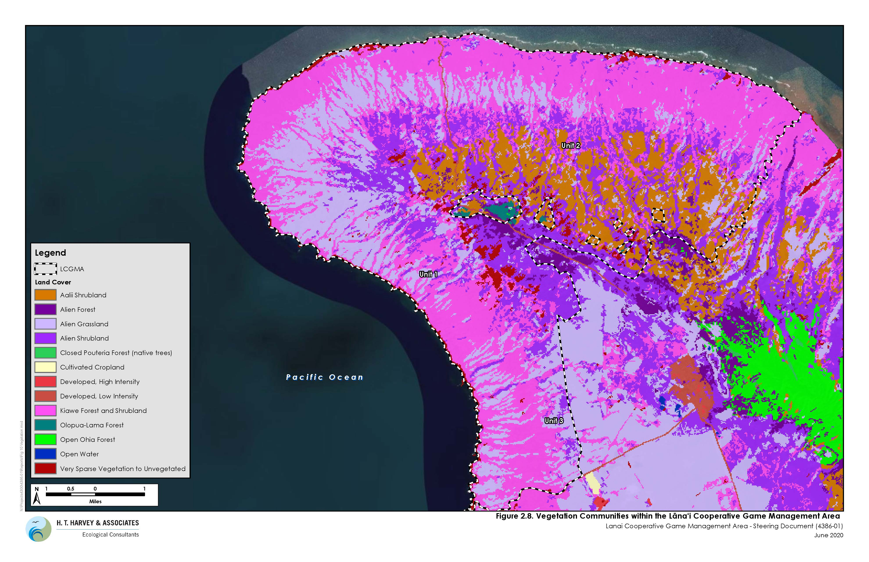
Vegetation communities in LCGMA
This steering document provides the following information:
LCGMA Background- cultural resources and environmental setting
Economic value
Current management practices
Gaps and opportunities
Future Goals, Objectives, and Approaches
Notes:
Research harvest totals

Slide 5
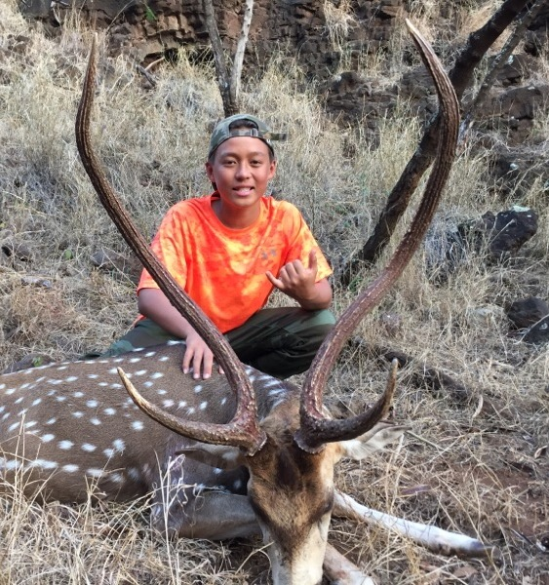
Trends in Population

Slide 6
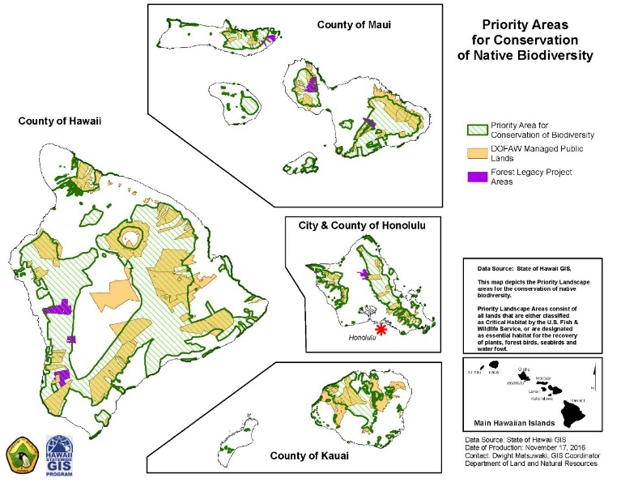
Map of priority areas for conservation

Slide 7
State Hunting Program Revenue
The Lāna‘i hunting program is one of the largest revenue-generating segments of the state of Hawai‘i hunting program. Each year approximately 3,000 hunters participate in the hunt and produce revenue for the program through their license fees, tag fees, and lottery application fees.
Revenue Source | No. Sold/Issued | Cost | Annual Amount
Lāna‘i hunting license (resident)¹ | 1,500 | $10.00 | $15,000
Lāna‘i hunting license (non-res)² | 200 | $95.00 | $19,000
Wildlife conservation stamp | 1,700 | $10.00 | $17,000
Axis deer lottery | 3,777 | $10.00 | $37,770
Axis deer tag issued (resident) | 4,413 | $20.00 | $88,240
Axis deer tag issued (non-res) | 48 | $125.00 | $6,000
Mouflon sheep lottery | 2,143 | $10.00 | $21,430
Mouflon sheep tags issued (resident) | 1,486 | $20.00 | $29,720
Mouflon sheep tags issued (non-res) | 13 | $125.00 | $1,625
Game bird stamp purchased | 174 | $10.00 | $1,740
Estimated annual revenue generated for state hunting program |  |  | $237,525
Federal wildlife and ecosystem restoration matching grant potential (3x) |  |  | $712,575
Notes:
Can delete this slide if needed

Slide 8
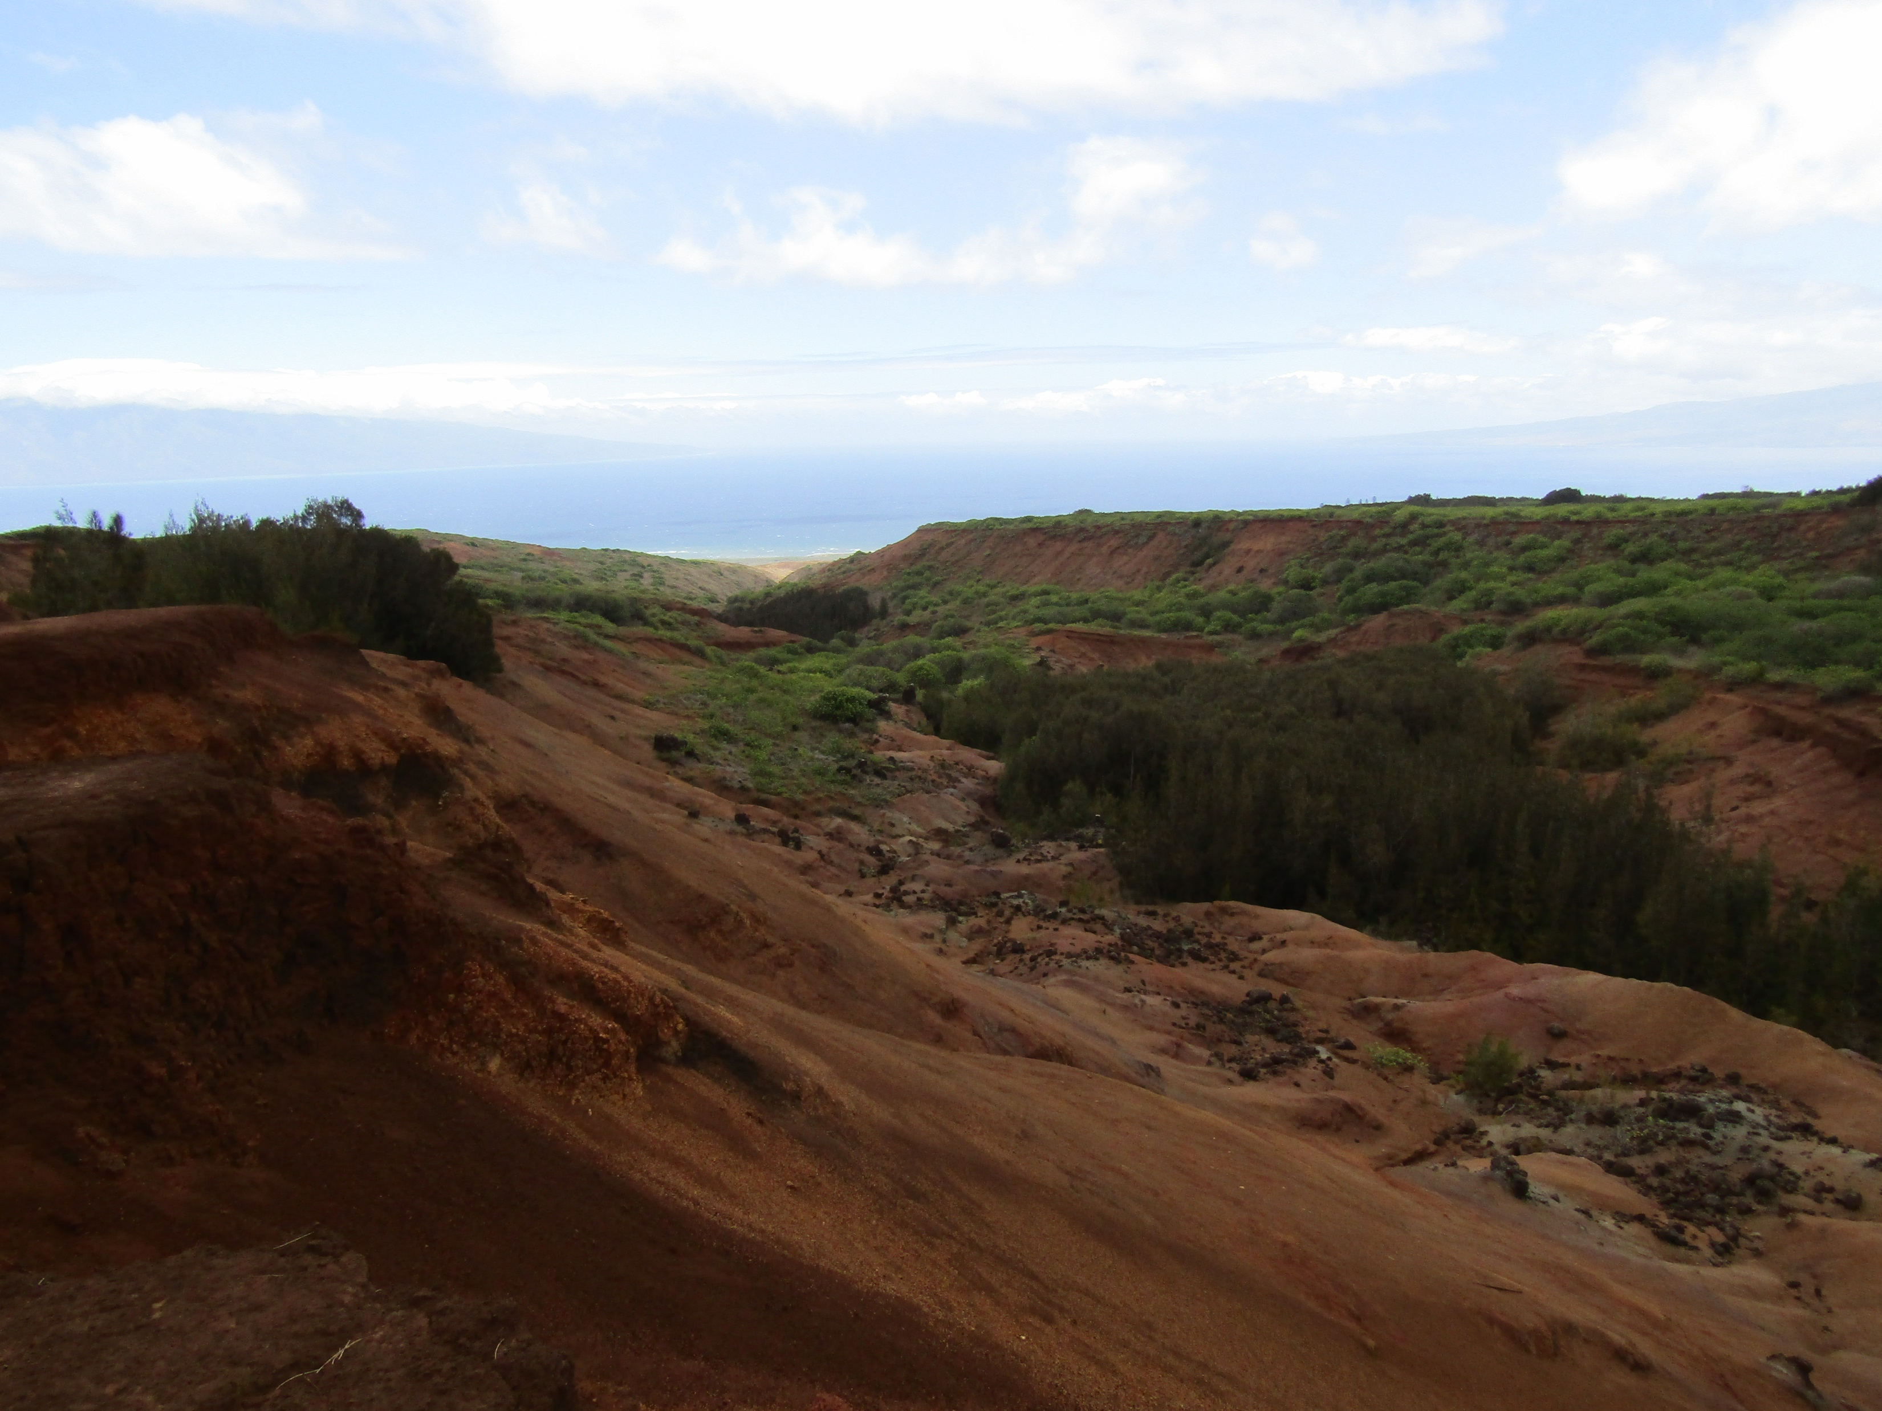
Boulder Strewn Area within LCGMA Exemplifies Habitat Degradation and Soil Erosion

Slide 9
Threatened and Endangered Species
Ko‘oloa ‘Ula (Abutilon menziesii) Growing within the Fenced Exclosure at Lāna‘i Cooperative Game Management Area

Slide 10
Future Goals, Objectives, and Approaches The two overarching goals that can guide the sustainable management of LCGMA are as follows: Goal 1—Use an adaptive management approach to provide public hunting at the LCGMA compatible with other public land uses and that is in balance with the conservation and protection of other natural and cultural resources. Goal 2—Work collaboratively with Pulama Lāna‘i to develop and implement the comprehensive management plan of the LCGMA and to establish a long term 20 lease.
Why? To have a sustainable hunting program on Lanai while conserving native and
protected wildlife and their habitats. To develop a long-term management agreement with the private landowner and to secure the strong revenue stream that supports the State Hunting program.

Slide 11
Image of land

Slide 12
Image 2 of land

Slide 13
Hunter Image

Slide 14
Hunter 2 Image

Slide 15
Mahalo

