Slide 1
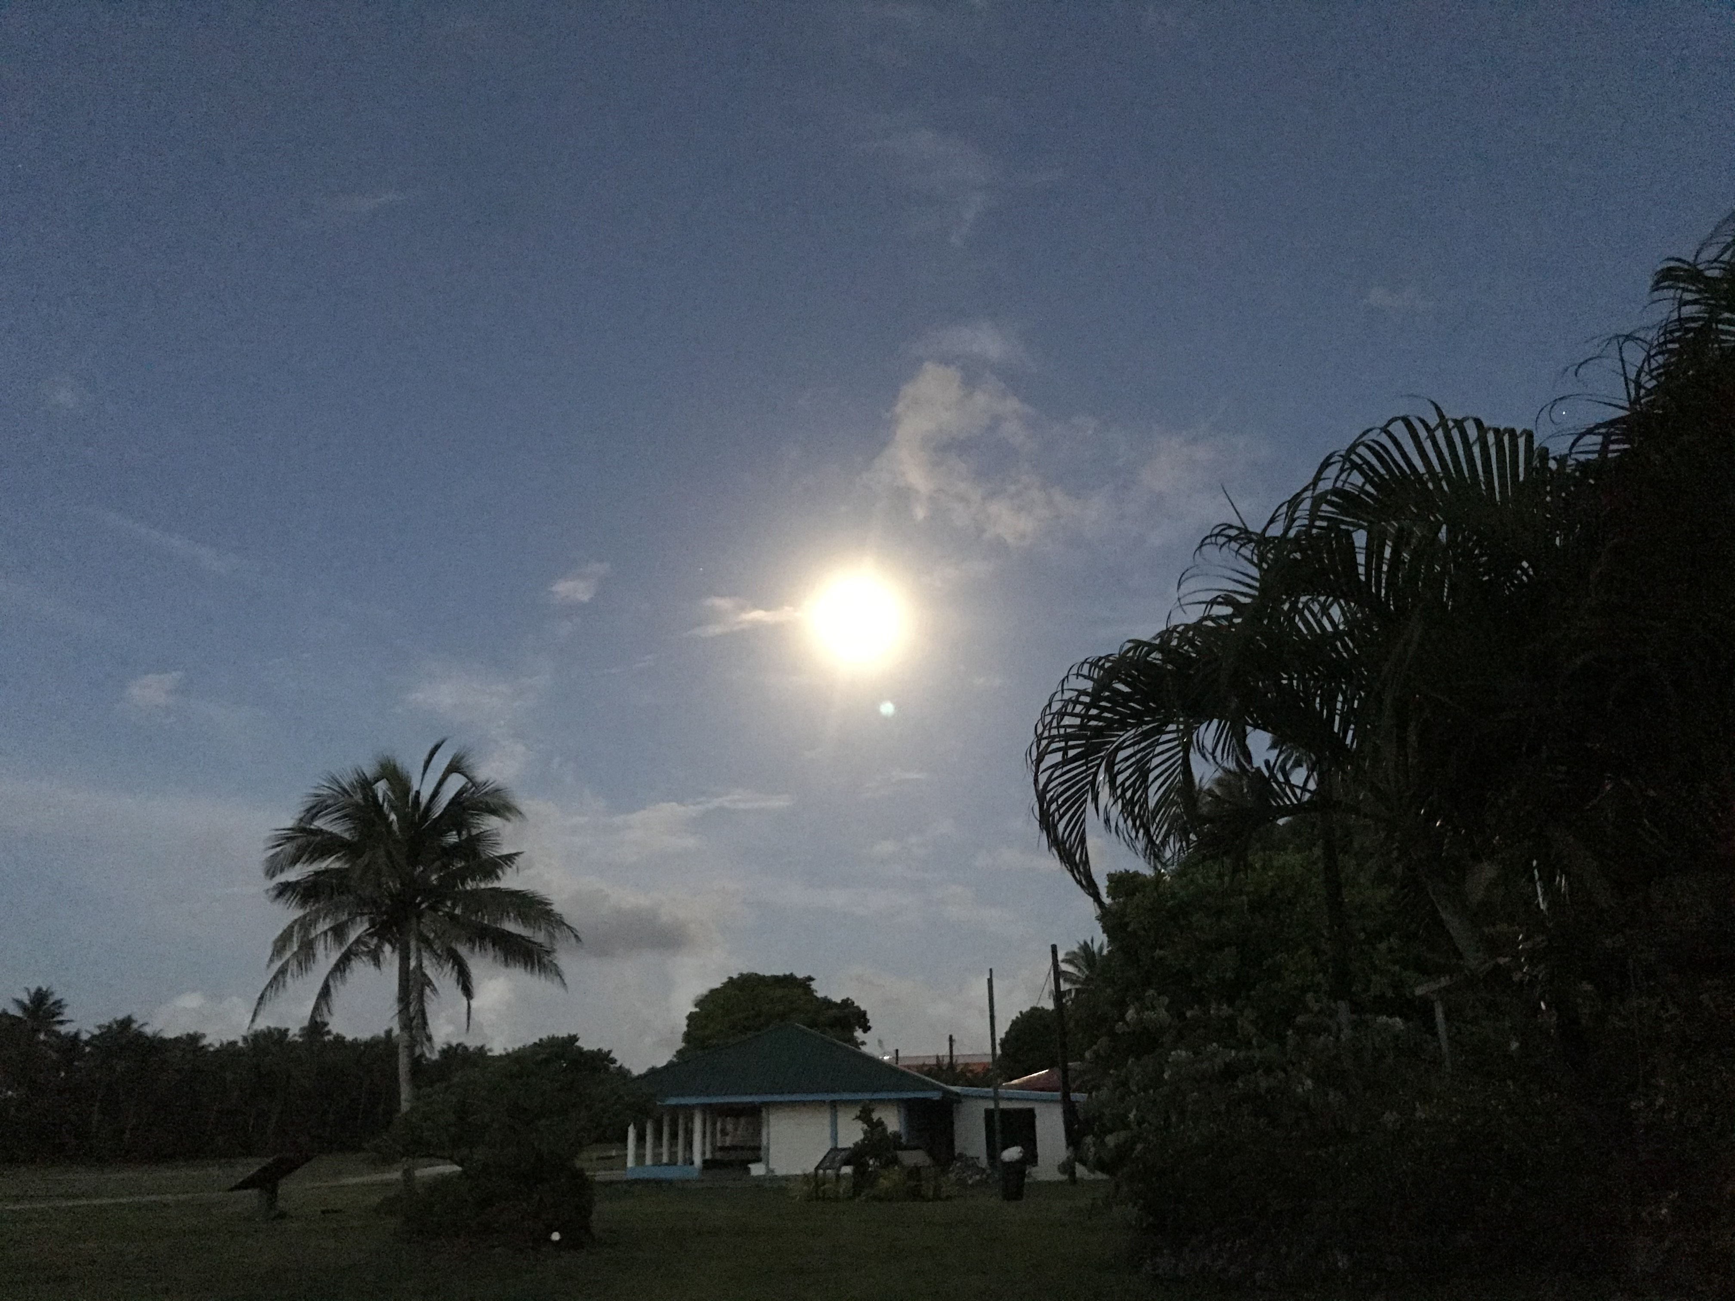
Am. Samoa Highlights in the face of COVID-19
Taotasi Archie Soliai

Slide 2
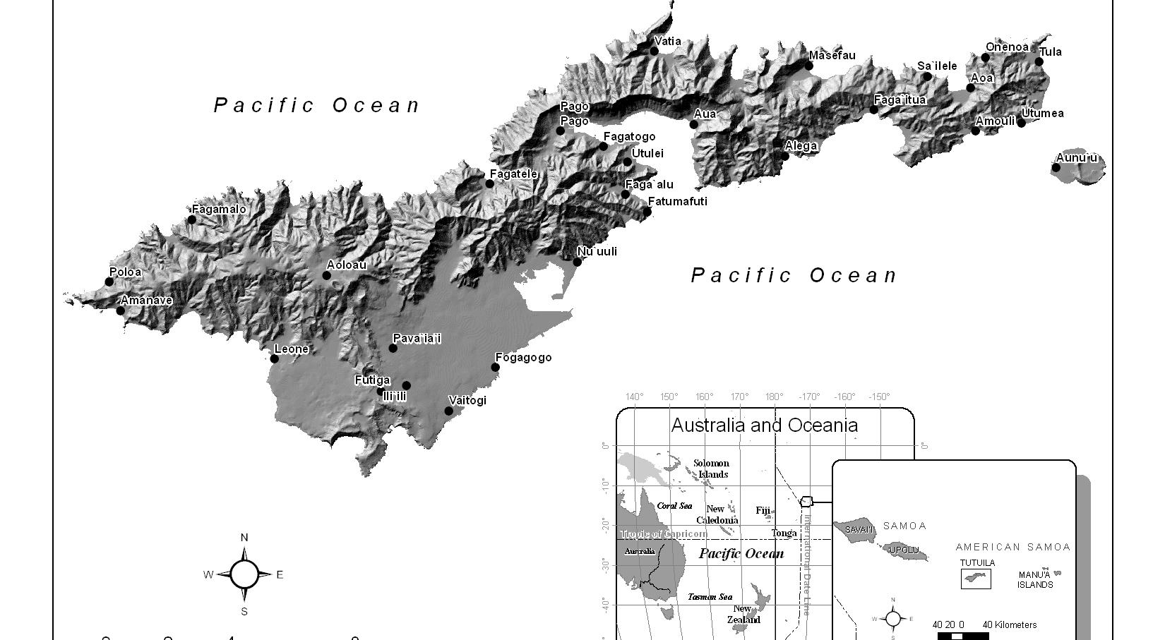
Where we are….

Slide 3
Impacts of COVID
Closed Borders
Reduced Working Hours
Distancing restrictions
New emerging policies in response to COVID
Additional limited resources
Compromised communication with federal partners

Slide 4
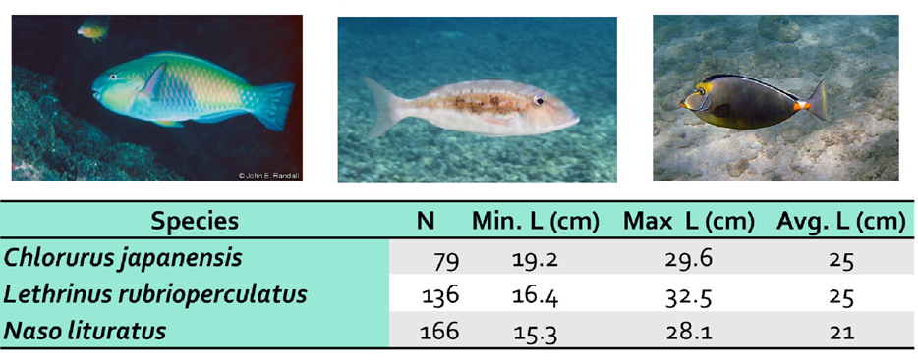
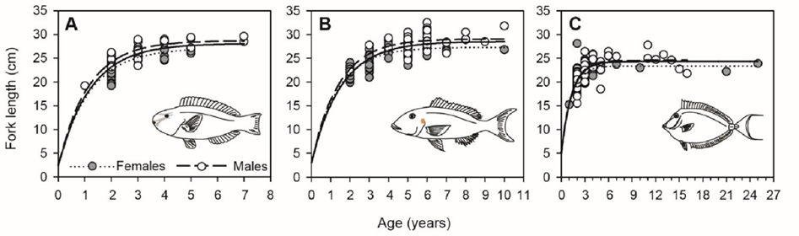
Highlights - SFR
Notes:
This work was supported by the Sports fish restoration funds. Given the COVID restrictions, it allowed DMWR to analyze some of the data that was collected over a period of time. We found that these different commonly caught species stop growing at a certain size and that they spend most of their energy in spawning. It also shows a range of maximum age (8 yrs for parrot, 11 yrs for Emperor and about 24 yrs for unicornfish).

Slide 5
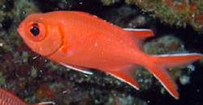
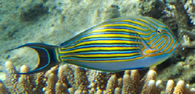
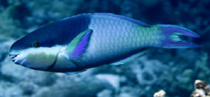
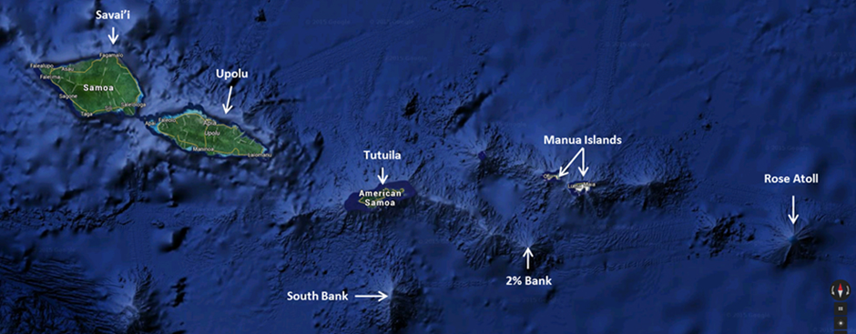
Highlights Continued - SFR
Notes:
DMWR is also looking into how genetically related these three species are in the Samoan Archipelago. Collecting existing data that will hopefully give us some idea of how to effectively manage them for the future.

Slide 6
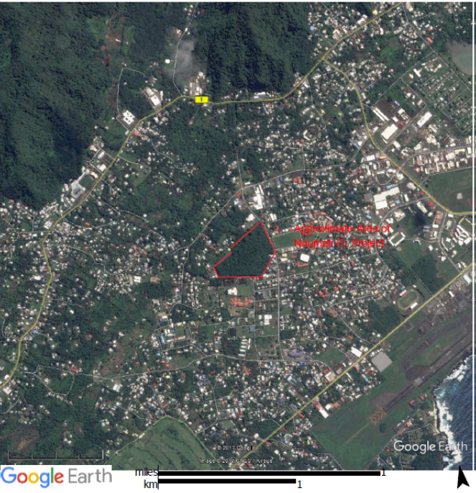
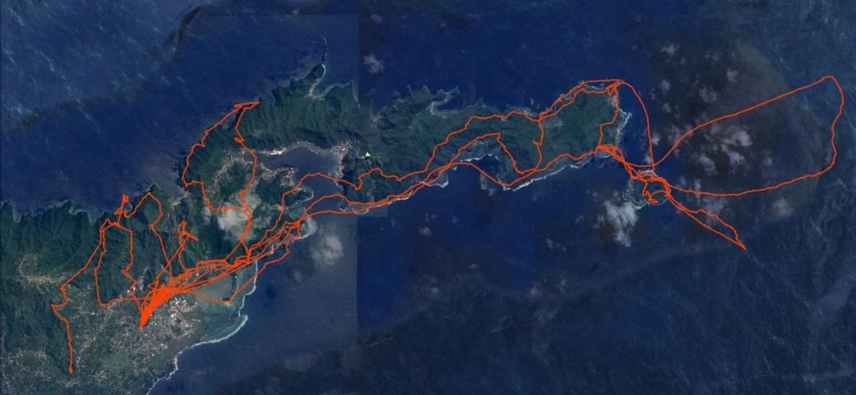

Highlights - WR
Naumati Rainforest
Ecologically Important
Notes:
The Naumati Lowland Rainforest is the last remaining stand of a unique tropical lowland forest that once covered the Tafuna Plain. It provides important habitat for most species of wildlife in American Samoa, including over 5000 flying foxes.
Picture represents movements of one Insular Flying Fox over 11 nights

Slide 7
Naumati Rainforest
Notes:
27 acres owned by 7 landowners
DMWR began leasing the forest in 2018 using WR funds to prevent development.
DMWR is preparing to purchase Naumati for permanent protection, restoration, and conservation management

Slide 8
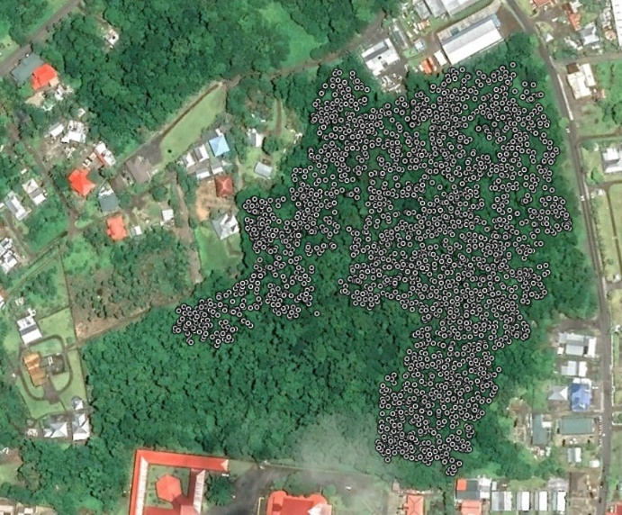
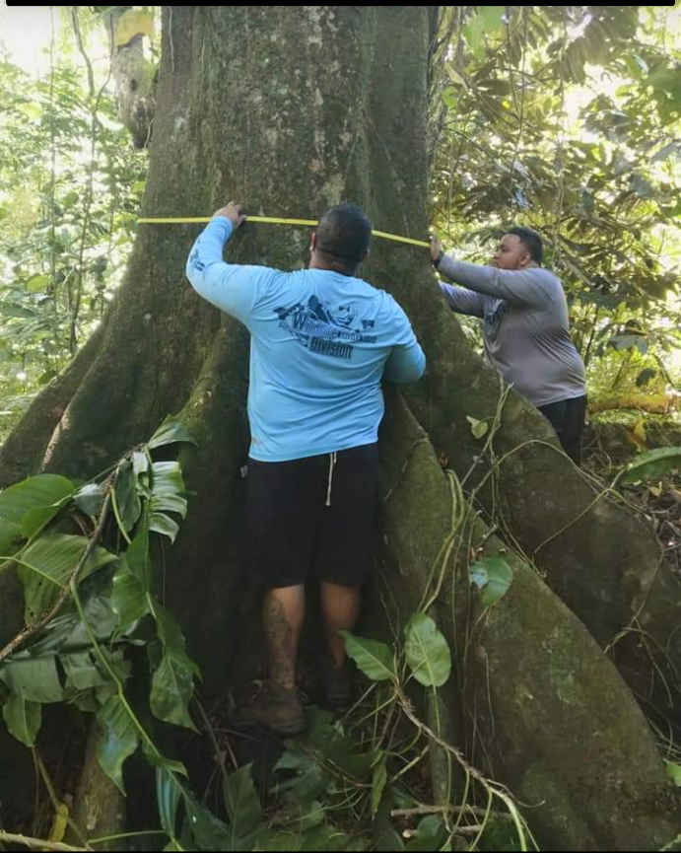
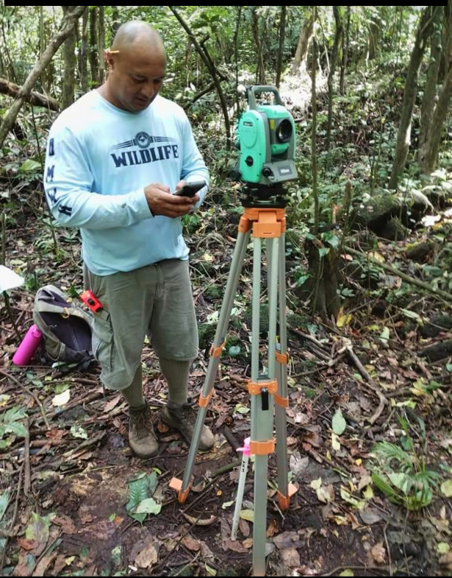
Naumati Rainforest
Continued
Vegetation Mapping
Notes:
Mapping all trees larger than 10 cm dbh.
Over 2909 trees of over 10 species have been mapped, measured, and tagged.
Data will be used for creation of a forest management and restoration plan.

Slide 9
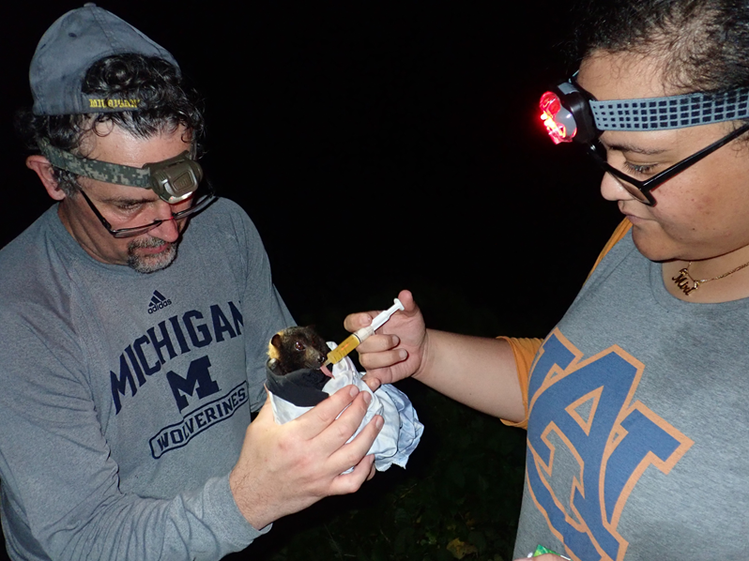
Capacity Building
Notes:
Nerisa S. Taua received her MS from Purdue University under Dr. Patrick Zollner in December 2020.

Slide 10
Graduate Thesis
Notes:
Her thesis was titled Tongan Flying Fox Activity Patterns and Associated Cover Types in American Samoa.
She classified behaviors of GPS tagged bats using 3-axes accelerometer data.
The research was part of DMWR’s Bat Movement Ecology project funded by WR funds (F18AF01038).
She is the first American Samoan student to receive a MS in Wildlife Ecology and will return to American Samoa to work for DMWR in the Summer of 2021.

Slide 11
THANK YOU!

