Slide 1
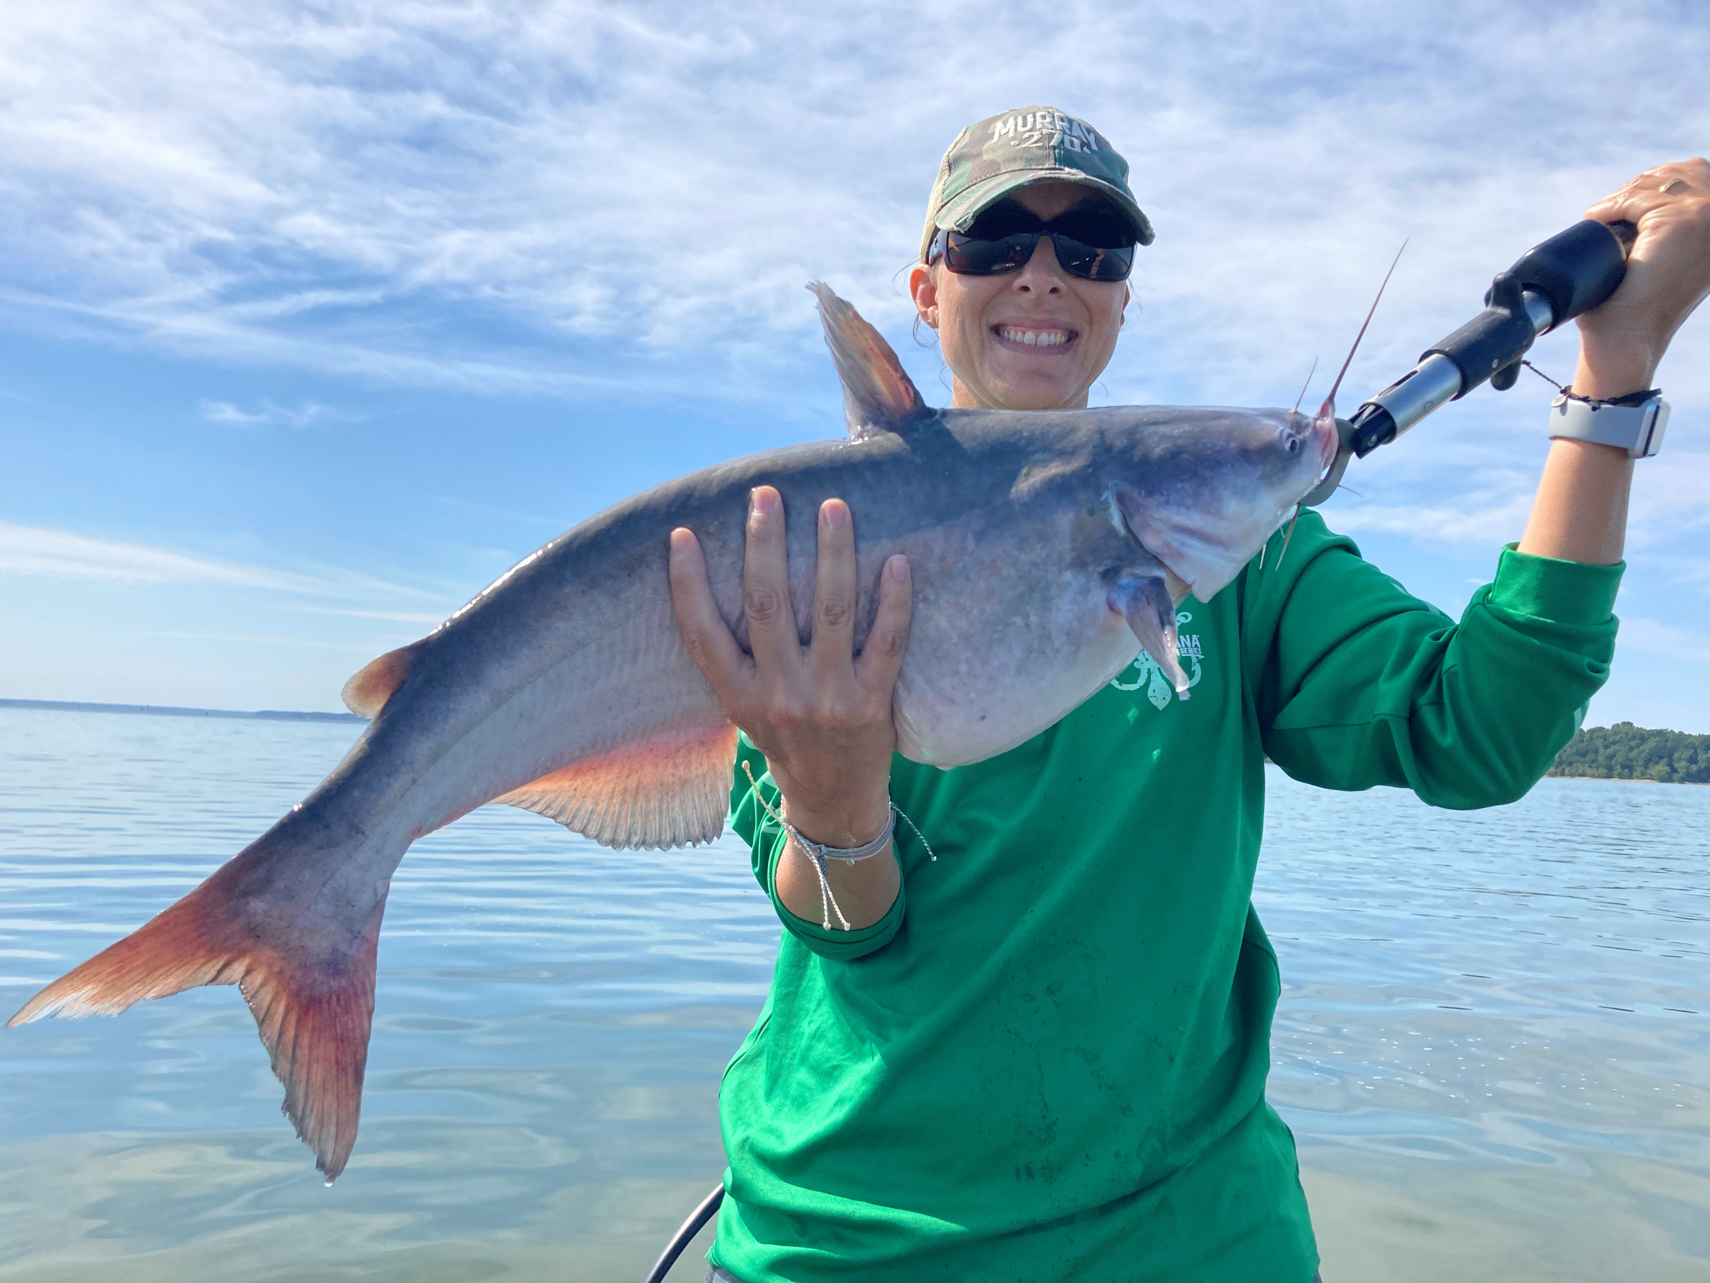
Multistate Conservation Grant Program
Credit: R. Oster
Credit: C. Sykes
Applicant Full Proposal Informational Webinar
June 29, 2021 and July 13, 2021

Slide 2
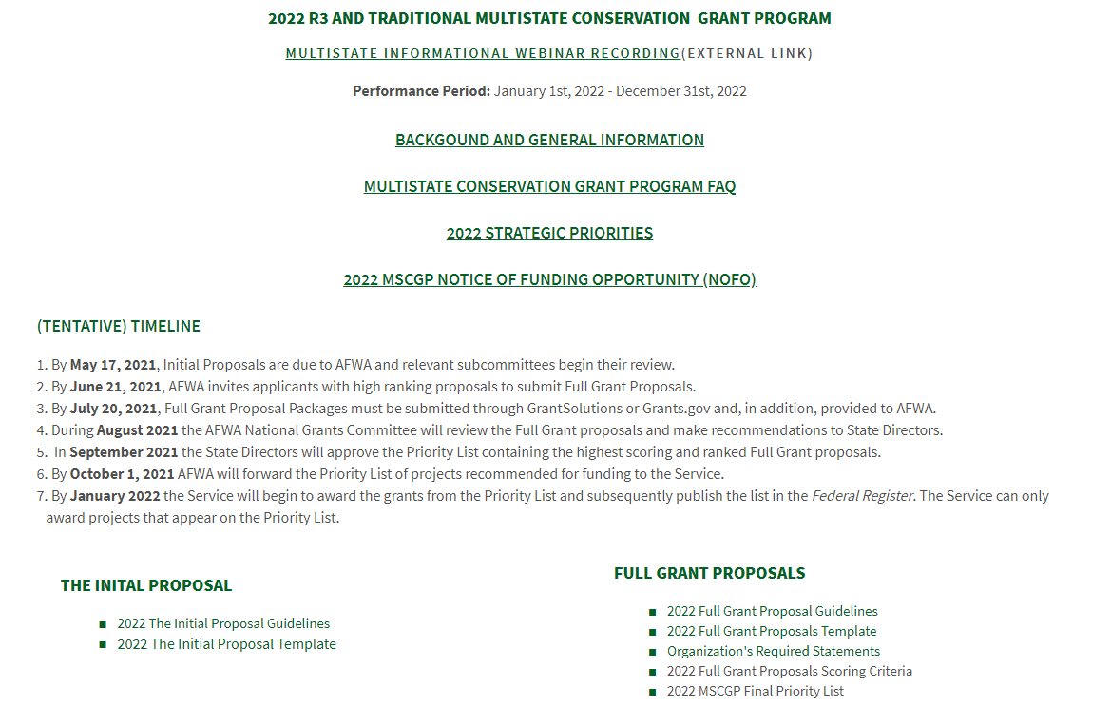
AFWA’s Multistate Conservation Page

Slide 3
Important items to remember prior to submitting a full grant proposal to AFWA and the USFWS – WSFR program.
UEI
SAM registration
ASAP (payments)
GrantSolutions / Grants.gov registration

Slide 4
Obtain a UEI
Unique Entity Identifier (UEI, currently DUNS).
Federal law mandates that all entities applying for Federal grants must have valid UEI (currently DUNS).
Unique 9-digit identifier that verifies the existence of a business entity.
Takes 1-2 business days when initiated online.
Obtain a DUNS number free at https://www.dnb.com/duns-number.html
Notes:
Federal law, and the regulations at 2 CFR 25, mandates that all entities applying for Federal grants must a valid unique entity identifier (UEI) as a universal identifier. This requirement to have valid UEI carries forward for recipients and is also required for subrecipients who receive subawards directly from the pass-through entity.
A UEI is a unique, 9-digit number that verifies the existence of a business entity worldwide. Business entities with multiple physical locations may have more than one UEI number. Presently, the UEI is provided by Dun & Bradstreet and is commonly referred to as a DUNS number. You can obtain a DUNS number, free of charge, by going to the Duns and Bradstreet website. A DUNS number may be issued as rapidly as 1-2 days, if initiated via their online portal.
A DUNS number is required prior to an entity registering in SAM, since one of the data fields required is the entity’s DUNS number. The DUNS number is used by the Federal awarding agency to search the SAM exclusion databases, prior to approving a Federal grant.
In the coming years, the Federal government will move away from a DUNS issued UEI. In place, the UEI will be issued and managed directly by SAM.gov. Presently this transition has been pushed back to April 2022.

Slide 5
SAM Registration Requirement
System for Award Management (SAM).
Federal repository into which applicants/recipients must provide required information to do business with the Federal government.
Unless waived, you must have, and maintain, an active registration in SAM in order to receive/amend a Federal grant.
Registration is free at www.SAM.gov
Notes:
In order to do business with the Federal government, applicants must register in the System for Award Management (SAM). SAM is a Federal repository that houses information about applicants and recipients who do direct business with the Federal government.
Unless you are waived, you must be registered in SAM prior to submitting a formal application for Federal funding to a Federal awarding agency. Once you have an active SAM registration, recipients are required to update their information in SAM on at least an annual basis in order to maintain the active registration. If you let your SAM registration expire, the FWS will not be able to make any financial amendments to your approved grant, while your registration is expired. Information that you will need to register in SAM includes: (1) DUNS; (2) Legal business name; (3) Address; (4) Taxpayer Identification Number (TIN)
What purpose does SAM serve? Prior to approving a Federal grant, Federal awarding agencies must verify the applicant has an active SAM registration and must do a search on the applicant (and its key project personnel) to see if they are excluded in any way from receiving Federal funds (SAM exclusions database).
Remember, in order to register in SAM, applicants must first obtain a unique entity identifier (UEI).

Slide 6
Payments under grants
U.S. Treasury’s Automated Standard Application for Payments (ASAP).
Unless waived, recipients must be registered and have a payment method established before Federal funds can be obligated to a grant.
Notes:
Applicants who receive a Federal grant will be required to enroll in the U.S. Treasury’s Automated Standard Application for Payments (ASAP) in order to receive payments under their grant. If you have never enrolled in ASAP or have never been enrolled in ASAP under a FWS grant, then WSFR staff will facilitate your enrollment by sending you an ASAP enrollment form. Once completed, WSFR will initiate your enrollment by entering information in ASAP. ASAP will notify your organization POC how to complete the enrollment process, including enter your organization’s banking information into the system.
Once your enrollment is complete, as you incur eligible and allowable costs under the grant, the person you designate with the “Payment Requestor” role can request payments as frequently as you want. You do not need to send an invoice to the Service to receive your grant funds. Funds are typically deposited electronically into your account the next business day. It is important to remember that recipients must not draw down all their funds immediately on a grant. Payments must minimize the time between requesting funds and your subsequent disbursement of those funds to pay for allowable costs or on a reimbursement basis. Additional information will be provided in your Notice of Award.

Slide 7
Registration in GrantSolutions
DOI mandated that all bureaus use GrantSolutions beginning May 2020.
Financial assistance software platform that allows Federal agencies to manage grants throughout the entire award life cycle.
Roll-based system, so recipients decide who in their organization has what roles. Click here to go to GrantSolutions.
Need to register as a new recipient in GrantSolutions? Click here to fill out the Recipient User Account Request Form.
Notes:
The Service adopted GrantSolutions as its official system for financial assistance in May 2020. GrantSolutions is a role-based system that allows both the Service and its applicants/recipients to fully utilize and manage financial assistance grant awards throughout the entire life cycle of the grant award. It allows recipients to search for and apply for funding, as well as fulfill the grant award requirements once they are awarded a grant. If you are not registered in GrantSolutions, you will be required to do so prior to submitting a grant application. In order to register, new users must complete a Recipient User Account Request Form (there is a link provided to this directly on the powerpoint slide) and submit it to the GrantSolutions Help Desk.
Applicants/Recipients have the ability to assign up to 5 different roles to various individuals within their organization. Each role allows users to complete different tasks in GrantSolutions. The roll of “Authorizing Official/Representative” is the highest level roll for recipients in GrantSolutions, but other roles include “Financial Officer”, “Financial Officer Support”, and “Program Director/Principal Investigator”.

Slide 8
Full Proposal Requirements
A complete full proposal includes the following elements/documents:
Part I: Required Federal forms
SF-424
SF-424 A/C
SF-424D, if applicable
Required Certification Statements
NICRA, if applicable
Part II: Grant Proposal
Project Summary (1-page) and Narrative (8-pages)
Budget Narrative
Project Personnel Qualifications (1 paragraph/person)

Slide 9
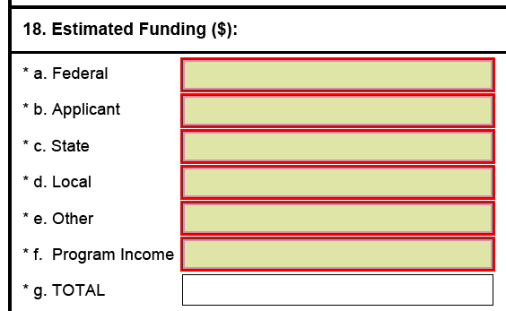
SF-424 (AFA)
OMB-approved common form for applicants (not individuals) of Federal financial assistance funding.
Form is available in GrantSolutions and grants.gov.

Slide 10
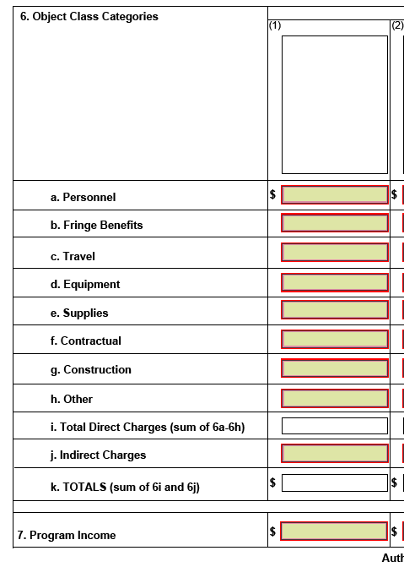
SF-424A/C
OMB-approved common form for budget information for non-construction or construction programs.
Instructional Video:
https://wsfrtraining.fws.gov/mod/page/view.php?id=213

Slide 11
SF-424A/C
OMB-approved common form for budget information for non-construction or construction programs.
Instructional Video:
https://wsfrtraining.fws.gov/mod/page/view.php?id=213
Estimated funds for personnel costs (salaries/wages) of employees performing activities of the proposed project.
(2 CFR 200.430 “Compensation – personal services)

Slide 12
SF-424A/C
OMB-approved common form for budget information for non-construction or construction programs.
Instructional Video:
https://wsfrtraining.fws.gov/mod/page/view.php?id=213
Estimated funds for fringe benefits of employees performing activities of the proposed project.
(2 CFR 200.431 “Compensation – fringe benefits)

Slide 13
SF-424A/C
OMB-approved common form for budget information for non-construction or construction programs.
Instructional Video:
https://wsfrtraining.fws.gov/mod/page/view.php?id=213
Estimated funds for travel costs of employees performing activities of the proposed project.
(2 CFR 200.474 “Travel costs”)

Slide 14
SF-424A/C
OMB-approved common form for budget information for non-construction or construction programs.
Instructional Video:
https://wsfrtraining.fws.gov/mod/page/view.php?id=213
Estimated funds for equipment acquisition or depreciation needed for the activities of the proposed project.
(2 CFR 200.474 “Equipment and other capital expenditures”)
(2 CFR 200.436 “Depreciation”)

Slide 15
SF-424A/C
OMB-approved common form for budget information for non-construction or construction programs.
Instructional Video:
https://wsfrtraining.fws.gov/mod/page/view.php?id=213
Estimated funds for the acquisition of supplies needed for the activities of the proposed project.
(2 CFR 200.314 “Supplies”)

Slide 16
SF-424A/C
OMB-approved common form for budget information for non-construction or construction programs.
Instructional Video:
https://wsfrtraining.fws.gov/mod/page/view.php?id=213
Estimated funds for any contractual costs needed for the activities of the proposed project.
Contracts are defined as the legal instrument by which the applicant purchases/obtains property or services needed to carry out a project under a Federal award.
Notes:
Conversely, a subaward is an award provided by a pass-through entity to a subrecipient for the subrecipient to carry out part or all of a Federal award received by the pass-through entity. A subaward may be provided through any form of legal instrument, including an agreement that the pass-through entity considers a contract.
WSFR recommends that budgeted amounts for subawards be listed in the “Other” category of the budget form.

Slide 17
SF-424A/C
OMB-approved common form for budget information for non-construction or construction programs.
Instructional Video:
https://wsfrtraining.fws.gov/mod/page/view.php?id=213
Estimated funds for construction and other types of capital expenditures needed for the activities of the proposed project.

Slide 18
SF-424A/C
OMB-approved common form for budget information for non-construction or construction programs.
Instructional Video:
https://wsfrtraining.fws.gov/mod/page/view.php?id=213
Estimated funds for all other direct costs (subawards, rental costs, printing, conference costs, training, participant support costs, and relocation) needed for the activities of the proposed project.

Slide 19
SF-424A/C
OMB-approved common form for budget information for non-construction or construction programs.
Instructional Video:
https://wsfrtraining.fws.gov/mod/page/view.php?id=213
Estimated funds for the amount of indirect costs allocable for the activities of the proposed project. Indirect costs are those costs that are incurred for a common or joint purpose benefitting more than one cost objective, and not readily assignable to the cost objective.

Slide 20
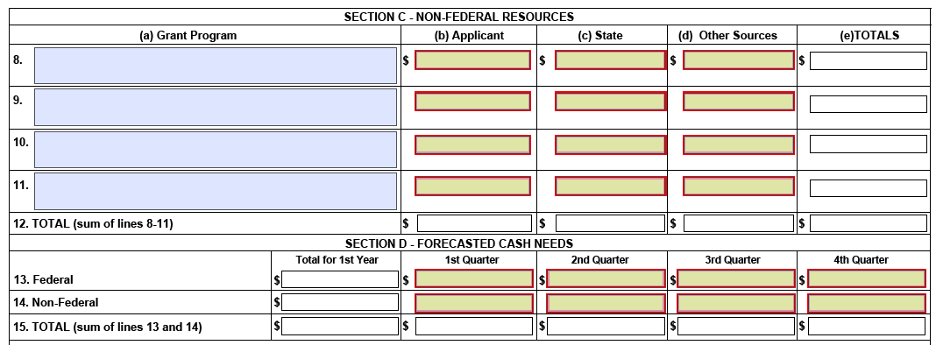
SF-424A/C
OMB-approved common form for budget information for non-construction or construction programs.

Slide 21
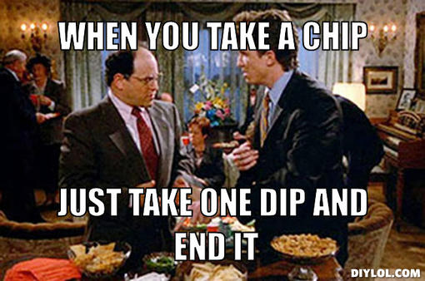
Allowable Costs
Necessary and reasonable.
Conform to 2 CFR 200 and terms & conditions of Federal award.
Consistent with policies and procedures to both Federal and other activities of the non-Federal entity.
Accorded consistent treatment.
In accordance with GAAP.
Not included as a cost of another Federal program.
Adequately documented.
Incurred during the approved budget period.
2 CFR 200.403

Slide 22
Required Applicant Statements
Full applications must include the following required statements (preferably on your organization’s official letterhead).
Certification Regarding Hunting, Trapping, Fishing, Recreational Shooting.
Single Audit Reporting Statement.
Indirect Cost Statement.
Overlap/Duplication Statement
Conflict of Interest, if applicable

Slide 23
Hunting, Fishing, Shooting
Each applicant organization must provide a certification statement…
Our organization will not use the grant funds to fund, in whole or in part, any activity of the organization that promotes or encourages opposition to the regulated hunting or trapping of wildlife, regulated taking of fish, or to recreational shooting activities; and
Our organization will not use a grant, in whole or in part, for an activity, project, or program that promotes or encourages opposition to the regulated hunting or trapping of wildlife, regulated taking of fish, or to recreational shooting activities.
- 16 U.S.C. 669h-2
- 16 U.S.C. 777m

Slide 24
Single Audit Statement
A [insert your organization type] that was required to submit a Single Audit report for the organization's most recently closed fiscal year and that report is not available on the Federal Audit Clearinghouse Single Audit Database website.
A [insert your organization type] that was not required to submit a Single Audit report for the organization's most recently closed fiscal year.
A [insert your organization type] that was required to submit a Single Audit report for the organization's most recently closed fiscal year and that report is available on the Federal Audit Clearinghouse Single Audit Database website. The report is filed under the EIN of [insert EIN].

Slide 25
Indirect Cost Statement
State or local government entity:

Slide 26
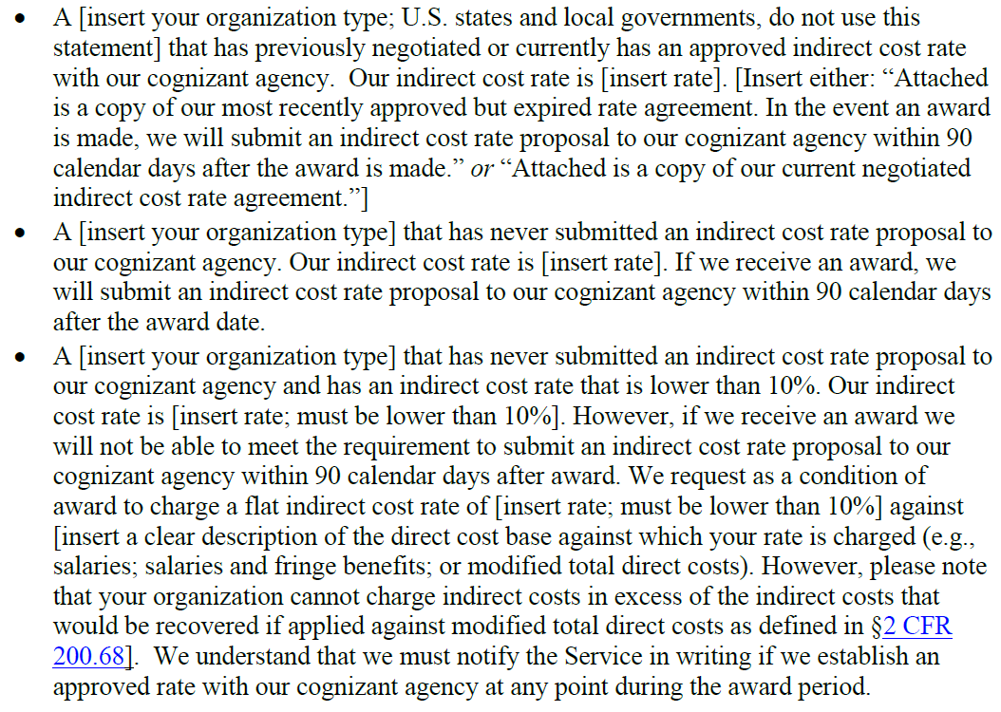
Indirect Cost Statement
Other organization entity types:

Slide 27
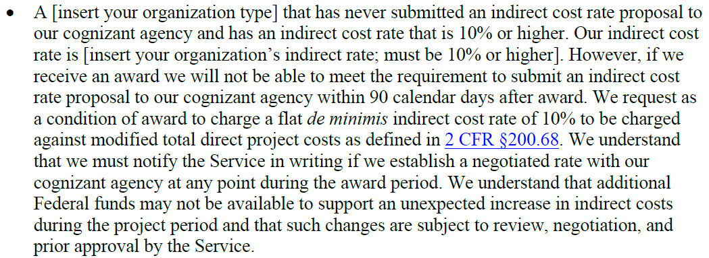
Indirect Cost Statement
Other organization entity types:

Slide 28
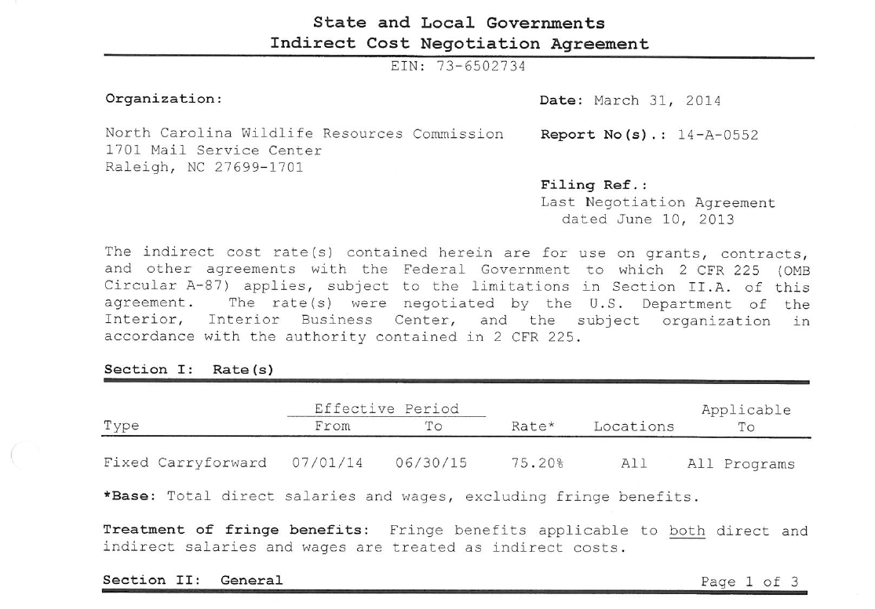
Example NICRA letter

Slide 29
Overlap/Duplication Statement
Is there overlap between this Federal application and any other Federal application, or funded project, regarding activities, costs, or time commitment?
If no, please state.
If yes, explain the overlap and provide a copy of the duplicative proposal (when submitted and when you anticipate being notified of a funding decision).
“We understand that if at any time, we receive funding from another source that is duplicative of the funding we are requesting from the USFWS in this application, we will immediately notify the USFWS point of contact in writing.”

Slide 30
Conflict of Interest
Applicant must state in their application if any actual or potential conflict of interest exists at the time of submission.
When subawarding funds to a subrecipient, the subrecipient must report any actual or potential conflict of interest to the pass-through entity.
2 CFR 200.112

Slide 31
Grant Proposal Information
AFWA provides a wonderful full proposal template (see Slide #2) for applicants to populate with their project information.
Let’s walk thru it and highlight a few areas.

Slide 32
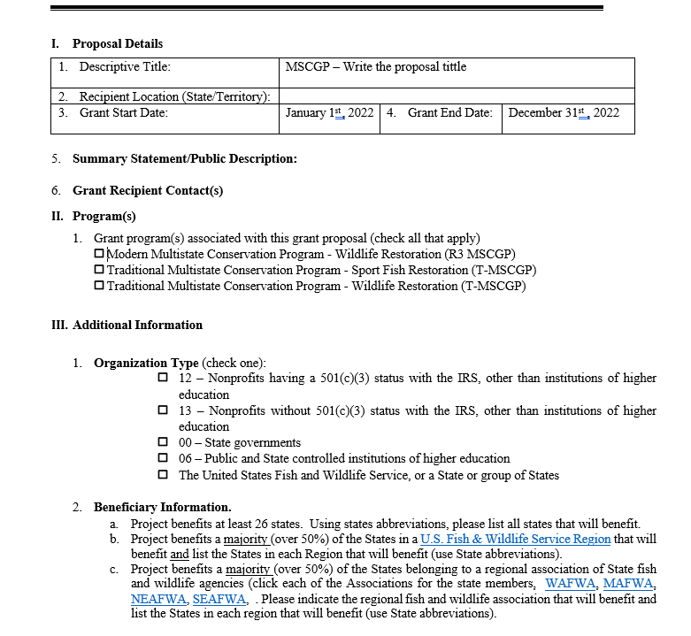
Full Grant Proposal Template
Page 1

Slide 33
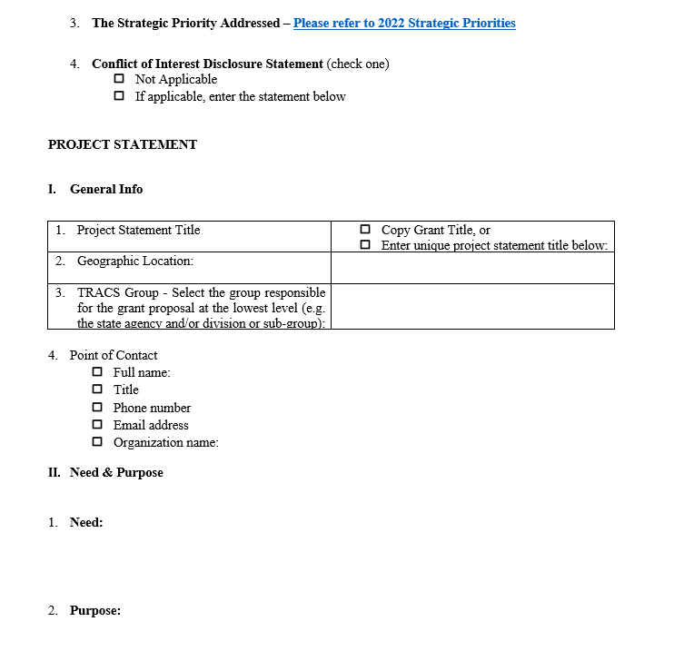
Full Grant Proposal Template
Page 2

Slide 34
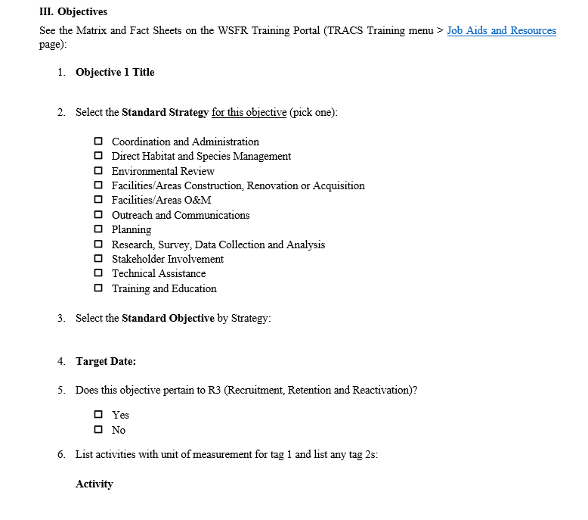
Full Grant Proposal Template
Page 2-3

Slide 35
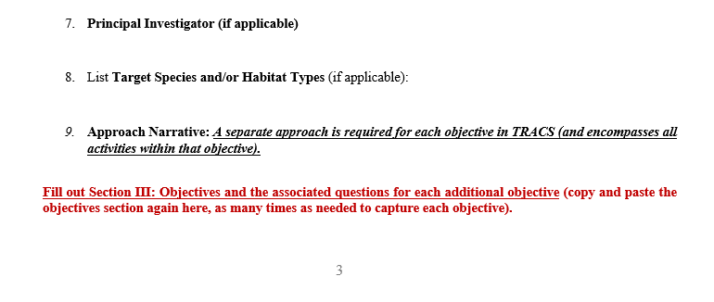
Full Grant Proposal Template
Page 3

Slide 36
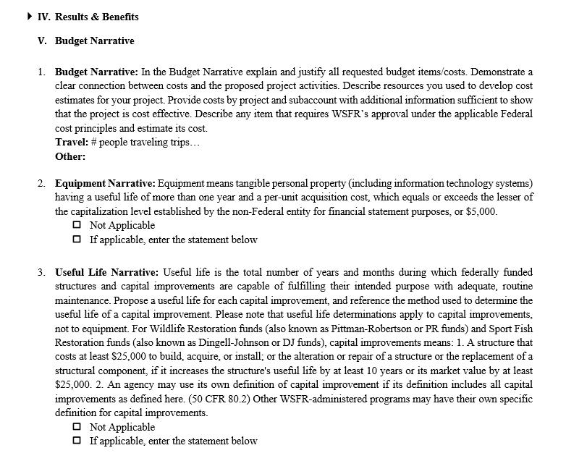
Full Grant Proposal Template
Page 3-4
Notes:
Pre-award costs are those costs incurred prior to the effective date of the Federal award or subaward directly pursuant to the negotiation and in anticipation of the Federal award where such costs are necessary for the efficient and timely performance of the scope of the work. Such costs are allowable only to the extent that they would have been allowable if incurred after the start date of the period of performance and only with the written approval of the Federal awarding agency.

Slide 37
Full Grant Proposal Template
Page 4

Slide 38
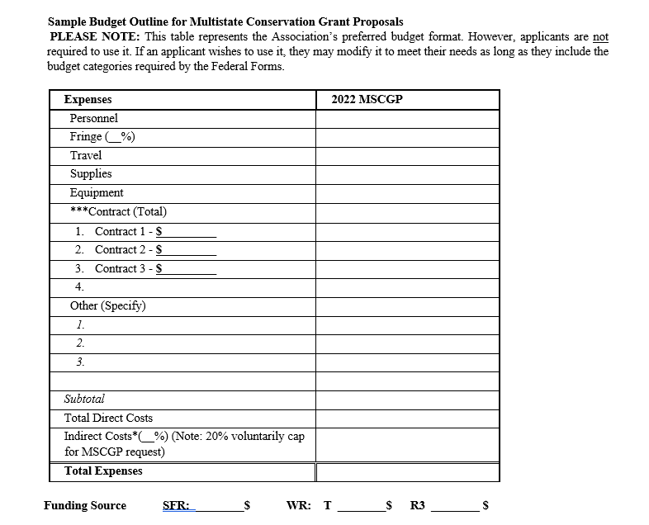
Full Grant Proposal Template
Page 5

Slide 39
Full Grant Proposal Template
Page 6

Slide 40
Submission of Full Proposals
Full proposals must be submitted by July 20, 2021 (5:00pm EST), to both:
AFWA: via their application portal (requires a user account).
https://afwamscgp.smapply.io/
USFWS – WSFR Program via.
www.GrantSolutions.gov or www.grants.gov
Search “F22AS00011” or “Multistate Conservation Grant Program”
Applicants are encouraged not to wait to the last minute to submit applications.

Slide 41
Need Assistance?
AFWA
Silvana Yaroschuk – syaroschuk@fishwildlife.org
WSFR
John Stremple - john_stremple@fws.gov
Lori Bennett - lori_bennett@fws.gov
Yonah Cohen - yonah_cohen@fws.gov
Margaret Druyor - margaret_druyor@fws.gov
Mike Sawyers - michael_sawyers@fws.gov
Ryan Oster - ryan_oster@fws.gov

Slide 42
Any Questions

