Slide 1
WELCOME
TRACS Objective Builder Webinar
Multi State Conservation Grants
June 28-29 2021 1pm-3pm ET
July 12-13 2021 1pm-3pm ET

Slide 2
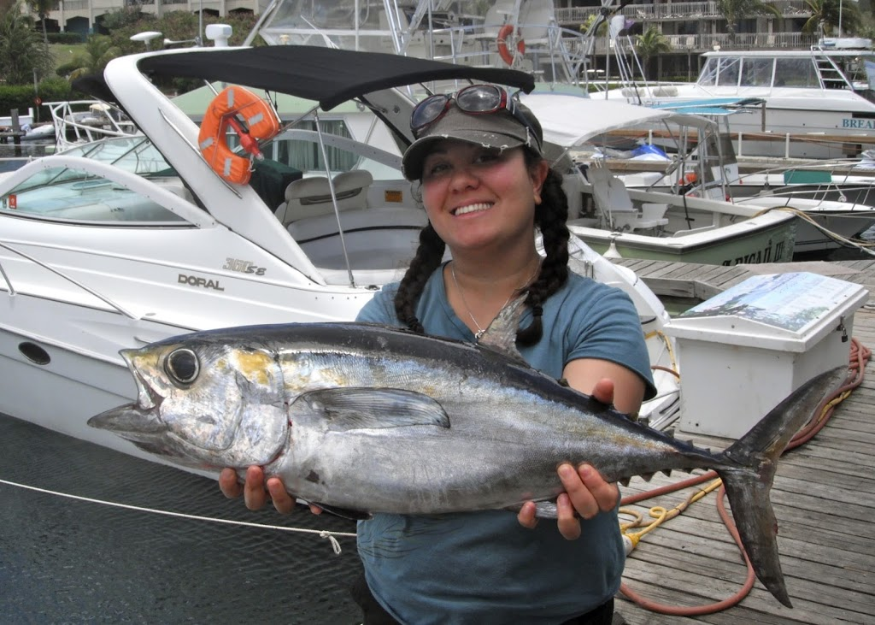
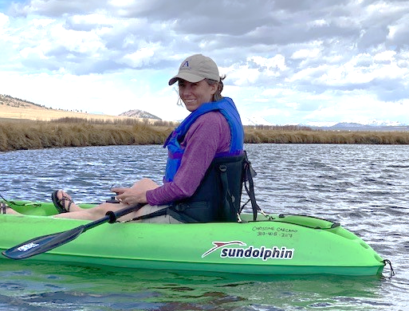
Meet the Instructors
Yonah Cohen
Training Coordinator
Meg Druyor
eLearning Specialist

Slide 3
Agenda
Introductions
TRACS Overview
TRACS Objective Format
TRACS Matrix Demonstration
TRACS Objective Builder Demo
Wrap Up

Slide 4
What is TRACS
Tracking and Reporting Actions for the Conservation of Species

Slide 5
Why TRACS
Gather performance data
Share accomplishments
Provide data to stakeholders
Illustrate your success
Identify your objectives
Substantial in character and design

Slide 6
TRACS Working Group (WG)
29 State and Federal representatives
National review
Thousands of hours of development and testing
Unanimously accepted

Slide 7
TRACS-Formatted Objectives
Activities
Specific
Measurable
Timebound
Clearly describes what we expect to achieve
Objective
Strategy
Approach

Slide 8
Approach
Activities
Describes the work in detail
Objective
Strategy
Approach

Slide 9
Strategy
Activities
Plan of action designed to resolve a conservation issue or problem
Objective
Strategy
Approach

Slide 10
Standard Strategies
Coordination & Administration
Direct Habitat & Species Management
Environmental Review
Facilities/Areas Construction, Renovation, or Acquisition
Facilities/Areas Operation & Maintenance
Incentives
Outreach / Communication
Planning
Real Property Acquisition
Research, Survey, Data Collection and Analysis
Species Stocking
Stakeholder Involvement
Technical Assistance
Training / Education

Slide 11
Objective
Activities
Further defines the intent
Objective
Strategy
Approach

Slide 12
Activities
Activities
Details the steps required to achieve the objective
Objective
Strategy
Approach

Slide 13
Aquatic Education Objective Example
Activity Tag 2
Aquatic Resource Education
Angler Education
Objective Title:
1000 Students Complete Aquatic Education Training by 12/31/2022.
Activity Tag 1
Aquatic Education
(Unit of Measure)
Standard Objective
Students Complete Training
Strategy
Training / Education
Notes:
Students complete training, train instructors/mentors, O&M facilities

Slide 14
Translate your Objectives

Slide 15
Testing and Implementation of the Hunter Avidity Model to Assess & Improve R3 Participation
Objective 1 - Survey States to Determine Operational Capacity: The survey will measure interest in using the Model and Scale, potential barriers affecting use of the tool, and any state-specific issues that may limit its adoption
Objective 2 - Conduct Focus Groups with Agency Professionals to Fine Tune the Model and Scale: Following analysis of the survey findings, we will convene a series of focus groups with agency professionals (to include marketing, licensing, and R3 specialists) to solicit feedback on the survey implications and determine how best to finalize development of the Model and Scale.
Objective 3 - Pilot State Projects: This final stage entails pilot testing to evaluate the application of the Model to make any final refinements to the Avidity Model and Scale for wide-scale implementation across the country. The partners will select a representative group of test states encompassing the four AFWA regions and work with agency personnel to incorporate the model into their systems.

Slide 16
Highlighted key words to search the Matrix
Testing and Implementation of the Hunter Avidity Model to Assess & Improve R3 Participation
Objective 1 - Survey States to Determine Operational Capacity: The survey will measure interest in using the Model and Scale, potential barriers affecting use of the tool, and any state-specific issues that may limit its adoption
Objective 2 - Conduct Focus Groups with Agency Professionals to Fine Tune the Model and Scale: Following analysis of the survey findings, we will convene a series of focus groups with agency professionals (to include marketing, licensing, and R3 specialists) to solicit feedback on the survey implications and determine how best to finalize development of the Model and Scale.
Objective 3 - Pilot State Projects: This final stage entails pilot testing to evaluate the application of the Model to make any final refinements to the Avidity Model and Scale for wide-scale implementation across the country. The partners will select a representative group of test states encompassing the four AFWA regions and work with agency personnel to incorporate the model into their systems.

Slide 17
Objective Title: Conduct 1 Investigation of the Hunter Avidity Model by December 31, 2022
Testing and Implementation of the Hunter Avidity Model to Assess & Improve R3 Participation
Strategy: Research, Survey, Data Collection, and Analysis
Objective: Conduct Investigations
Target Date: 12/31/2022
Activity Tag 1: Recruitment, Retention, and Reactivation Data Acquisition and Analysis
Activity Tag 2: Not Applicable
Unit of Measure (UOM): # of investigations (1)
Additional Required Information: None

Slide 18
Objective: Conduct 1 Investigation of the Hunter Avidity Model by December 31, 2022
Objective 1 - Survey States to Determine Operational Capacity: The survey will measure interest in using the Model and Scale, potential barriers affecting use of the tool, and any state-specific issues that may limit its adoption
Objective 2 - Conduct Focus Groups with Agency Professionals to Fine Tune the Model and Scale: Following analysis of the survey findings, we will convene a series of focus groups with agency professionals (to include marketing, licensing, and R3 specialists) to solicit feedback on the survey implications and determine how best to finalize development of the Model and Scale.
Objective 3 - Pilot State Projects: This final stage entails pilot testing to evaluate the application of the Model to make any final refinements to the Avidity Model and Scale for wide-scale implementation across the country. The partners will select a representative group of test states encompassing the four AFWA regions and work with agency personnel to incorporate the model into their systems.

Slide 19
Original Objective: Conduct 1 Investigation of the Hunter Avidity Model by December 31, 2022
Approach Narrative
Survey States to Determine Operational Capacity: The survey will measure interest in using the Model and Scale, potential barriers affecting use of the tool, and any state-specific issues that may limit its adoption.
Conduct Focus Groups with Agency Professionals to Fine Tune the Model and Scale: Following analysis of the survey findings, we will convene a series of focus groups with agency professionals (to include marketing, licensing, and R3 specialists) to solicit feedback on the survey implications and determine how best to finalize development of the Model and Scale.
Pilot State Projects: This final stage entails pilot testing to evaluate the application of the Model to make any final refinements to the Avidity Model and Scale for wide-scale implementation across the country. The partners will select a representative group of test states encompassing the four AFWA regions and work with agency personnel to incorporate the model into their systems.

Slide 20
Objective: Conduct 15 archery safety training events for high school students by 12/31/2022
Objective: Hold 15 hunter education classes that teach high school students the safety features of a compound bow.
Strategy: Training / Education
Objective: Conduct Training Events
Target Date: 12/31/2022
Activity Tag 1: Hunter Education
Activity Tag 2: Archery-Shooting
Unit of Measure (UOM): Number of Events (15)
Additional Required Information: None

Slide 21
Additional Examples

Slide 22
Project Title: Archers USA Varsity Archery next step program taking Recruitment into Retention, transitioning the National Archery in the Schools Program Participants into Bowhunters
The goal for this project is twofold. Goal one is to create future bowhunters from the pool of archers that participate in the school program and the second is to track these participants with individual customer ID numbers that can be used to follow their progression.
Objective 1. Outfit 10 schools per state with the equipment and training to implement Varsity Archery at the High School level. Approach Narrative
Objective 2. Fold in the simple modifications to the NASP state tournament to include using the bows outfitted
with sights and release aids. Approach Narrative
Objective 3. Provide an online hunter education course that provides a unique identifier to each participant.
Objective 4. Support mentored hunts that allow for these bows to be used by students that don’t have one of their own.

Slide 23
Original Project Title: Archers USA Varsity Archery next step program taking Recruitment into Retention, transitioning the National Archery in the Schools Program Participants into Bowhunters
The goal for this project is twofold. Goal one is to create future bowhunters from the pool of archers that participate in the school program and the second is to track these participants with individual customer ID numbers that can be used to follow their progression.
Objective 1. Outfit 10 schools per state with the equipment and training to implement Varsity Archery at the High School level. Approach Narrative
Objective 2. Fold in the simple modifications to the NASP state tournament to include using the bows outfitted
with sights and release aids. Approach Narrative
Objective 3. Provide an online hunter education course that provides a unique identifier to each participant.
Objective 4. Support mentored hunts that allow for these bows to be used by students that don’t have one of their own.

Slide 24
Objective 3. Provide an online hunter education course that provides a unique identifier to each participant.
Number of Students
Strategy: Training / Education
Objective: Students Complete Training
Activity Tag 1: Hunter Education
Activity Tag 2: Archery – Hunting
Unit of Measure: Number of students
Number of Trainings Created
Strategy: Outreach / Communication
Objective: Produce products
Activity Tag 1: Digital products
Activity Tag 2: N/A
Unit of Measure: Number of products
Number of Events
Strategy: Training / Education
Objective: Conduct Training Events
Activity Tag 1: Hunter Education
Activity Tag 2: Archery – Hunting & Archery – Shooting
Unit of Measure: Number of Events

Slide 25
Project Title Review: Archers USA Varsity Archery next step program taking Recruitment into Retention, transitioning the National Archery in the Schools Program Participants into Bowhunters
The goal for this project is twofold. Goal one is to create future bowhunters from the pool of archers that participate in the school program and the second is to track these participants with individual customer ID numbers that can be used to follow their progression.
Objective 1. Outfit 10 schools per state with the equipment and training to implement Varsity Archery at the High School level. Approach Narrative
Objective 2. Fold in the simple modifications to the NASP state tournament to include using the bows outfitted
with sights and release aids. Approach Narrative
Objective 3. Provide an online hunter education course that provides a unique identifier to each participant.
Objective 4. Support mentored hunts that allow for these bows to be used by students that don’t have one of their own.

Slide 26
Project Title Review Part 2: Archers USA Varsity Archery next step program taking Recruitment into Retention, transitioning the National Archery in the Schools Program Participants into Bowhunters
Sponsored Hunt
Strategy: Outreach / Communication
Objective: Participate in / or Sponsor Events
Activity Tag 1: Outreach Events
Activity Tag 2: Not Applicable
Unit of Measure: Number of events
The goal for this project is twofold. Goal one is to create future bowhunters from the pool of archers that participate in the school program and the second is to track these participants with individual customer ID numbers that can be used to follow their progression.
Objective 1. Outfit 10 schools per state with the equipment and training to implement Varsity Archery at the High School level. Approach Narrative
Objective 2. Fold in the simple modifications to the NASP state tournament to include using the bows outfitted
with sights and release aids. Approach Narrative
Objective 3. Provide an online hunter education course that provides a unique identifier to each participant.
Objective 4. Support mentored hunts that allow for these bows to be used by students that don’t have one of their own.

Slide 27
Project Title (with Updated Objectives Below): Archers USA Varsity Archery next step program taking Recruitment into Retention, transitioning the National Archery in the Schools Program Participants into Bowhunters
Objective 1: X Students complete online archery hunter education training by 12/31/2022
Objective 2: Produce 1 online training by 12/31/2022
Objective 3: Conduct X online archery hunter education training event(s) by 12/31/2022
Objective 4. Sponsor X archery hunting event(s) by 12/31/2022
Note: Unit of Measure is missing from original objectives and noted with an X.

Slide 28
After the session
P
ARKING
Parking Lot
sent out with Q&A

Slide 29
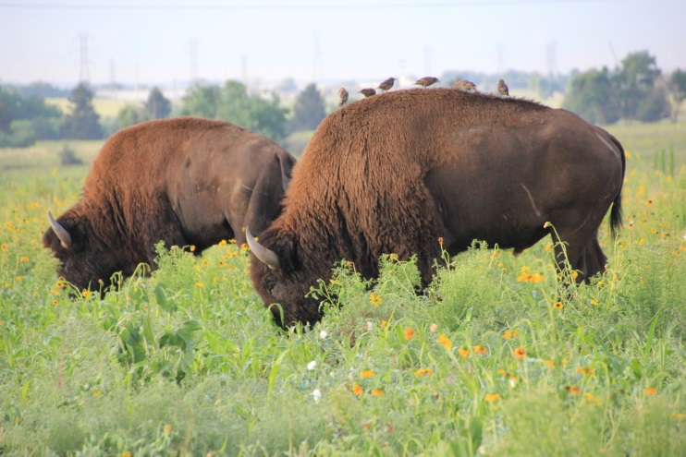
Thank you!
The WSFR TRACS Team

