Slide 1
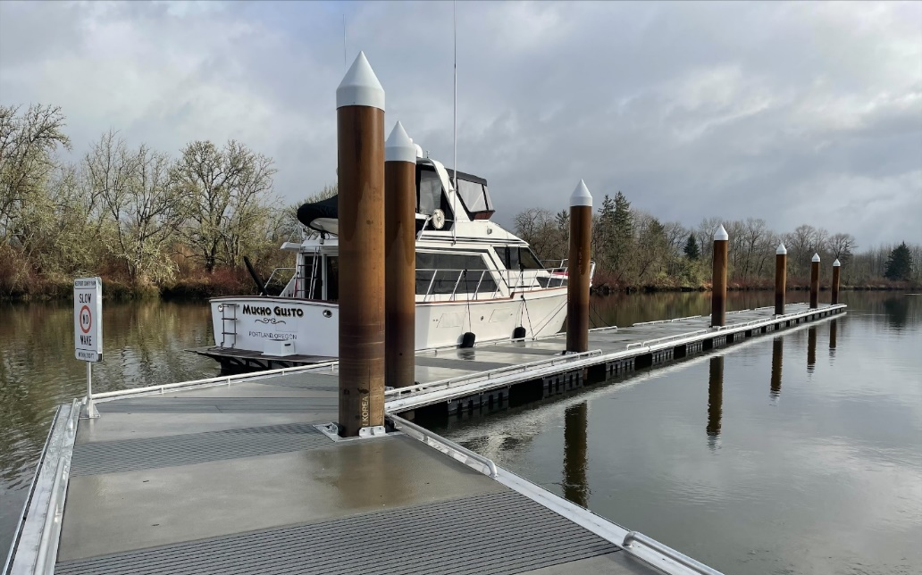
National Reviewer’s Perspective Tier 2
June 30, 2022

Slide 2
Significant Commitment
Notes:
Time commitment – Significant. A good to average application will take about 2 hours to read, review and rank. A BELOW average application can take twice the amount of time. There were 25 applications last year minimum of 50 hours, however it took about 70 hours plus ranking committee discussions. Estimated time spent ranking 25 applications is 90-100 hours.

Slide 3
Brad, Do you have clarifications on proration?
Brad, Is there a clearer image?
Brad, Is this the entire application?
Brad, What is the water depth?
Brad….

Slide 4
Use the same numbering and headings from the NOFO
Notes:
This makes it easier on reviewers.

Slide 5
MAPS &
LOCATIONS

Slide 6
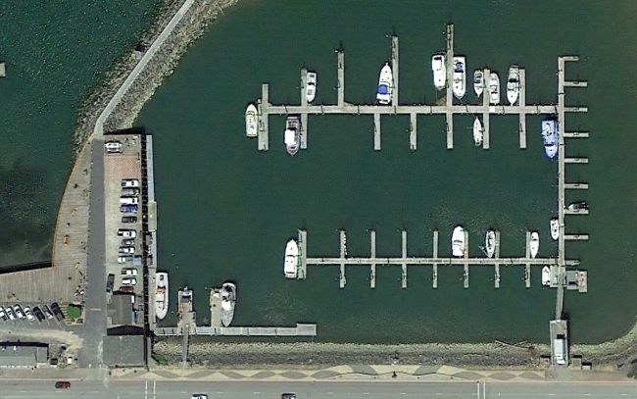
Where is the project within the basin?
Notes:
Not bad resolution. BUT where is the project located within the basin?

Slide 7
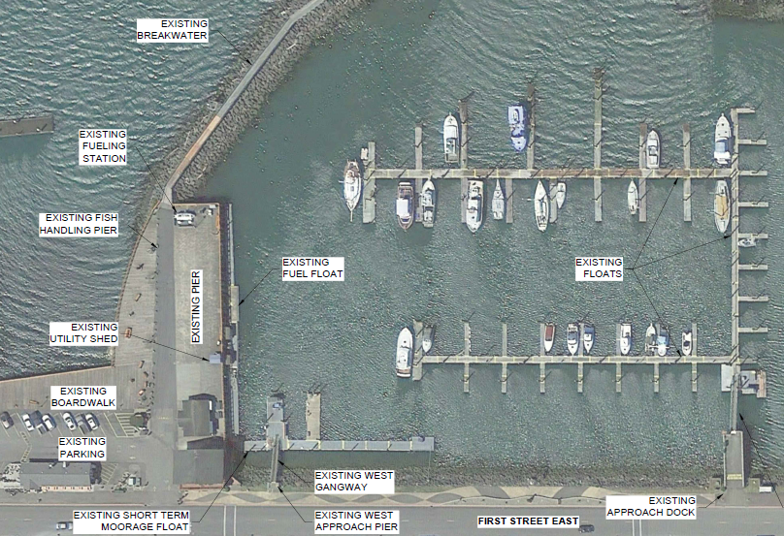
More information but….
Where is the project within the basin?

Slide 8
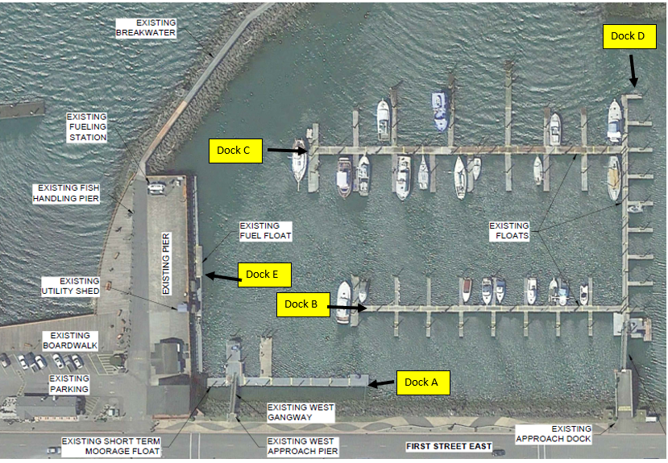
Better…Narrative connection on dock location

Slide 9
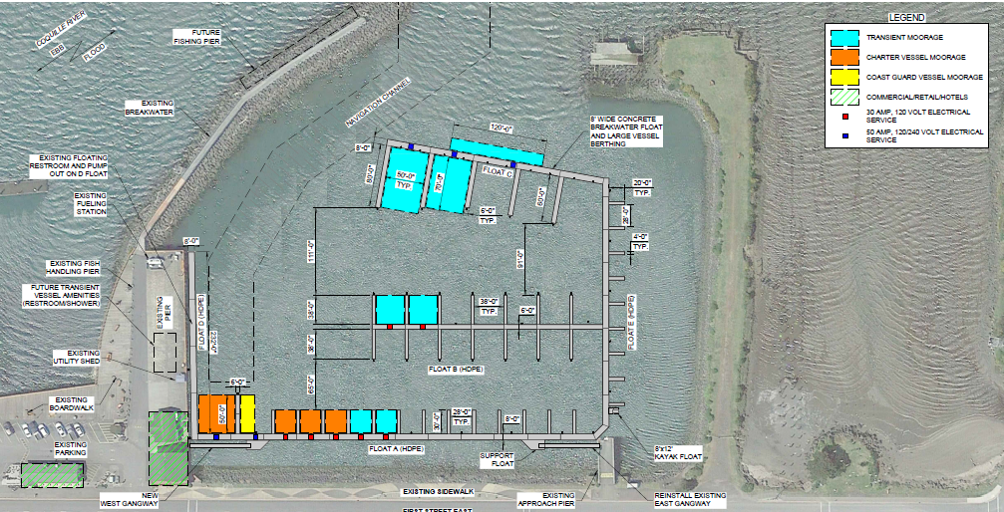
Better…Narrative connection on dock location and utilities

Slide 10
Where is the pumpout station?

Slide 11
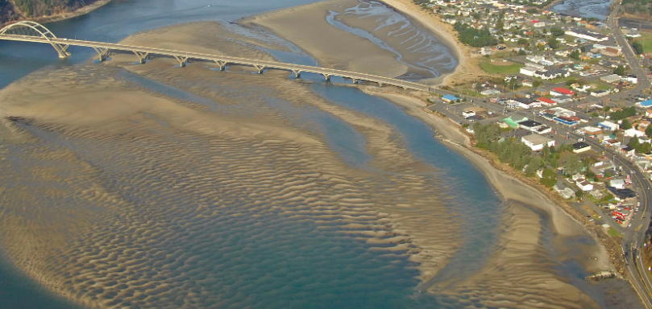
Is there 6 feet of water depth or navigable depth?
If application includes dredging, is it prorated and within dollar limitation?

Slide 12
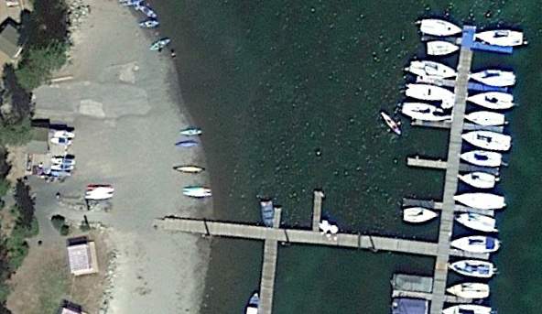
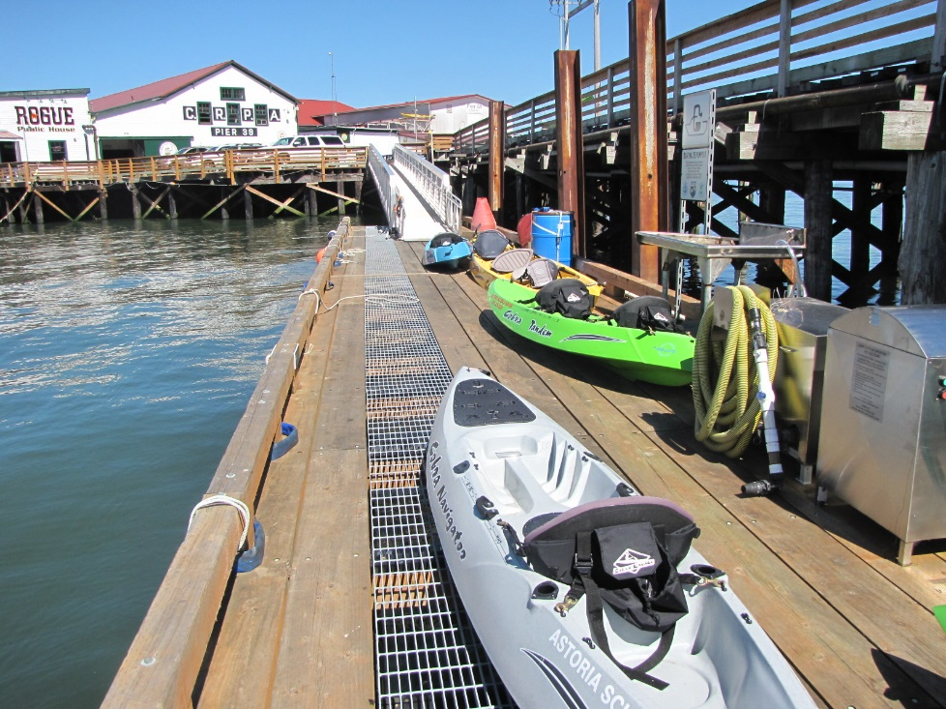
?
Who are the users and what is the need?

Slide 13
Hints and Risk

Slide 14
Funding Restrictions:
The XXXXXX acknowledges and will operate and manage the BIG funded recreational transient tie-up slips as follows:
Limit use of overnight docks to eligible boats that are 26 feet or more in length staying no more than 15 consecutive days in a 30-day period;
Operate and maintain the facilities for the intended purpose for its useful life as originally proposed or as extended pursuant to 50 CFR 86.14(b)(2), except in the case of a catastrophic event;
Clearly designate eligible uses and inform the public of restrictions;
Offer security, safety and service for eligible users and boats;
Be open and accessible to eligible vessels on navigable waters that are at least 6 feet deep at the lowest tide or fluctuation, unless the XXXXXX can show that the facility will still serve its intended purpose for typical eligible users that visit the location;
Allow public access as described at 50 CFR 86.92;
If the XXXXXX allows overnight stays provide pumpout service.
Notes:
In NOFO there is usually something that says Funding Restrictions. Have applicant acknowledge those items and any State items in writing. Oregon does Risk Assessment prior to submitting applications.

