Slide 1
Red Flags & Reminders

Slide 2
Missing Application Components
SF-424 form, Application for Federal Assistance
SF-424C form, Budget Information for Construction Program
SF-424D form, Assurances (unless on file)
Project Abstract Summary Form
Project Narrative
Budget Narrative
Maps, Drawings, Photographs
Conflict of Interest Disclosure
Uniform Audit Reporting Statement
SF-LLL form, Disclosure of Lobbying Activities form (if applicable)
Overlap or Duplication of Effort Statement
Indirect Cost Statement a copy of your current NICRA, if applicable
Detailed Responses to the Ranking Criteria.

Slide 3
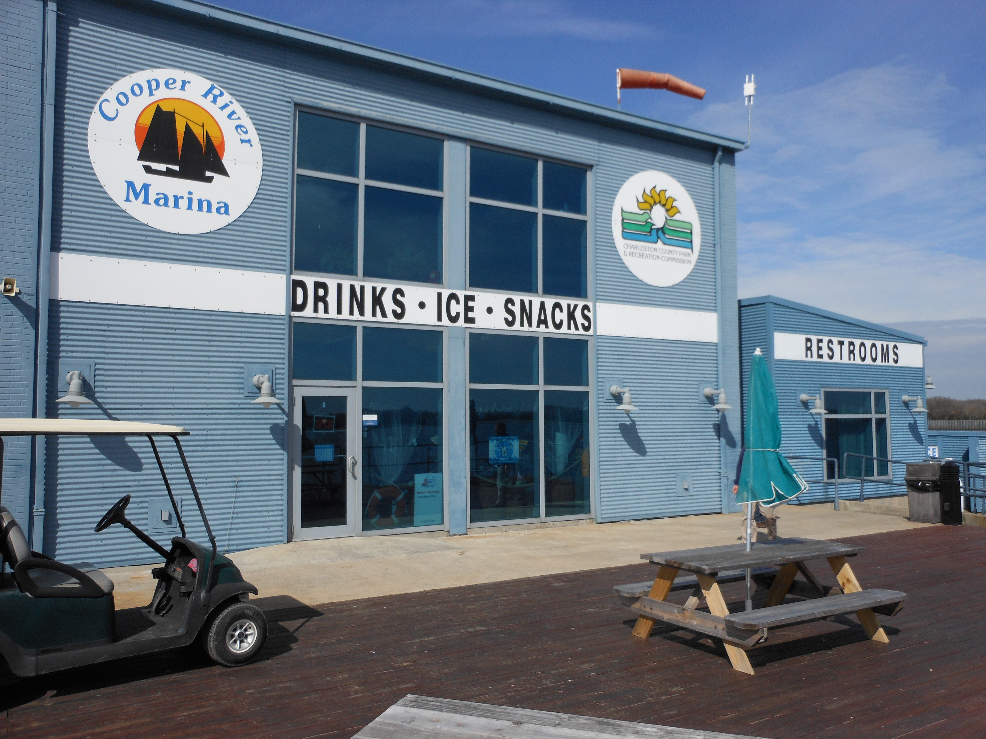
Ineligible Items/Activities
Any infrastructure for ineligible users only
Roads, parking lots, walkways
Ship stores
Food service
Boat storage or repair facilities
Purchase of land
Law enforcement

Slide 4
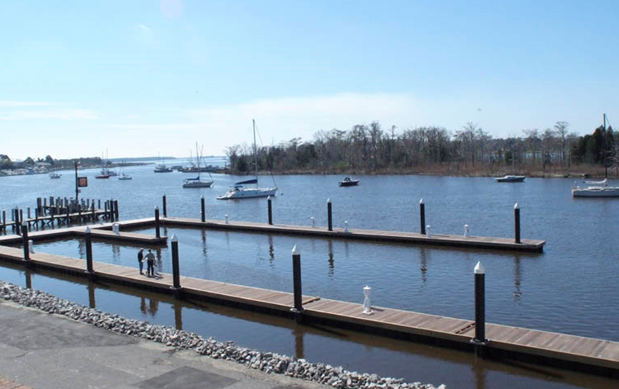
Shared Infrastructure - proration
Restrooms
Breakwaters
Sea walls
Docks
Fueling systems
Gangways
Dredging

Slide 5
Poor Explanation of Need
Why is the project necessary and how does it fulfill the purpose of BIG?
Describe existing transient facilities in the area.
Provide data to support the expected # of transient vessels and why existing facilities are insufficient to meet the need.
Provide waitlists, current occupancy, market analysis or other mechanism to show the eligible BIG users are locally underserved.

Slide 6
Missing Useful Life Estimations
Estimate useful life (in years) of each capital improvement for the project.
Capital Improvement: a structure that costs at least $25K to build, or the renovation of a structure that costs at least $25K and increases the useful life by 10 years+.
Explain your methodology. Did you use generally accepted methods of estimation?
What is your monitoring plan over the 20+ years of useful life?

Slide 7
Red Flags cont.
Docks adjacent to dry-stacks or boat ramp-staging areas
100 slips in the middle of nowhere
Insufficient water depth (minimum 6’ depth at MLW)

Slide 8
Reminders
Provide clear, detailed drawings/schematics with dimensions, designated tie-up dock space and supporting infrastructure labeled and readable.
Budgets must be line item level detail and if dredging is part of the application it must be identified in a separate line item.
When identifying destinations and services include distance from project site and how eligible users would access the destination/service.
Focus on how the project will benefit transient boaters, not the marina itself.

Slide 9
Reminders cont.
Don’t let improper or unclear proration sink your application.
Match has the highest # of points than any category – maximize it.
Take advantage of WSFR Grant Manager pre-review.
Don’t use cents!
Utilize contingency costs.
Utilize published resources.
Do not use the TRACS format for your application.
Thoroughly review application prior to submittal.

Slide 10
Questions?

