Slide 1
Internal State Processes
Nick Wallover
Federal Aid Coordinator
SCDNR Marine Resource Division
Thursday June 30, 2022

Slide 2
The SCDNR BIG/CVA team
BIG offered in SC since 2002
+/-50 awarded projects, +/- $20,000,000
Program Office
Program Coordinator
Part-time Administrative Specialist
Agency Offices
Grants Coordinator
Procurement Officer
SCDNR Engineer
Office of Environmental Programs
Legal Office
Archeology Program

Slide 3
Annual Cycle of the SCDNR BIG program
Kick off Annual Workshop each spring
Applicant pre-submission phase
Internal review and scoring phase
Internal agency submission phase
Award Phase

Slide 4
Annual Workshop
Held early spring each year (March/April)
Expect 2-3 hours (in-person when possible)
Invitees includes marina operators, consultants,
Engineers
Covers both TII and TI
Multiple presenters-
Program Staff, grants officer, OEP staff, USFWS
‘Product Plus’- also provides opportunity for CVA and
Clean Marina programs and ‘teachable moments’
from current partners
SHM Beaufort Downtown Marina

Slide 5
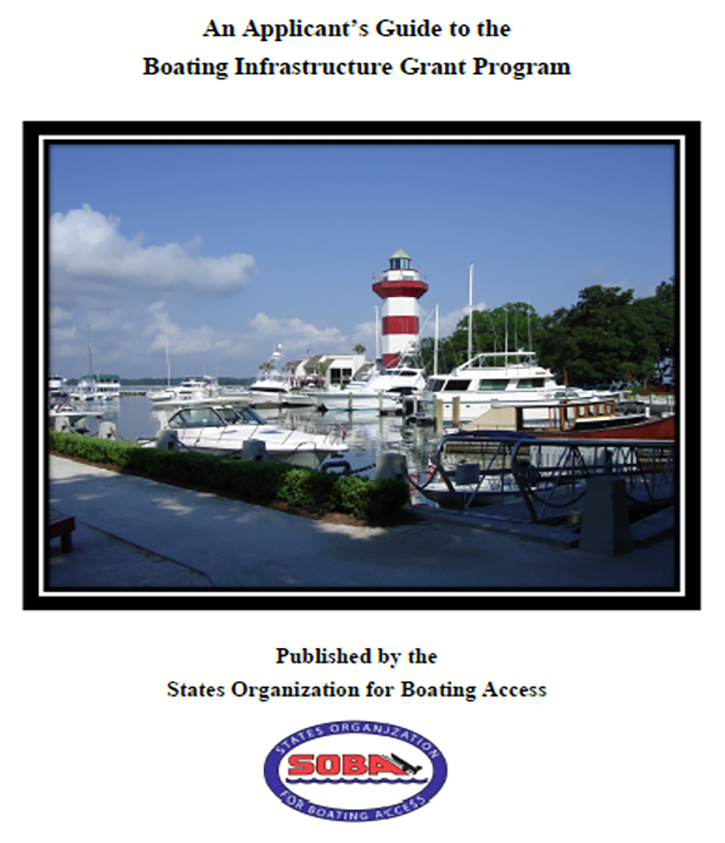
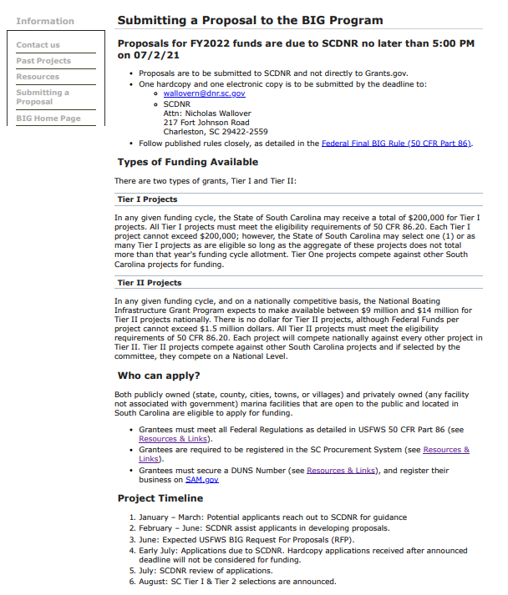
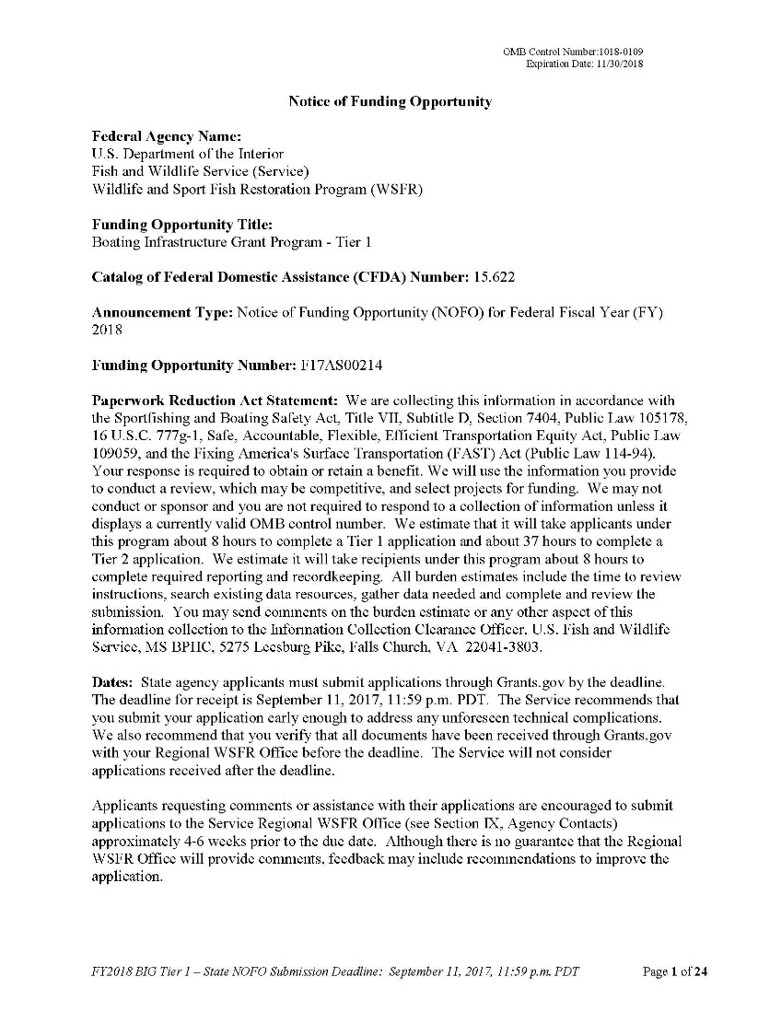
Workshop Content- Programmatic
4 Pillars of the WSFR/BIG program
Provide for transient boaters
Strengthen local boating community and industry
Create public/private partnerships
Promote resilient infrastructure and stewardship
Stress Collaboration and the long-term subrecipient relationship
Outline program goals and processes, requirements and expectations of subrecipients, eligible
and ineligible activities- citing 50 CFR 86, prior year BIG NOFOs, SOBA Applicant Guide
How to assemble a competitive (and complete!) proposal to submit to SCDNR

Slide 6
Workshop Content- Programmatic
Pitfalls
Missing elements
Proration
Response to Ranking Criteria
Poor Proration
Poor justification of costs
Ineligible costs
Unjustified contingency
No consideration of pre-award costs
Tips
Frame proposal around the boater
Define need as clearly as possible
Quantitative and Qualitative
Clear, concise, direct
Consider pre-awards
Letters of support
Consider how to maximize points

Slide 7
Workshop Content- Administrative
Grants Officer- Deep dive on the Subrecipient Process and Agreement
Eligibility requirements in receiving federal funds and doing business with the state
(small minority of partners are governmental partners)
reimbursement process and required expense
Elements of 2 CFR 200
*Proof of Control/Acknowledgement of owner
*Notice of Grant Agreement
Office of Environmental Review - discusses appropriate activity that SCDNR is willing to facilitate (minimum required impact, public access, dredging)
USFWS Region 4 Coordinator provides a ‘view from the hill’
trends on funding availability, TII selection updates, common issues

Slide 8
Application preparation phase
After workshop, prior to July 1 deadline
We benefit from a very experienced group of applicants and especially consultants/engineers
We encourage applicants to reach out early to collaborate or review
Contribute to applications as requested
Hard deadline first week of July (also published on website)

Slide 9
Review/Scoring Phase
After applicant submission, prior to USFWS submission
Reviewed by OEP for any expected permitting red flags, and for SCDNR ‘appropriateness’
Reviewed for required elements
Reviewed by Engineering section for any new or untested tech or methods

Slide 10
Review/Scoring Phase
SC BIG Advisory Committee modelled after VA
Committee Participants:
SCDNR Engineering
SC Sea Grant
SC Parks, Recreation and Tourism
Industry (temporarily vacant, formerly SC marina trade group)
Utilizes same scoring metrics as national committee
Committee advises, but SCDNR reserves the right to final selection
Tier I’s selected for balance of funds available after Admin grant costs

Slide 11
Review/Scoring Phase
Applicants have two weeks to incorporate critiques/ edits from SCDNR
& Advisory Committee
Confer with USFWS regional lead for any questions or foreseeable issues
SCDNR reserves option for final submission as the primary grant recipient
Need to consider not only need/quality of proposal
Subrecipient risk (consider Risk Assessment at this stage)
Environmental ‘appropriateness’
Long term monitoring concerns
*Develop transparent and justifiable levers in the process to justify declining proposals or proposal elements

Slide 12
Final Submission/ Grant Dance
Program Staff prepares required federal and agency forms
Application packet is reviewed by our Grants Coordinator and squired through required offices before final signatures
Program Staff submits to Grant Solutions with plenty of time for confirmation
--------Take a breather-----------
Program Staff submits awarded programs to TRACS, completes compliance, and works towards obligation

Slide 13
Take Homes
Start process before NOFO released
Utilize Tier I funding for administrative support
Institute hard stops (activities, deadlines, etc)
Maintain control in selecting projects for long term success
Require Notice of Grant Agreement on deed
Ensure regular long-term monitoring
Submit early to USFWS for pre-review to avoid technical and eligibility issues

Slide 14
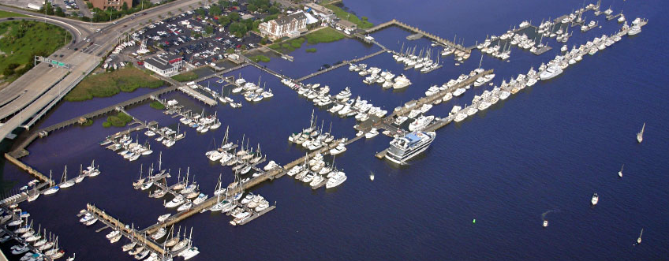
Questions?
Nick Wallover
Federal Aid Coordinator
SCDNR Marine Resource Division
wallovern@dnr.sc.gov
843 729 7356
SHM Charleston City Megadock

