Slide 1
March 22, 2023
Build America, Buy America (BABA)
Update on Implementation
Ryan Oster & Mike Sawyers
Systems & Training Branch
Financial Assistance Support & Oversight Division
Wildlife & Sport Fish Restoration Program

Slide 2
Agenda for Today
Review of legislative history
Implementation timeline
Defining “Infrastructure” for financial assistance awards
BABA (domestic procurement) requirements
Overview of approved waivers
Open Q & A session

Slide 3
Background
November 15, 2021, the Infrastructure Investment and Jobs Act signed into law:
Commonly called the Bipartisan Infrastructure Law (BIL).
Build America, Buy America Act included in BIL.
Build America, Buy America (BABA) Act:
No later than May 14, 2022:
“… each Federal agency shall ensure that none of the funds made available for a Federal financial assistance program for infrastructure,… may be obligated for a project unless all of the iron, steel, manufactured products, and construction materials used in the project are produced in the United States.”
Pub. L. 117-58 §§ 70901-52

Slide 4
Purpose of the BABA Act
Affirms, consistent with E.O. 14005 (Ensuring the Future is Made in All of America by All of America’s Workers), the priority to use financial assistance awards to maximize the use of goods, products, and materials produced in the United States.
Increase domestic supply chains
Make domestic supply chains more resilient
Provide demand to domestic producers
Provides statutory authority to OMB – Made in America Office to maximize and enforce compliance.
OMB Memorandum M-22-11

Slide 5
When do the BABA Requirements Begin?
BABA requirements took effect NLT 180 days after BIL became law:
BIL: November 15, 2021
BABA Requirement: May 14, 2022
How does this impact Program awards that include infrastructure?
Beginning May 14, 2022:
All new awards, amendments that add funds to existing awards, and renewal awards will be subject to BABA requirements.
“Project” means any activity related to the construction, alteration, maintenance, or repair of infrastructure in the U.S.

Slide 6
Temporary Waiver for DOI Awards
The Department submitted a General Applicability Waiver for all DOI programs for 6 months.
OMB approved this waiver on July 13, 2022.
Waiver was in effect from July 13, 2022 – January 12, 2023.
Training Branch Suggestion to Recipients:
Use the 6-month waiver period to prepare procurement processes to comply with BABA provisions and/or develop recipient-specific waiver request.

Slide 7
Build America, Buy America (BABA) – DOI/FWS Implementation Timeline
Period during which BABA requirements are applicable but may not be included in eligible award terms & conditions. Awards may be amended to add such conditions.
DOI General Applicability Waiver approved by OMB
Temporarily suspends BABA domestic requirements for all applicable awards during this time period.
Allows DOI/FWS programs or recipients to consider, develop, and submit additional BABA waiver requests.
June 6, 2022
November 15, 2021
July 13, 2022
January 12, 2023
Infrastructure Investment & Jobs Act (which includes Build America, Buy America Act) signed into law.
FWS begins to add BABA terms & conditions to all new awards and amendments to add funds to existing awards involving infrastructure projects.
January 13, 2023
DOI General Applicability Waiver expires.
BABA requirements applicable to all awards & amendments to add funds to existing awards involving infrastructure projects approved on or after May 14, 2022.
May 14, 2022
BABA requirements applicable to all new awards & amendments to add funds to existing awards involving infrastructure projects.

Slide 8
Define “Infrastructure”
means, at a minimum, the structures, facilities, and equipment for, in the United States,
roads, highways, bridges;
public transportation;
dams, ports, harbors, and other maritime facilities;
intercity passenger and freight railroads;
freight and intermodal facilities;
airports;
water systems, including drinking water and wastewater systems;
electrical transmission facilities & systems;
utilities;
broadband infrastructure;
facilities that generate, transport, and distribute energy; and
buildings and real property
Pub. Law
117-58

Slide 9
Infrastructure in “our World”
“Federal agencies should interpret “infrastructure” broadly (illustrative)…”
Please consider whether the project:
Serves a public function?
Is publicly owned & operated, privately operated on behalf of the public, or is a place of public accommodation?
Or is the project privately owned and not open to the public?
Greater indicator of infrastructure
Lesser indicator of infrastructure
M-22-11
Section II

Slide 10
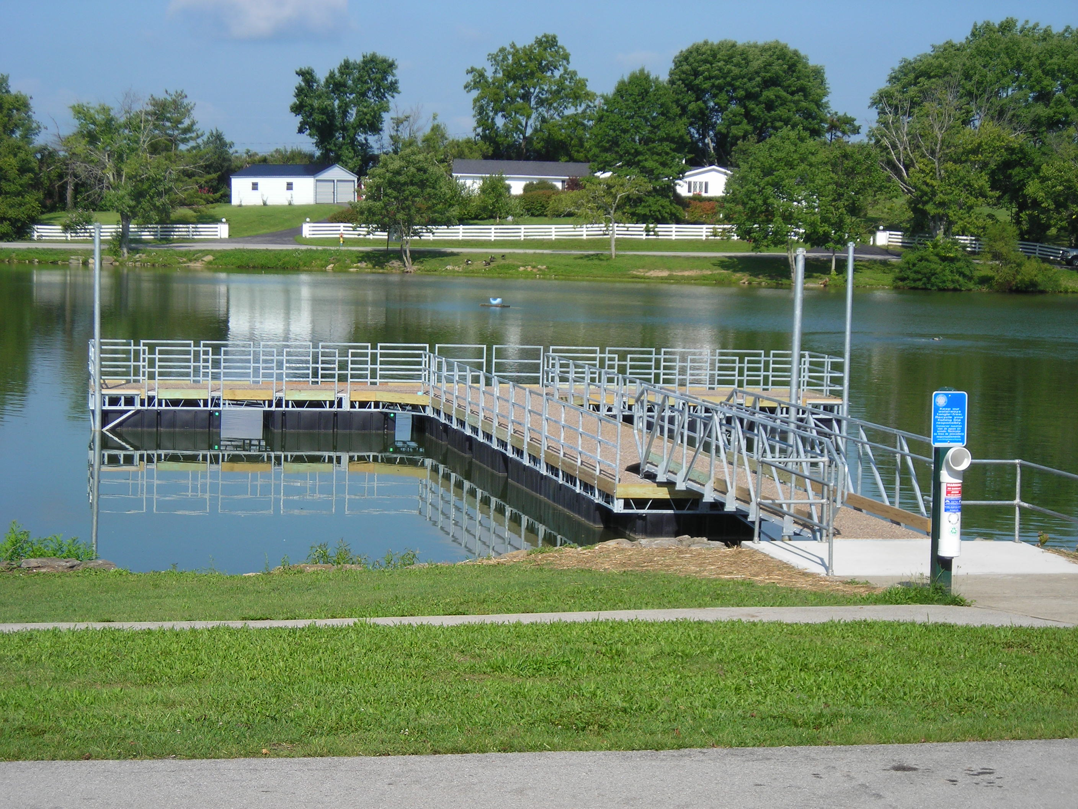
Infrastructure in “our World”
Is it serving a public purpose; publicly owned/operated; or a place of public accommodation?
Examples of projects that may be Infrastructure.
WMAs
Boat ramps
Fishing piers / platforms
Shooting ranges / platforms
Office buildings, education centers
Water control structures for hunting/wildlife viewing
Propagation facilities / Fish hatcheries
Docks
Dams
Marine pumpout stations
Floating restrooms
Public restrooms
Parking areas

Slide 11
Costs subject to BABA?
Domestic procurement preferences applies to articles, materials, and supplies that are consumed in, incorporated into, an integral part of, or affixed to an infrastructure project:
Iron and steel, including the manufacturing processes thereof.
Manufactured products were manufactured in the U.S., and cost of the components from the U.S. is > 55% of the total cost of all the components of the manufactured product.
Construction materials, including the manufacturing processes thereof.

Slide 12
Costs subject to BABA?
Domestic procurement preferences does not apply to:
Tools, equipment, and supplies brought to construction site and removed upon completion of the infrastructure project.
Equipment and furnishings used at the site of the completed infrastructure project that are not an integral part of the structure or permanently affixed to.

Slide 13
BABA Waiver Criteria
Federal agencies may waive BABA requirements when:
Public Interest Waiver: Applying domestic procurement preference inconsistent with public interest.
Small Grants
De Minimis
Nonavailability Waiver: Covered products are not produced domestically in sufficient or reasonable quantities or satisfactory quality.
Unreasonable Cost Waiver: Use of domestic products will increase the overall project cost in excess of 25%.

Slide 14
New DOI BABA Waivers
FWS worked with DOI to help develop two BABA waivers:
Small Grants (all forms of Federal financial assistance)
De Minimis Purchases
Both waivers were posted for public comment on December 22, 2022.
Public comment periods closed on January 6, 2023.
Great news, they were both approved February 21, 2023 (February 20, 2028).

Slide 15
Small Grants Waiver
Permits use of non-domestic iron, steel, manufactured products, and construction materials for small FA awards that meet the following standard:
Total award amount does not exceed the SAT* (currently $250,000).
Award amount is not anticipated to exceed the SAT for the life of the award.
Assists small and disadvantaged communities / recipients, as well as reduces administrative burden commensurate with funding amounts.
Duration = 5 years from final approval date.
*In 2018, SAT was raised from $100,000 to $250,000.

Slide 16
Small Grants Waiver Examples
Scenario 1: Canoe/Kayak Access Site Award
Entire award will be contracted out to build the access site.
Total Award = $125,000
Federal Share = $93,750
Match Share = $31,250
Does award qualify for SG Waiver?
Scenario 2: Boat Ramp Construction
Entire award will be contracted out to build the ramp.
Total Award = $500,000
Federal Share = $375,000
Match Share = $125,000
Does the award qualify for SG Waiver?
YES
NO

Slide 17
Small Grants Waiver Examples
Scenario 3: Statewide O&M of WMAs
Under this larger award, the state has multiple small “infrastructure” construction and maintenance projects. One of them involves a $10,000 maintenance to WMA fencing.
Total Award = $4,000,000
Federal Share = $3,000,000
Match Share = $1,000,000
Does the fencing qualify for SG Waiver?
Scenario 4: Public Target Range Expansion
State receives an award to expand a shooting range for $220,000. When it goes out for bid, the low bid comes back at $260,000.
Total Award = $260,000
Federal Share = $195,000
Match Share = $65,000
Does the award qualify for SG Waiver?
NO
NO

Slide 18
De Minimis Waiver
Waiver of up to 5% of the total applicable project costs¹, up to a max of $1,000,000.
“Recipients can devote their resources to Buy America compliance with larger purchases, rather than diverting resources to sourcing the miscellaneous , low-cost products.”
Assists small and disadvantaged communities / recipients, as well as reduces administrative burden commensurate with funding amounts.
Duration = 5 years from final approval date.
¹ Applicable project costs are defined as material costs subject to BABA.

Slide 19
De Minimis Purchases Waiver Examples
Scenario 1: Public Target Shooting Range Expansion Project
Recipient receives an award and plans to subaward it to a subrecipient to expand an existing target range to increase public access/opportunities. $250,000 of the total costs are project costs subject to Buy America preference.
Total Award = $500,000
Federal Share = $450,000 (90%)
Match Share = $50,000 (10%)
Does the de Minimis Waiver apply? If so, how much
YES - ($250,000 x 0.05) = $12,500

Slide 20
De Minimis Purchases Waiver Examples
Scenario 2: Boating Infrastructure Project
State receives a Tier II BIG award to construct a transient boat dock facility that is comprised of docks, piers, gangways, utilities, and restrooms. $2,500,000 of the total costs are project costs subject to Buy America preference.
Total Award = $4,000,000
Federal Share = $3,000,000
Match Share = $1,000,000
Does the de Minimis Waiver apply? If so, how much
YES - ($2,500,000 x 0.05) = $125,000

Slide 21
De Minimis Purchases Waiver Examples
Scenario 3: Fish Hatchery Construction
State receives a grant to construct a new fish hatchery. The total cost of the grant is $27,000,000.
$23,000,000 of the total costs are project costs subject to Buy America preference.
Total Award = $27,000,000
Federal Share = $20,250,000
Match Share = $6,750,000
Does the de Minimis Waiver apply? If so, how much
YES - ($23,000,000 x 0.05) = $1,150,000 (cap at $1,000,000)

Slide 22
De Minimis Purchases Waiver Examples
Scenario 4: Statewide WMA O&M grant
State receives a grant to operate and maintain their statewide WMAs. The total cost of the grant is $6,000,000. $160,000 of the total costs are for 3 infrastructure projects with costs subject to Buy America preference.
Total Award = $6,000,000
Federal Share = $4,500,000
Match Share = $1,500,000
Does the de Minimis Waiver apply? If so, how much
P1 = $40,000 Storage Shed
P2 = $50,000 Restrooms
P3 = $70,000 ADA Hunting Structures
YES - P1 ($40,000 x 0.05 = $2,000)
P2 ($50,000 x 0.05 = $2,500)
P3 ($70,000 x 0.05 = $3,500)

Slide 23
Training Team Thoughts
Domestic preference requirements continues to be a top priority
Increase domestic supply chains
Make domestic supply chains more resilient
Provide demand to domestic producers
Small Grants Waiver
Utility for low dollar procurement infrastructure awards < $210,000 (15% variance).
Audits/reviews may be looking for “piece-meal” projects looking to circumvent.

Slide 24
Training Team Thoughts
Domestic preference requirements continues to be a top priority
Increase domestic supply chains
Make domestic supply chains more resilient
Provide demand to domestic producers
De Minimis Waiver
Infrastructure projects should be bid/procured/purchased requiring domestic items.
Utility is meant to allow flexibility in select (lower cost items) that are not available domestically or in very limited supply.

Slide 25
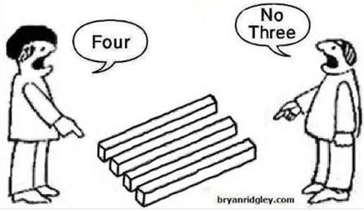
Any Questions?

