Slide 1
August 17-18, 2022
Build America, Buy America Act
Requirements for Financial Assistance Awards
Ryan Oster & Mike Sawyers
Systems & Training Branch
Financial Assistance Support & Oversight Division
Wildlife & Sport Fish Restoration Program

Slide 2
Background
November 15, 2021, the Infrastructure Investment and Jobs Act signed into law:
Commonly called the Bipartisan Infrastructure Law (BIL).
Build America, Buy America Act included in BIL.
Build America, Buy America Act (BABA):
No later than May 14, 2022:
“… each Federal agency shall ensure that none of the funds made available for a Federal financial assistance program for infrastructure,… may be obligated for a project unless all of the iron, steel, and manufactured products used in the project are produced in the United States.”
Pub. L. 117-58 §§ 70901-52

Slide 3
Who does BABA apply to?
Applicability to Federal Financial Assistance Programs:
OMB Memorandum M-22-11 states that:
“This guidance applies to all Federal financial assistance as defined in 2 CFR 200.1 – whether or not funded through [BIL] – where funds are appropriated or otherwise made available and used for a project for infrastructure.”
Does this apply to all Service-administered FA awards?
Yes. But only if the award includes infrastructure projects in the scope of work.
BABA preference applies to “an entire infrastructure project”, even if it is funded by both Federal and non-Federal funds.
OMB Memorandum M-22-11

Slide 4
When do the BABA Requirements Begin?
BABA requirements took effect NLT 180 days after BIL became law:
BIL: November 15, 2021
BABA Requirement: May 14, 2022
How does this impact Service FA awards that include infrastructure projects?
Beginning May 14, 2022:
All new awards, amendments that add funds to existing awards, and renewal awards will be subject to BABA requirements.
Construction, alteration, maintenance, or repair.
Currently no funding threshold limitations.

Slide 5
Temporary Waiver for DOI Awards
The Department submitted a General Applicability Waiver for all DOI programs for 6 months.
OMB approved this waiver on July 13, 2022.
Waiver is in effect from July 13, 2022 – January 12, 2023.
Training Team Suggestion to Recipients:
Use the 6-month waiver period to prepare procurement processes to comply with BABA provisions and/or develop recipient-specific waiver request.

Slide 6
Build America, Buy America (BABA) – DOI/FWS Implementation Timeline
Period during which BABA requirements are applicable but may not be included in eligible award terms & conditions. Awards may be amended to add such conditions.
DOI General Applicability Waiver approved by OMB
Temporarily suspends BABA domestic requirements for all applicable awards during this time period.
Allows DOI/FWS programs or recipients to consider, develop, and submit additional BABA waiver requests.
June 6, 2022
November 15, 2021
July 13, 2022
January 12, 2023
Infrastructure Investment & Jobs Act (which includes Build America, Buy America Act) signed into law.
FWS begins to add BABA terms & conditions to all new awards and amendments to add funds to existing awards involving infrastructure projects.
January 13, 2023
DOI General Applicability Waiver expires.
BABA requirements applicable to all awards & amendments to add funds to existing awards involving infrastructure projects approved on or after May 14, 2022.
May 14, 2022
BABA requirements applicable to all new awards & amendments to add funds to existing awards involving infrastructure projects.

Slide 7
Define “Infrastructure”
means, at a minimum, the structures, facilities, and equipment for, in the United States,
roads, highways, bridges;
public transportation;
dams, ports, harbors, and other maritime facilities;
intercity passenger and freight railroads;
freight and intermodal facilities;
airports;
water systems, including drinking water and wasterwater systems;
electrical transmission facilities & systems;
utilities;
broadband infrastructure;
facilities that generate, transport, and distribute energy; and
buildings and real property
Pub. Law
117-58

Slide 8
Infrastructure in “our World”
Federal agencies should interpret “infrastructure” broadly (not illustratively). Term encompasses public infrastructure projects
Please consider whether the project:
Serves a public function?
Is publicly owned & operated, privately operated on behalf of the public, or is a place of public accommodation?
Or is the project privately owned and not open to the public?
Greater indicator of infrastructure
Lesser indicator of infrastructure
M-22-11
Section II

Slide 9
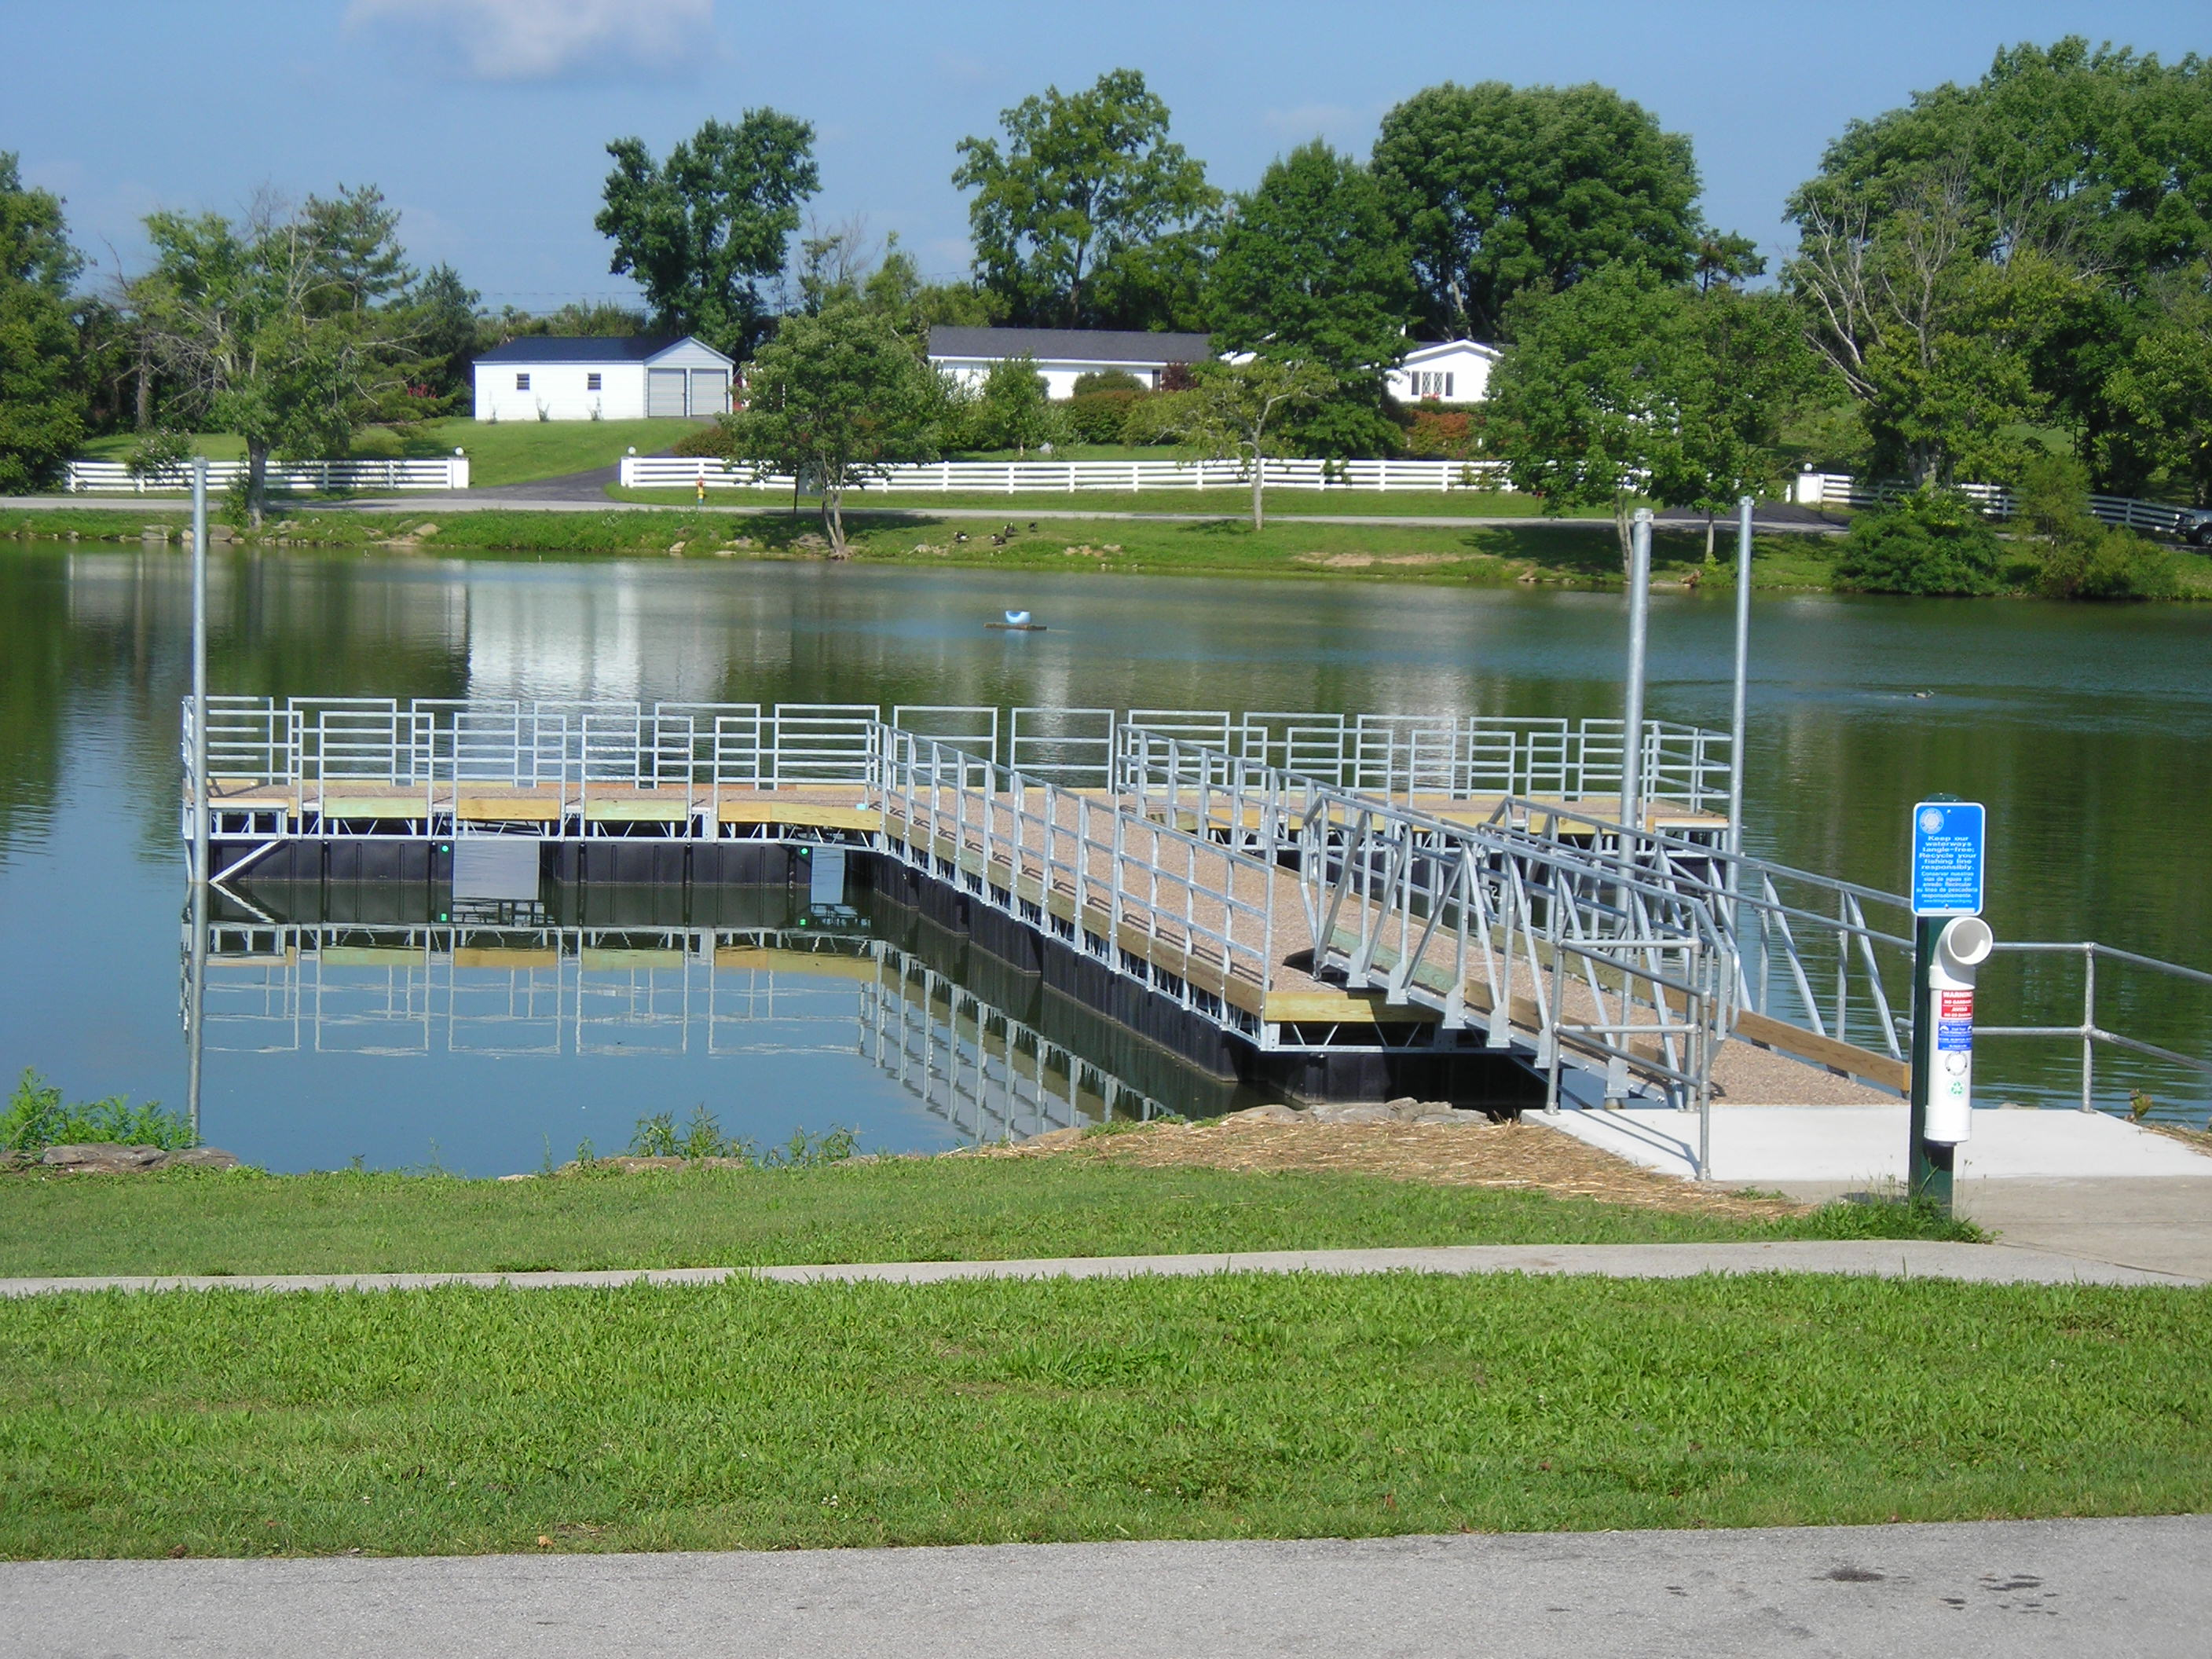
Infrastructure in “our World”
Is it serving a public purpose; publicly owned/operated; or a place of public accommodation?
Examples of projects that may be Infrastructure.
Boat ramps
Fishing piers / platforms
Shooting ranges / platforms
Office buildings, education centers
Water control structures for hunting/wildlife viewing
Propagation facilities / Fish hatcheries
Docks
Dams
Marine pumpout stations (affixed)
Floating restrooms
Public restrooms
Parking areas
Roads

Slide 10
What types of costs are subject to BABA?
Domestic procurement preferences applies to:
Iron and steel, including the entire manufacturing processes.
Manufactured products – cost of domestically mined, produced, or manufactured components must be greater than 55% of all components.
Construction materials, including the manufacturing processes thereof.
Does not apply to:
Tools, equipment, and supplies brought to construction site and removed upon completion of the infrastructure project.
Equipment and furnishings used at the site of the completed infrastructure project that are not an integral part of the structure or permanently affixed to.

Slide 11
New Terms & Conditions for BABA
Recipients will see Terms & Conditions on applicable NOAs
Buy America Provision:
Describes the applicable requirements for recipients effective May 14, 2022
Buy America Temporary Waiver Notice
Describes the 6-month waiver granted to certain DOI programs

Slide 12
BABA Waiver Criteria
Federal agencies may waive BABA requirements when:
Three Waiver Categories:
Public Interest Waiver: Applying domestic procurement preference inconsistent with public interest.
Nonavailability Waiver: Covered products are not produced domestically in sufficient or reasonable quantities or satisfactory quality.
Unreasonable Cost Waiver: Use of domestic products will increase the overall project cost in excess of 25%.

Slide 13
Waiver Submission
Email such requests to whqfasupport@fws.gov w/ subject line “Buy America Waiver Request”.
Type of waiver requested
Recipient name and UEI
Awarding bureau
Program Assistance Listing and Name
Award title
FAIN
Federal award amount
Total infrastructure cost, to the extent known
Infrastructure description and location, to the extent known
List of items for which the waiver is requested
Certification statement of good faith effort to solicit bids for domestic products
Statement of market research
Impact if waiver is denied.
NOA terms & conditions

Slide 14
Any Questions?

